Slide 1

Learning intention
To recognise and find equivalent fractions.

Slide 2
Equivalent fractions
Equivalent- it means the same.
So to day we are going to be looking at fractions that are the same as each other.

Slide 3


1
3
1
3
1
3
1
6
1
6
1
6
1
6
1
6
1
6
Here are two shapes.
They are the same size.
One has been divided into thirds. So each section is one third or 1
3
One has been divided into sixths. So each section is one sixth or 1
6

Slide 4
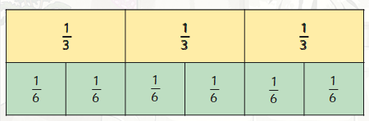
If we put the two shapes together, we can see that 1 is the same
3
size as 2. We say that these fractions are equivalent.
6

Slide 5
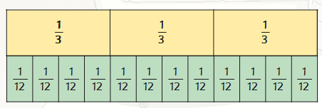
Look at these two shapes.
Here we can see that 1 is equivalent to 4, they are the same size.
3 12
Also 2 is equivalent to 8 , they are the same size.
3 12

Slide 6
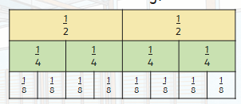
We can find equivalent fractions by putting the shapes together.
This is called a fraction wall.
Looking at this fraction wall, we can see that
1 is equivalent to 2 which is equivalent to 4
2 4 8
You can add other fractions to find the equivalent.

