Slide 1
Learning intention: To begin to recognise continents and increase knowledge of these.
Today we will learn about the continent of South America.

Slide 2
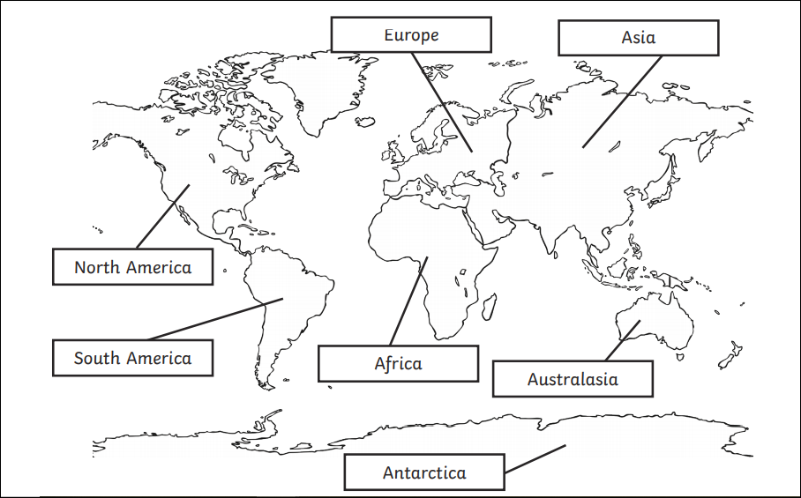
Remember the seven continents
Find South America on the map.
What do you already know about this continent?

Slide 3
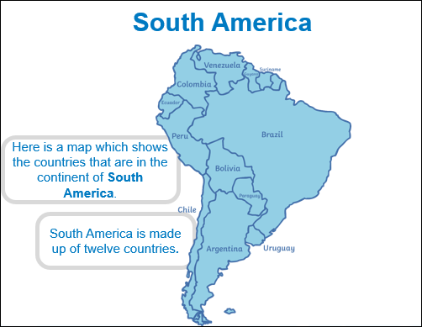
Which is the biggest country in South America?

Slide 4
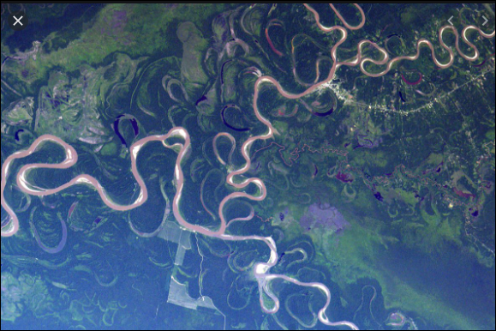
The Amazon River
This is the Amazon River from space. Look how long and winding it is!
It’s the second longest River in the world.
There are no bridges crossing the river so you would need a boat.

Slide 5
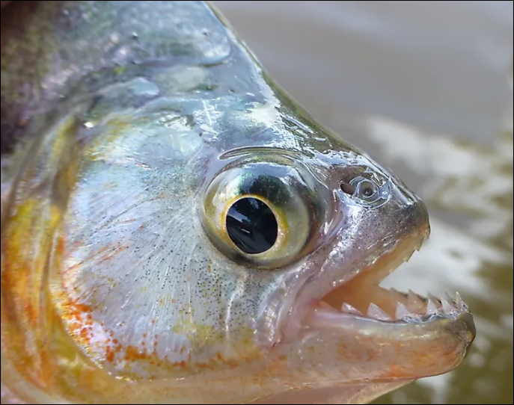
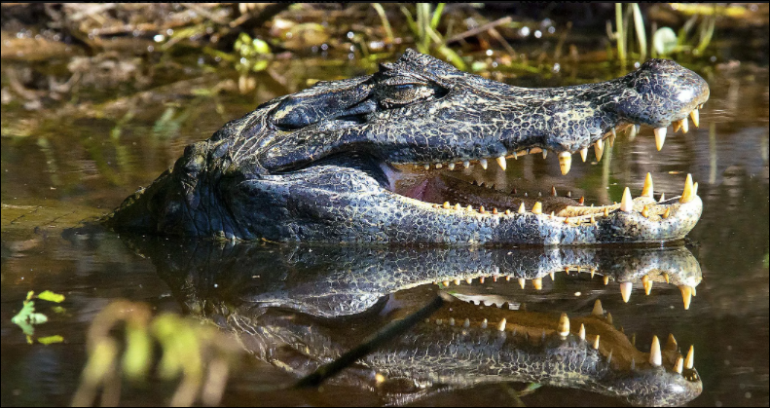
Let’s find out about some of the animals that live in the Amazon River
Piranha
Did you know piranhas are actually omnivores? They eat both meat and plants.
People believe that these are fierce carnivores.
They do have one of the most powerful bites among fish.
The black caiman
This is the largest and most dangerous reptile in the River.
They are nocturnal and hunt at night. This makes them difficult to be seen by their prey.

Slide 6
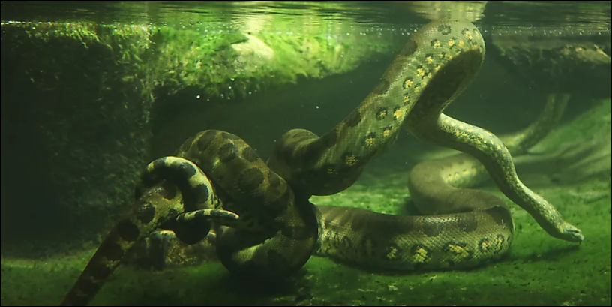
Green Anaconda.
This is the heaviest and one of the longest snakes found in the world.
They are slow on land but fast in the water.
To kill their prey they coil around them to suffocate them to death.

Slide 7
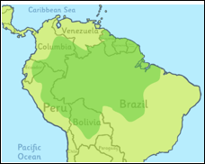
The Amazon rainforest
This is South America and the dark green colour shows the Amazon rainforest.
It is the largest tropical rainforest in the world.
It used to cover even more of the country put some was cut down or damaged.

Slide 8
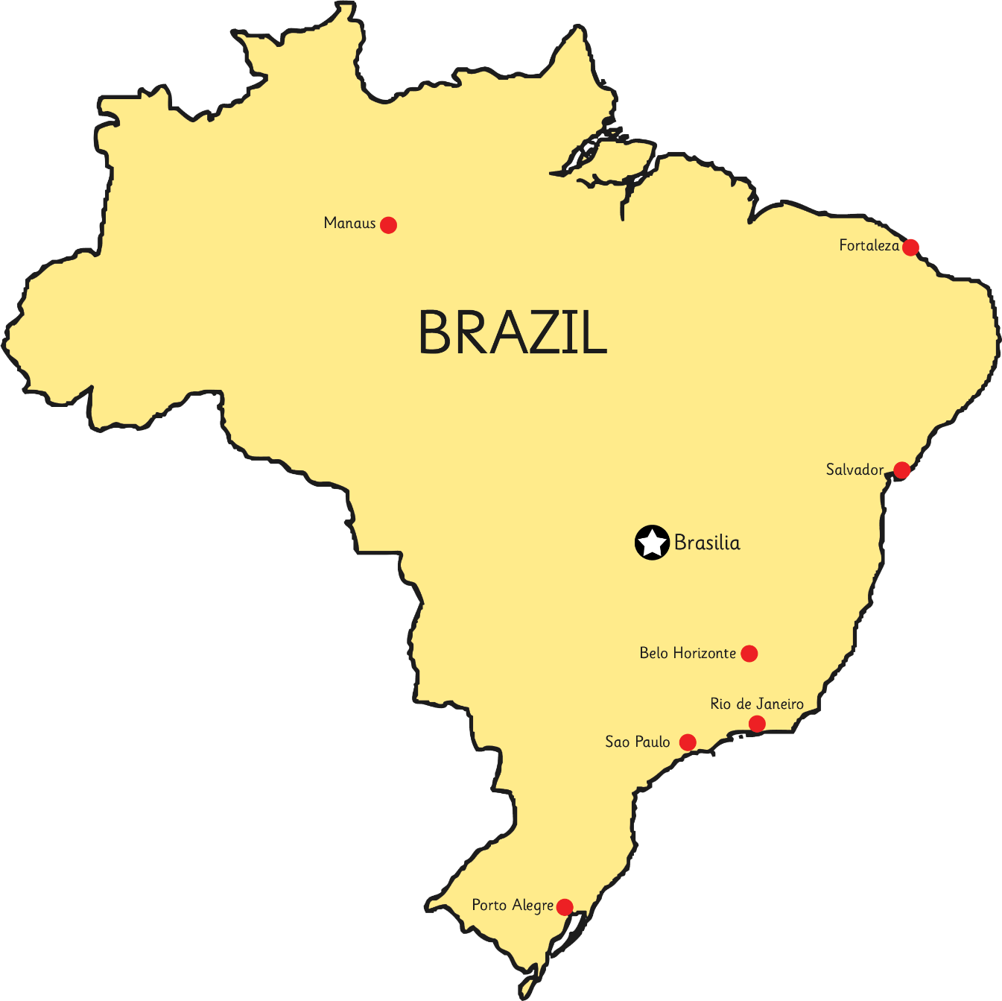
Let’s look at the largest country in South America.
This is Brazil and you can see the names of some of the cities in Brazil.

Slide 9
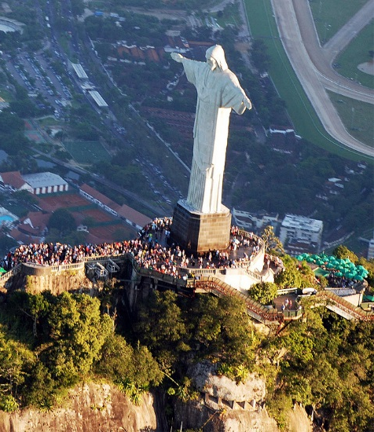
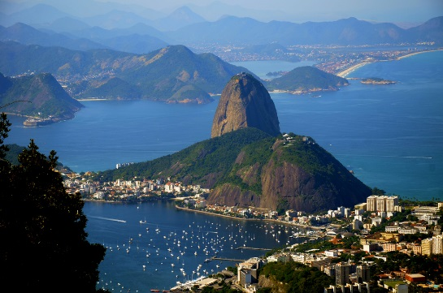
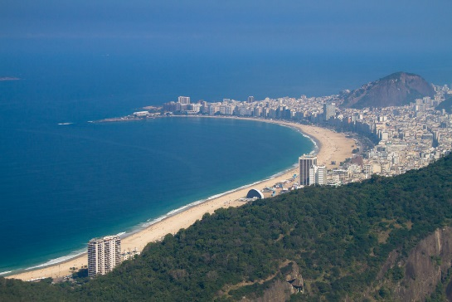
Rio de Janeiro
Physical Features
Human Feature
People call Rio de Janeiro ‘Rio’ for short.
It is the second largest city in Brazil.
Sugarloaf Mountain is at the mouth of Guanabara Bay.
It is nearly 400 metres high.
Christ the Redeemer statue is a religious statue that stands on top of Corcovado Mountain.
Copacabana beach is 4km in length.

Slide 10
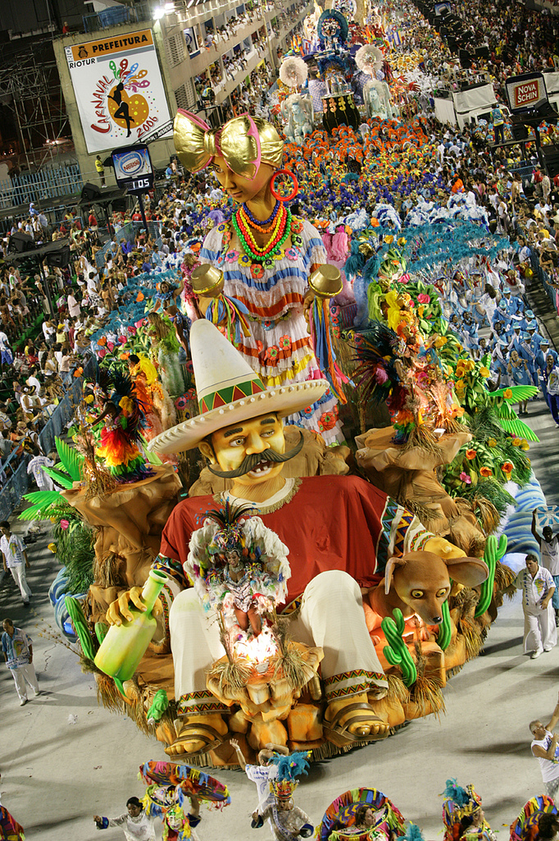
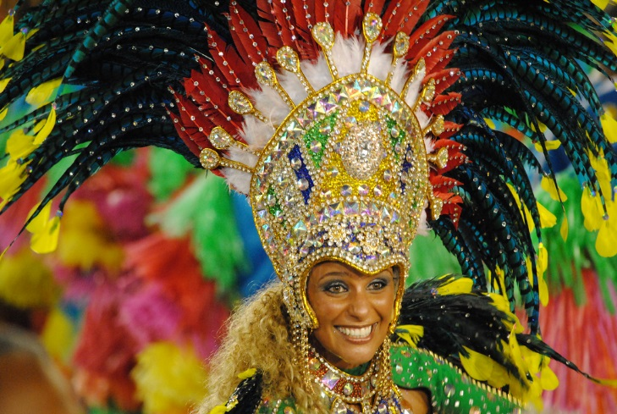
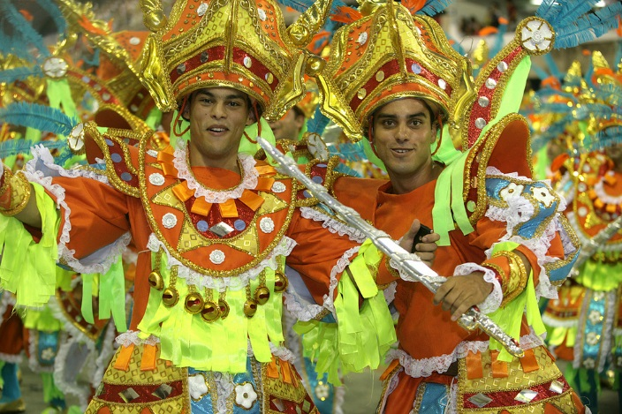
Carnival
Rio de Janeiro is famous for its carnival.
The carnival lasts for three
days.
Rio is filled with dancing, music, singing and lots of street parades with colourful costumed dancers performing the samba.

Slide 11
Task:
Talk to an adult about what you have learnt about the continent of South America.
Would you like to visit here?
Draw and label four things you have found out about this continent.
If you have access to the internet you could find out more about Brazil on BBC bitesize.
https://www.bbc.co.uk/bitesize/topics/zyhp34j/articles/zr2h47h

