Slide 1

Today we will be reading this book.
You can find it on Oxford Owl. > eBooks> rwinc> grey level
https://www.oxfordowl.co.uk/api/interactives/33870.html

Slide 2
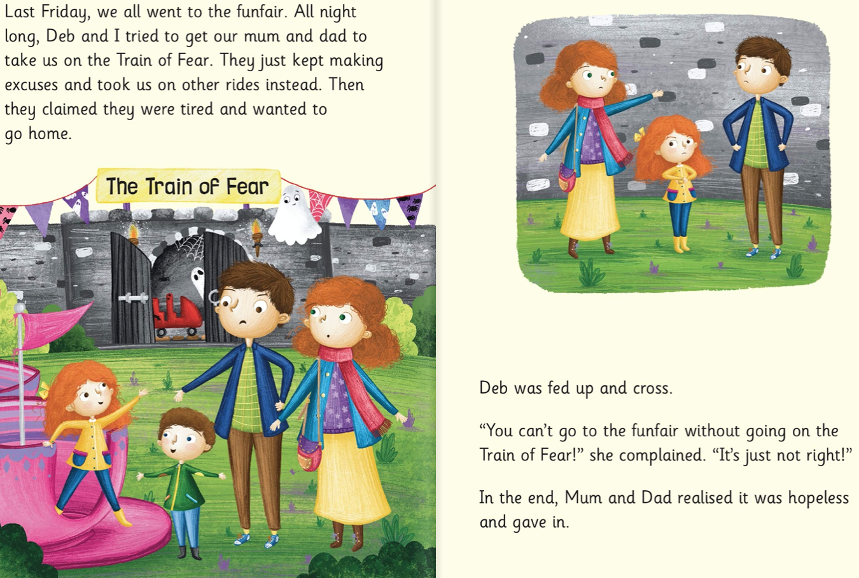

Slide 3
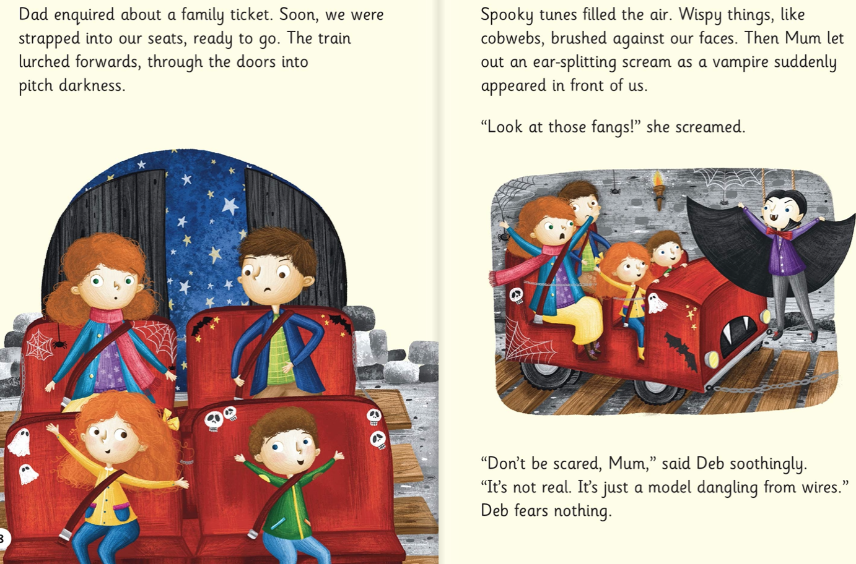

Slide 4
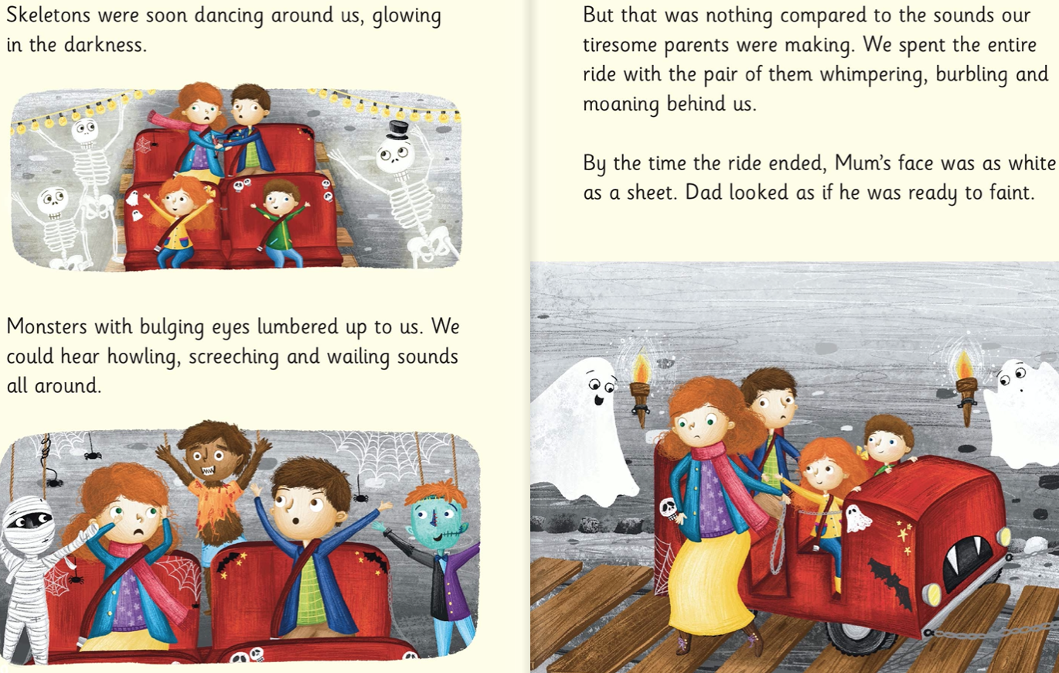

Slide 5
