Slide 1
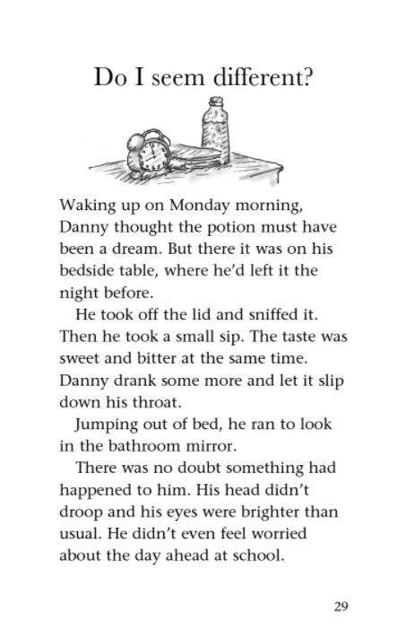

Slide 2
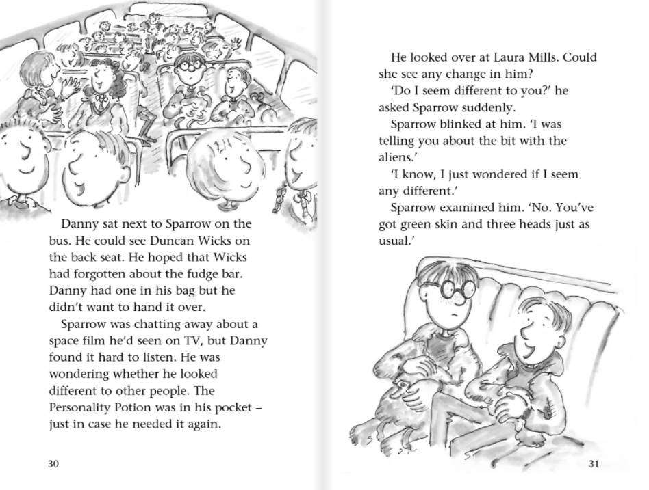

Slide 3
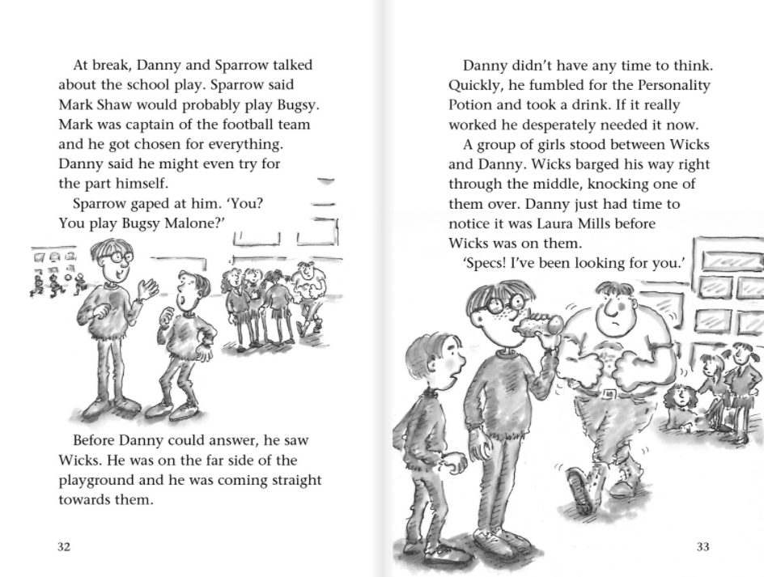
Why did the author choose to use the word ‘barged’ instead of ‘walked’?

Slide 4
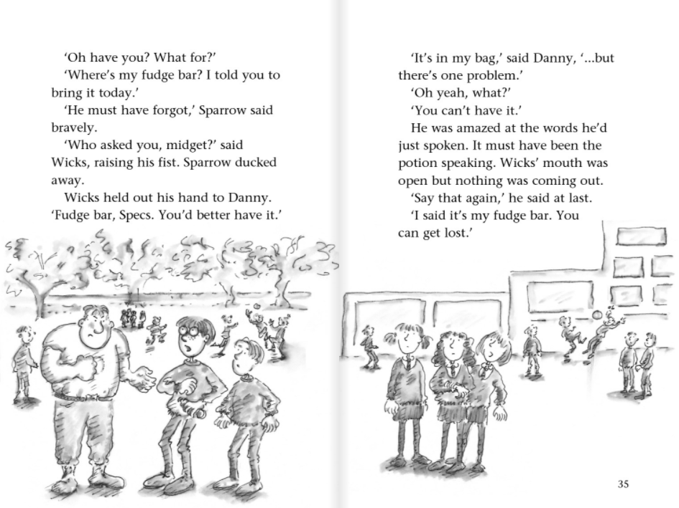

Slide 5
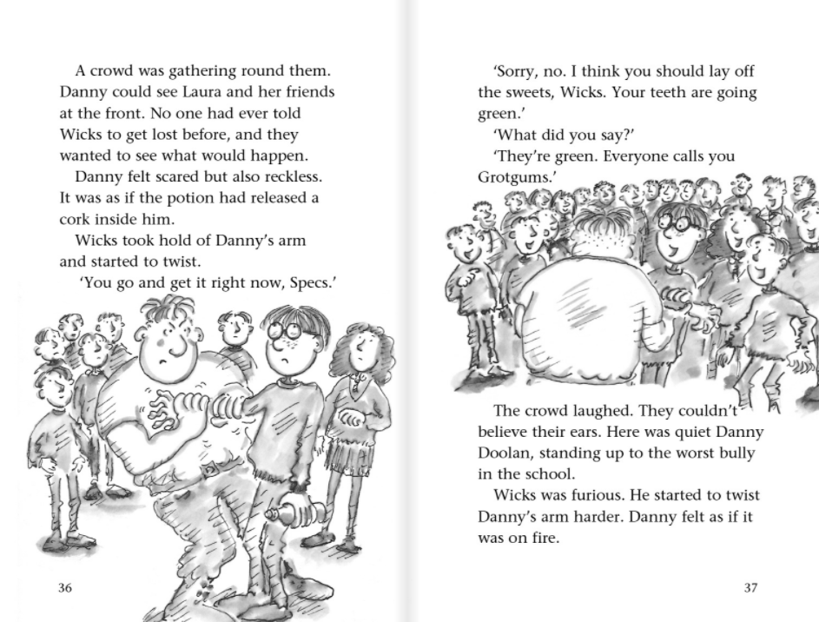
What do you think the author meant by ‘it was as if the potion had released a cork inside of him’?

Slide 6
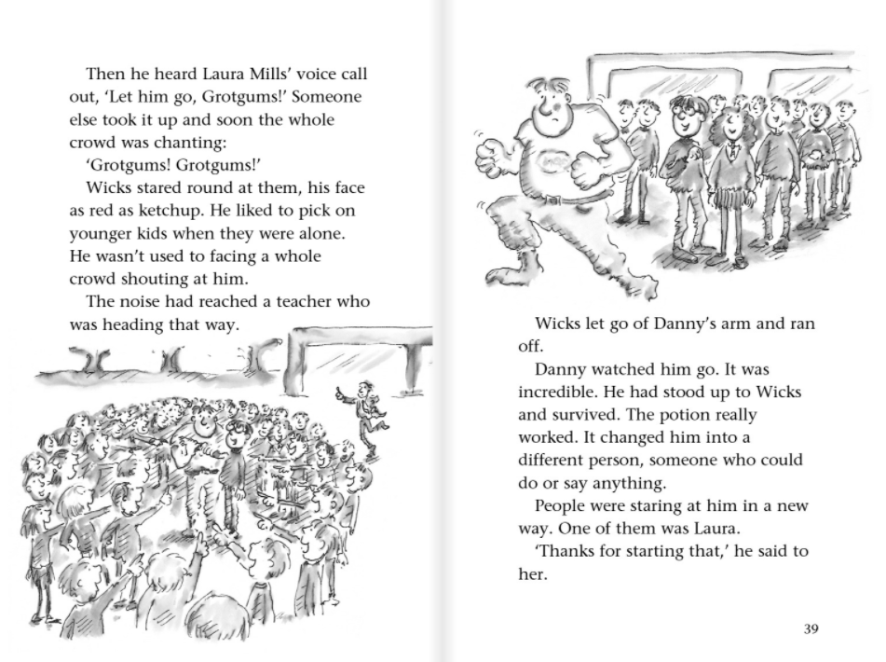
Why do you think the author chose the simile ‘his face as red as ketchup’? What does it tell you about how Wicks is feeling?

