Slide 1
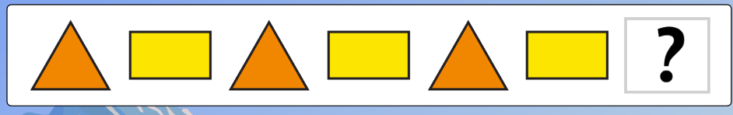
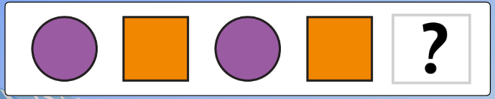
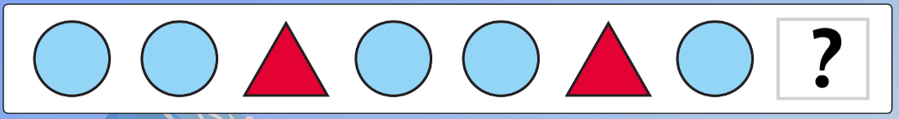

Warm up:
Spot the shape pattern… What will come next?
Notes:
Hello! Before we start our maths work, let’s warm up our brains so that we’re ready to learn.
Spot the shape pattern. Can you guess which shape will come next? The answers will be at the end of the powerpoint.

Slide 2
Recap: 2D or 3D?
Notes:
Today we’ll be learning about shapes, in particular, 3D shapes. Can you sort these shapes into either 2D or 3D?
Remember, 2D shapes are flat,

Slide 3
Recap: 2D or 3D?
Oval
2D
Rectangle
2D
Triangle
2D
Cube
3D
Cylinder
3D
Notes:
Here are the shape names and whether they are 2D or 3D. The 2D shapes were: the yellow rectangle, the orange oval and the purple triangle. The 3D shapes were the blue cube and the green cylinder. Today we are going to focus on some of the 3D shapes.

Slide 4
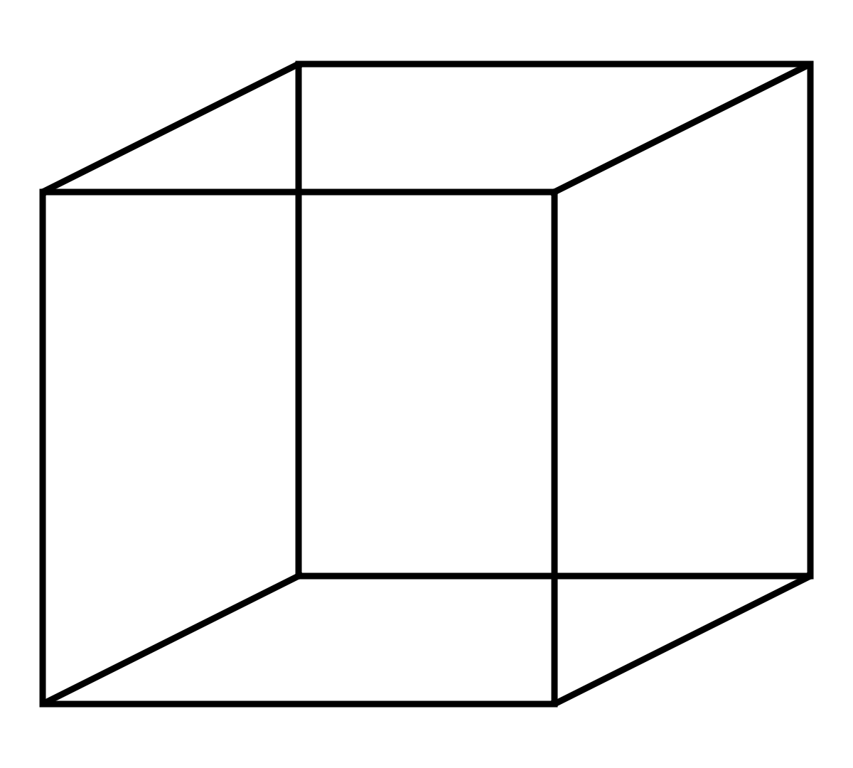
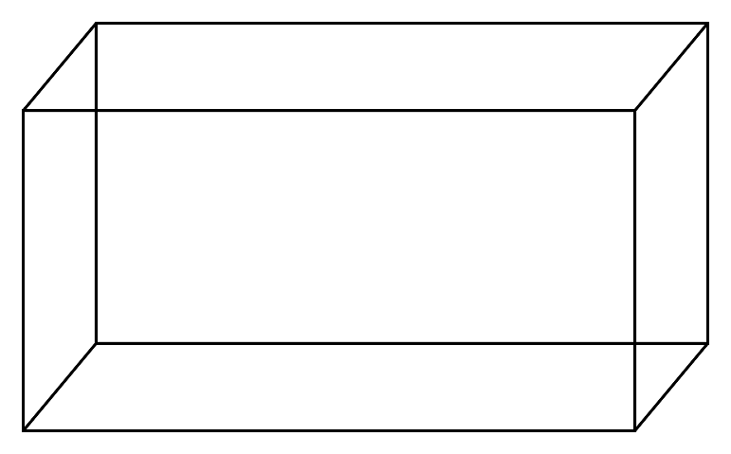
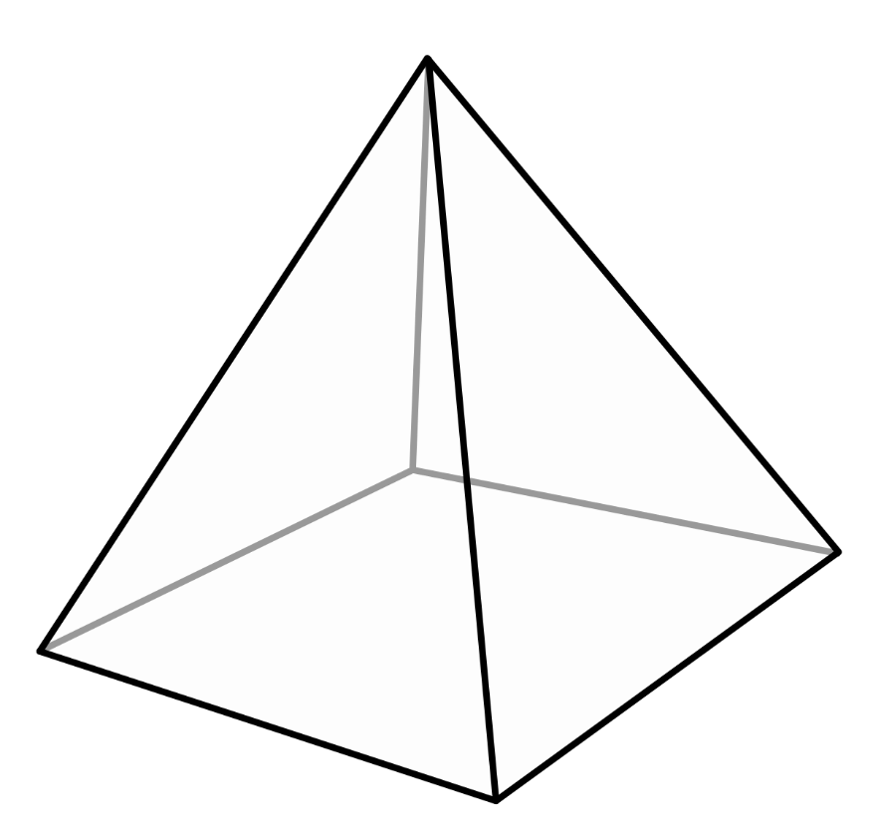
Odd One Out:
Notes:
Which shape do you think is the ‘odd one out’ and different to the other two? Talk to your grown up and tell them what you think. Do they have a different idea?
These are the 3D shapes that we are going to learn about today.

Slide 5
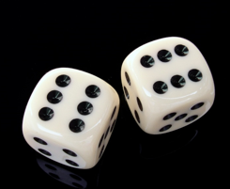
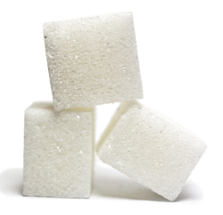
Cube
Notes:
The first one is a cube. Cubes have 6 square faces (the flat part), 8 vertices (the pointy parts/corners) and 12 edges (the lines that connect everything else). Cubes can be found in many places, we even have them in our classrooms to put in our jars. Here are two examples, dice and sugar cubes. Do you have any cubes at home?

Slide 6
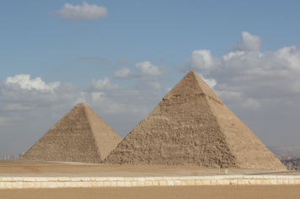
Pyramid (square-based)
Notes:
This is a square based pyramid. It is called that because at it’s base (the bottom) there is a square face. There are 3 triangle faces. These pyramids have 4 vertices and 8 edges. A real example of a pyramid are those in Egypt – you can even see them on Google maps! These pyramids are huge. Do you have any smaller pyramid items at home?

Slide 7
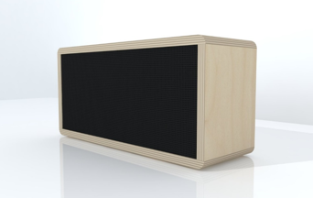
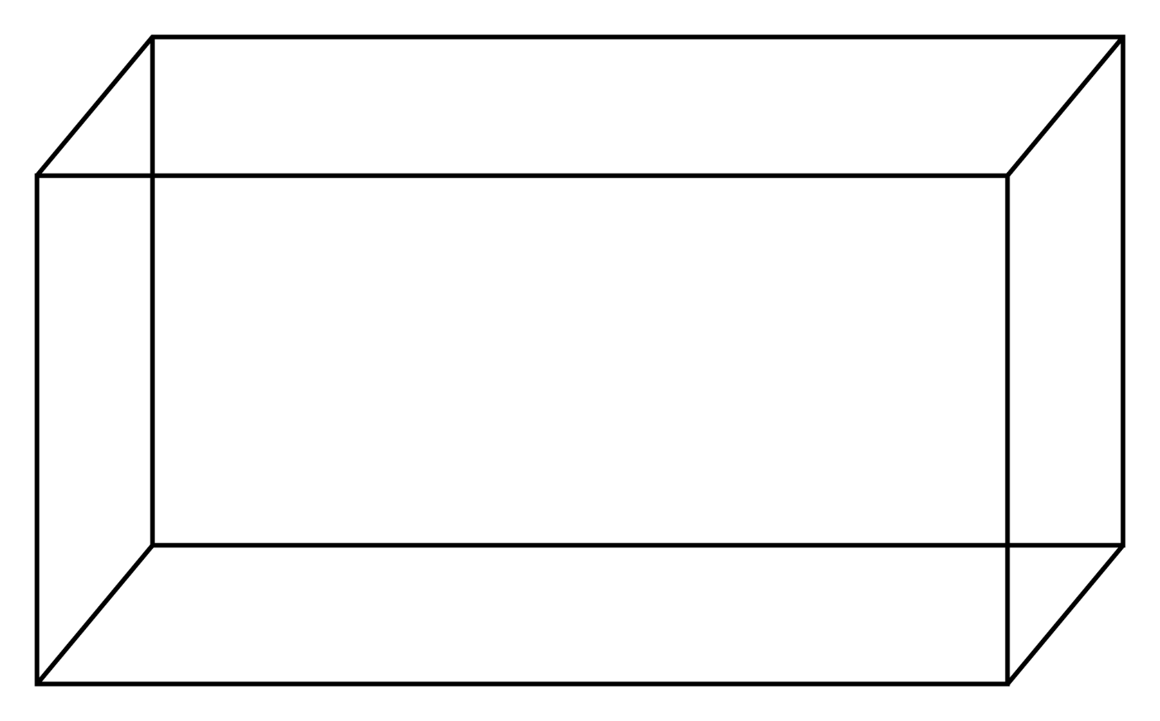
Cuboid
Notes:
Last but not least, here is a cuboid. It is similar to a cube, but it has 4 rectangle faces and 2 square faces. A cuboid has 8 vertices and 12 edges, just like a cube! Cuboids can be hard to spot, here is an example of a plant pot in a cuboid shape. Perhaps you can find some cuboids at home?

Slide 8
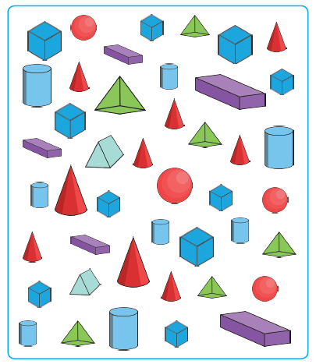
Fill in the worksheet!
cubes
cuboids
pyramids
Notes:
Have a go at your worksheet, you need to count how many cubes, cuboids and square based pyramids you can see!

Slide 9

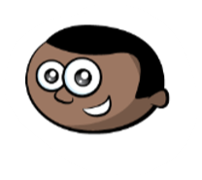
Amjed
Destiny
cubes | 15
cuboids | 0
pyramids | 8
cubes | 10
cuboids | 5
pyramids | 6
Who is right?
What mistakes have been made?
Notes:
This is an extra challenge! Amjed and Destiny have both had a go at counting the cubes, cuboids and pyramids. One of them is right and the other has made some mistakes. Can you find out who was correct and what the other child did wrong?

Slide 10



Warm up Answers

Slide 11
Text Commentary:
Slide 1: Hello! Before we start our maths work, let’s warm up our brains so that we’re ready to learn. Spot the shape pattern. Can you guess which shape will come next? The answers will be at the end of the powerpoint.
Slide 2: Today we’ll be learning about shapes, in particular, 3D shapes. Can you sort these shapes into 2D or 3D? Remember, 2D shapes are flat.
Slide 3: Here are the shape names and whether they are 2D or 3D. The 2D shapes were: the yellow rectangle, the orange oval and the purple triangle. The 3D shapes were the blue cube and the green cylinder. Today we are going to focus on some of the 3D shapes.
Slide 4: Which shape do you think is the ‘odd one out’ and different to the other two? Talk to your grown up and tell them what you think. Do they have a different idea? These are the 3D shapes that we are going to learn about today.
Slide 5: The first one is a cube. Cubes have 6 square faces (the flat part), 8 vertices (the pointy parts/corners) and 12 edges (the lines that connect everything else). Cubes can be found in many places, we even have them in our classrooms to put in our jars. Here are two examples, dice and sugar cubes. Do you have any cubes at home?
Slide 6: This is a square based pyramid. It is called that because at it’s base (the bottom) there is a square face. There are 3 triangle faces. These pyramids have 4 vertices and 8 edges. A real example of a pyramid are those in Egypt – you can even see them on Google maps! These pyramids are huge. Do you have any smaller pyramid items at home?
Slide 7: Last but not least, here is a cuboid. It is similar to a cube, but it has 4 rectangle faces and 2 square faces. A cuboid has 8 vertices and 12 edges, just like a cube! Cuboids can be hard to spot, here is an example of a plant pot in a cuboid shape. Perhaps you can find some cuboids at home?
Slide 8: Have a go at your worksheet, you need to count how many cubes, cuboids and square based pyramids you can see!
Slide 9: This is an extra challenge! Amjed and Destiny have both had a go at counting the cubes, cuboids and pyramids. One of them is right and the other has made some mistakes. Can you find out who was correct and what the other child did wrong?

