Slide 1

Learning intention
Understand how to keep safe around Metro train lines.

Slide 2

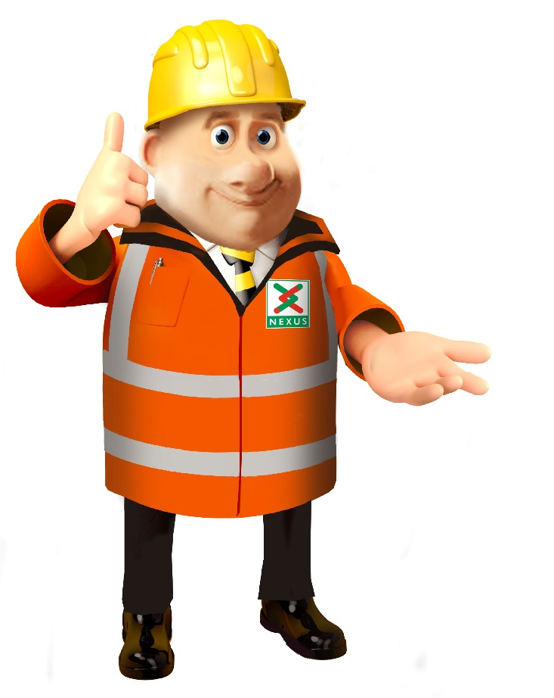

Slide 3

YOUR SAFETY
Notes:
There safety is very important to all of us.

Slide 4
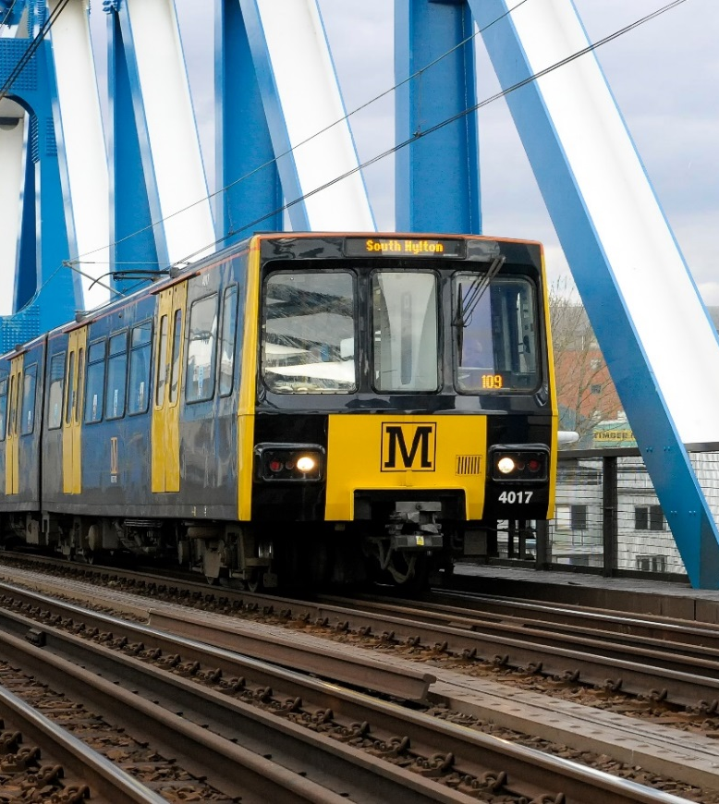
90 trains
40 tonnes
50 mph
150 meters to stop in an emergency
1 ½ football pitches
1,500 volts

Slide 5



15th Feb
28th Feb
15 Feb
From Monday 15 to Sunday 28 February, no trains will run between Heworth and Regent Centre or Heworth and Four Lane Ends. This is to allow us to replace 18,000 metres of overhead line wire. Trains will run as normal again from Monday 1 March.
Notes:
Between the 15th February

Slide 6
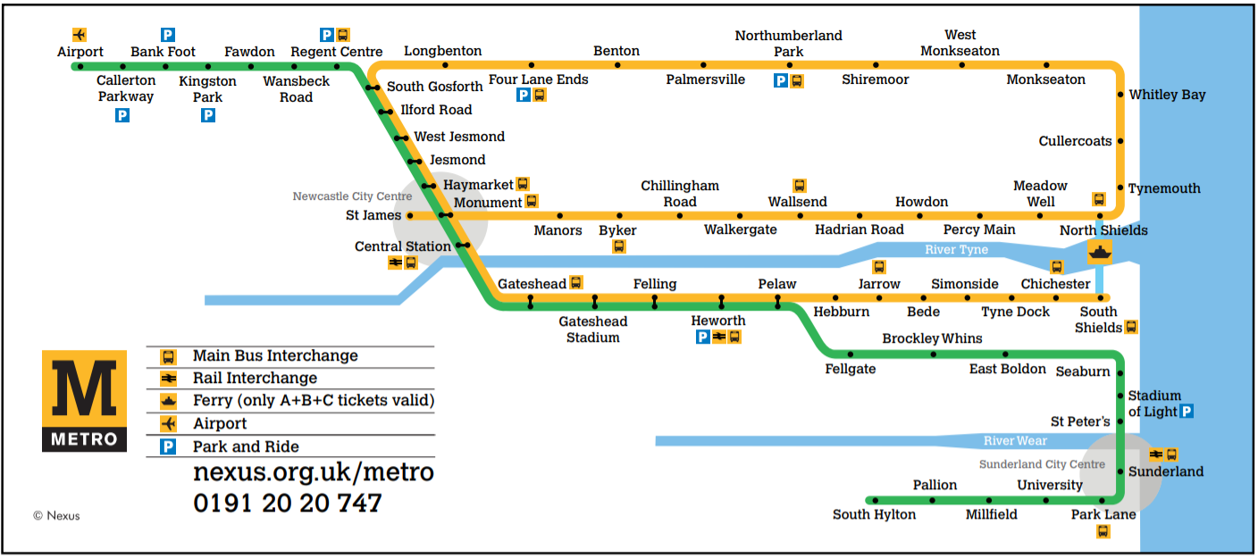
x
x
x

Slide 7

2 Week’s
Notes:
For two weeks. service resumes on Monday 1st March

Slide 8
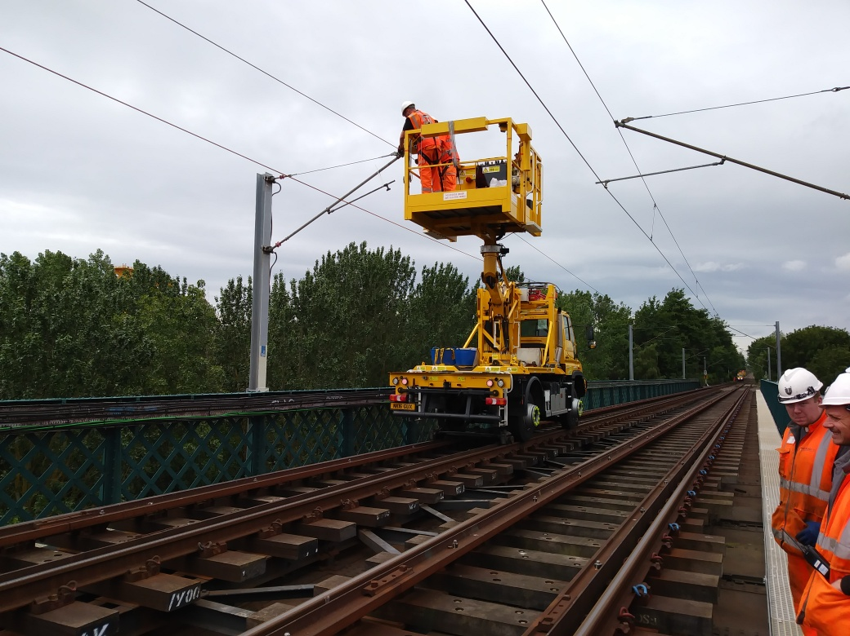
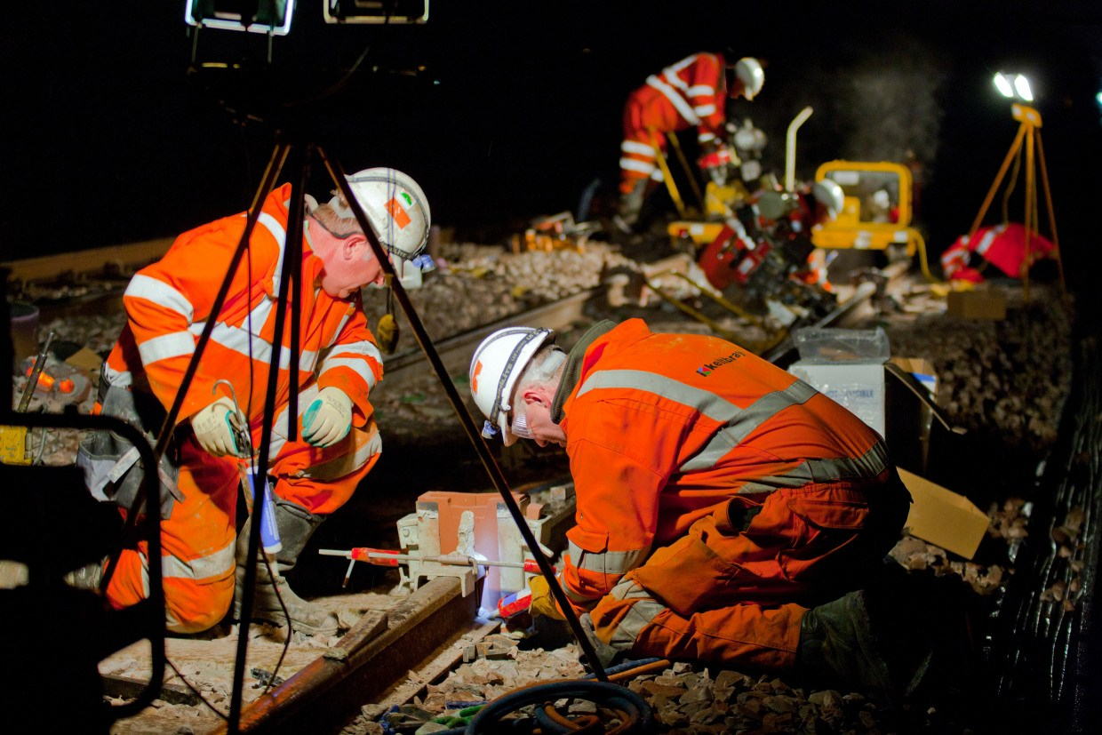
Day
Night
Notes:
Our engineers will be working day and night to replace the overhead lines in the busiest area (Central corridor).

Slide 9

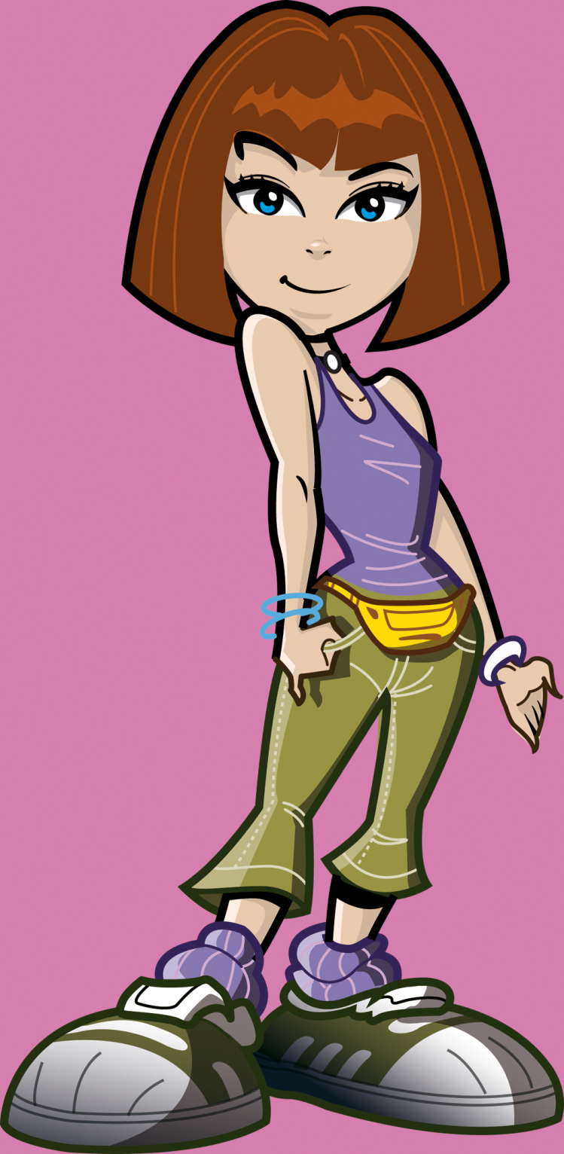
Overhead lines are being replaced. How about we learn more about the Overhead line from our engineers.

Slide 10
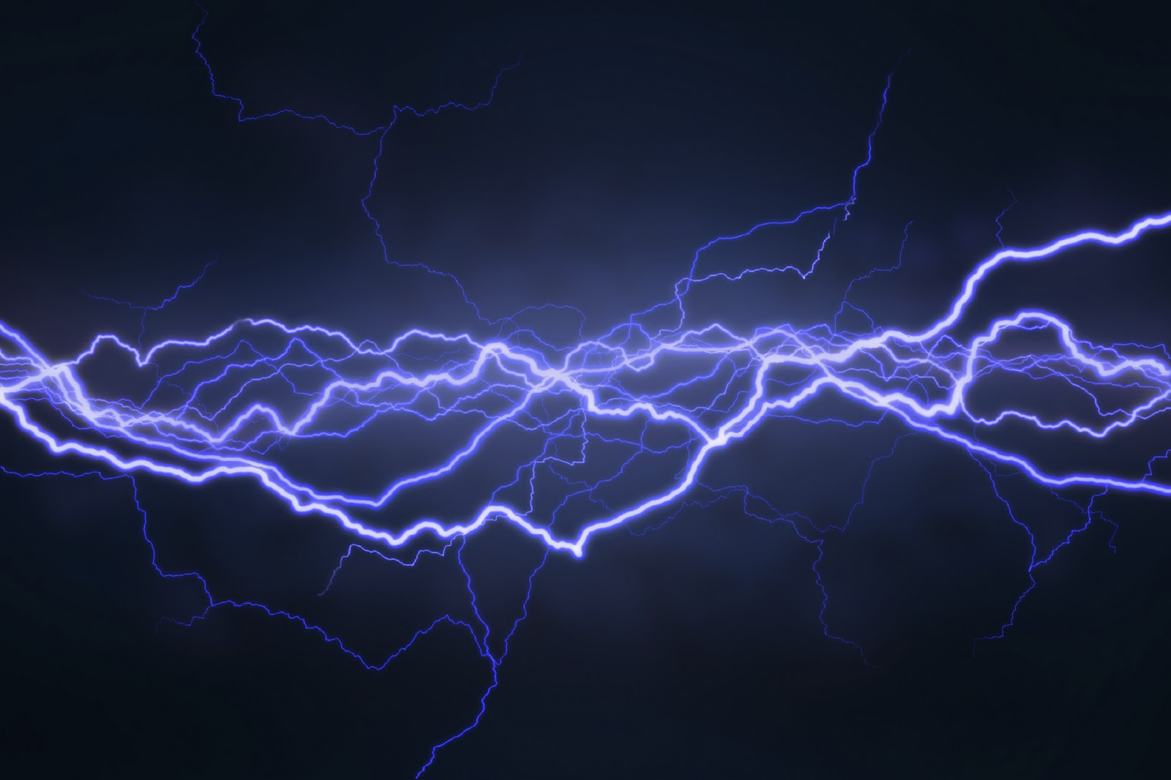

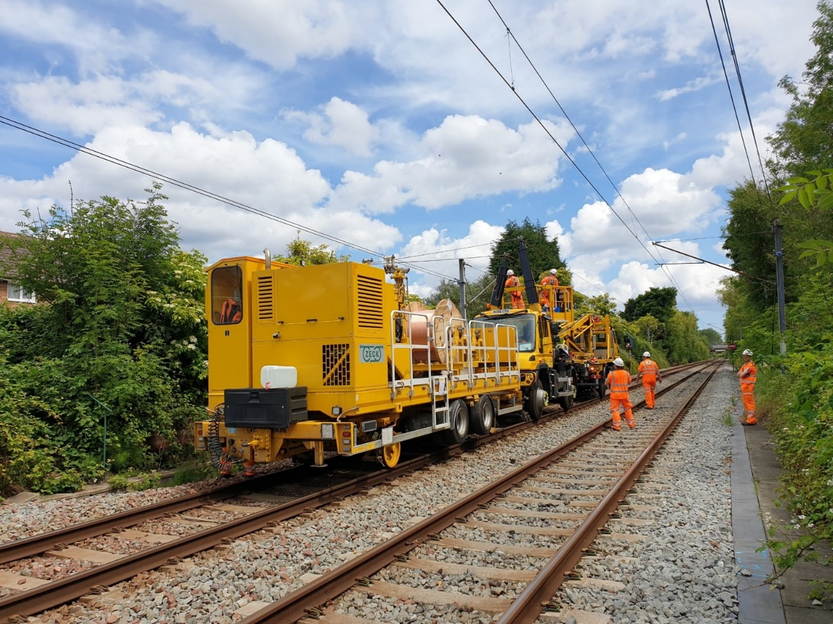
Do you know what makes the train travel so fast?
The electricity in the Overhead lines.
BY-SA-NC
Notes:
This machine helps our engineers to tighten the overhead line. We called it WIWO which stands for Wind In and Wind out.(real name is Catenary Installation Unit).

Slide 11
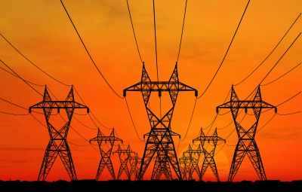
How powerful are electric overhead lines?
A
100 times greater voltage than the power supply in the average home
7 times greater voltage than the power supply in the average home
C
The same as the power supply in the average home
7 times

Slide 12
What happens when you get electrocuted?
A. A tingling or painful sensation.
B. A painful shock, muscles contract and grip the electrical source so you’re unable to let go.
C. The heart ‘flutters’. Burns at entry and exit points and internal damage.
D. Prolonged exposure or strong muscular contractions stop the heart. Internal organs, tissue and skin burn.
Answer: All of the above!
The effects vary depending on the electric current and frequency, but they affect the whole of the body…

Slide 13
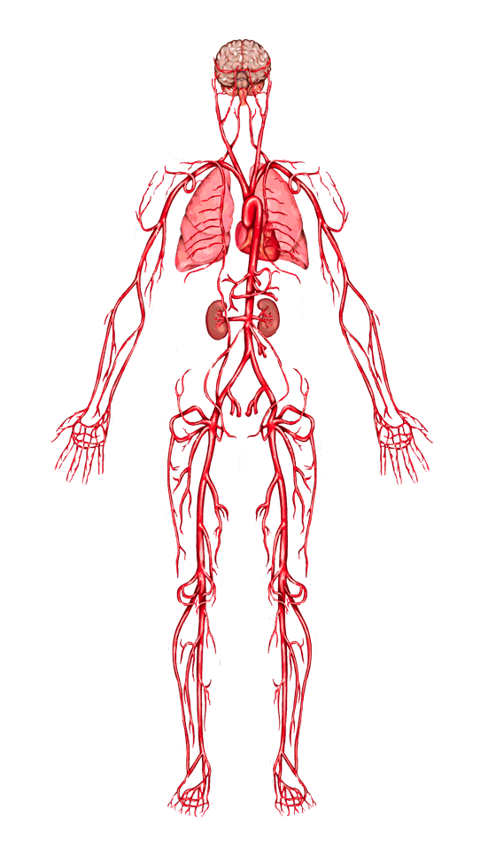
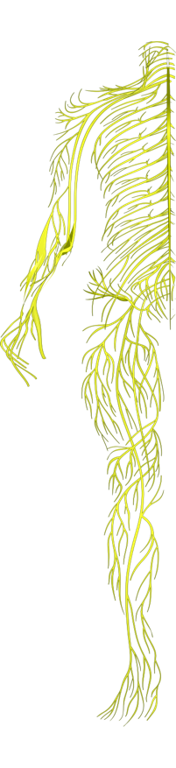
When you get electrocuted…
Lungs: breathing is paralyzed.
Hands, heels, head: points of contact with the electrical source and the ground receive the most severe burns.
Nervous system: disrupts the tiny electrical impulses that enable you to sense, move, think, respond and remember.
Heart: ‘flutters’ and fails to pump blood properly. Goes into cardiac arrest, resulting in death.
Electricity seeks the easiest path to the ground. Human bodies contain 70% water – a great conductor for electricity.

Slide 14
When you get electrocuted…
Spine/Bones: being thrown by force of the current or the strength of muscle contractions can lead to broken bones or an injured spine.
Muscles: sometimes you grip the electrical source so you can’t let go!
Abdomen: strong muscle contractions throw you clear of an electrical source and can damage internal organs.
Skin and tissue: electricity burns beneath skin and the burns blacken and melt surface skin and tissue.
FACT: 9 out of 10 people die from the electric shock received
from getting too close to railway electric overhead lines.

Slide 15



YOUR SAFETY

Slide 16

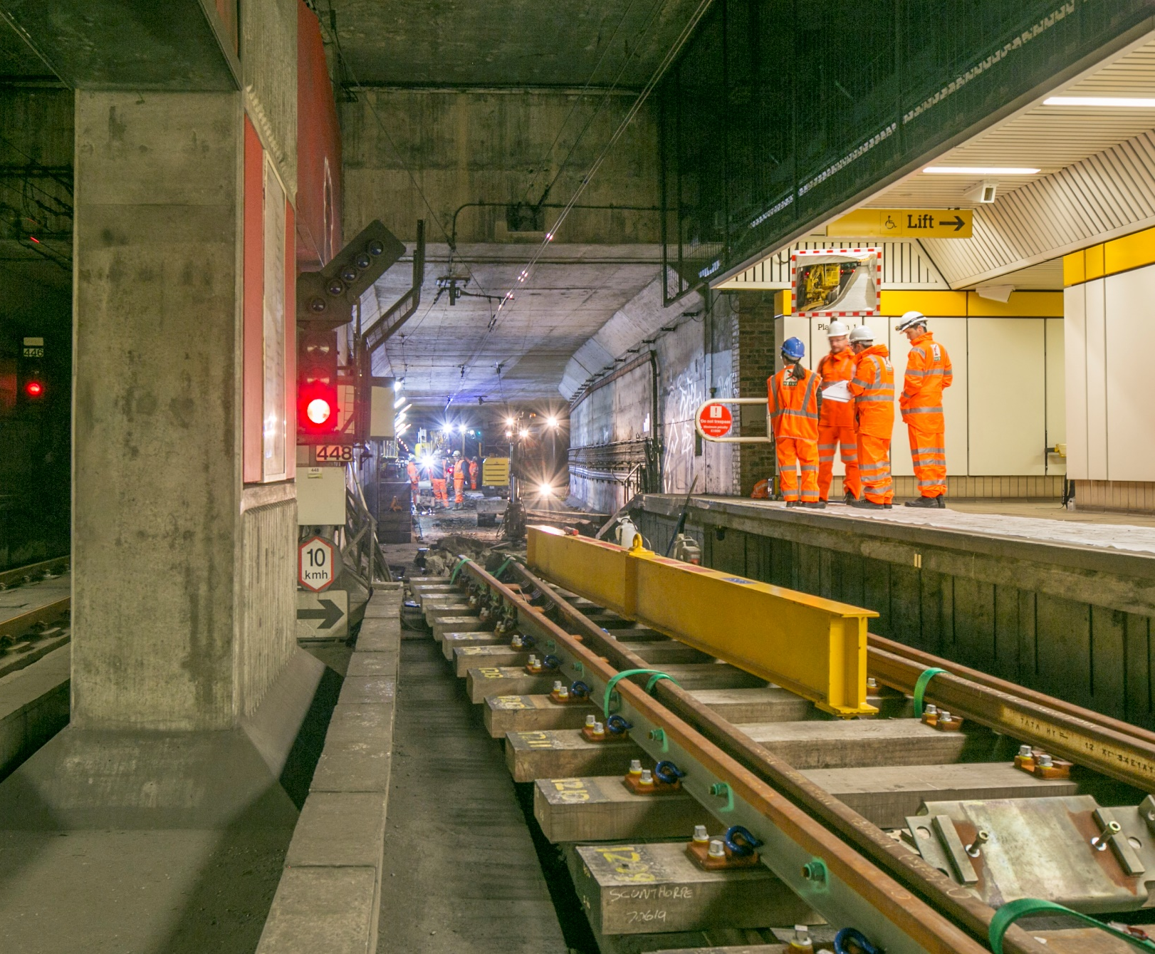

Notes:
Engineers working in the underground stations

Slide 17

What dangers are there around a working area on the metro line?
Notes:
In our compounds there will be many hidden dangers and heavy machinery. Can you think of any dangers

Slide 18

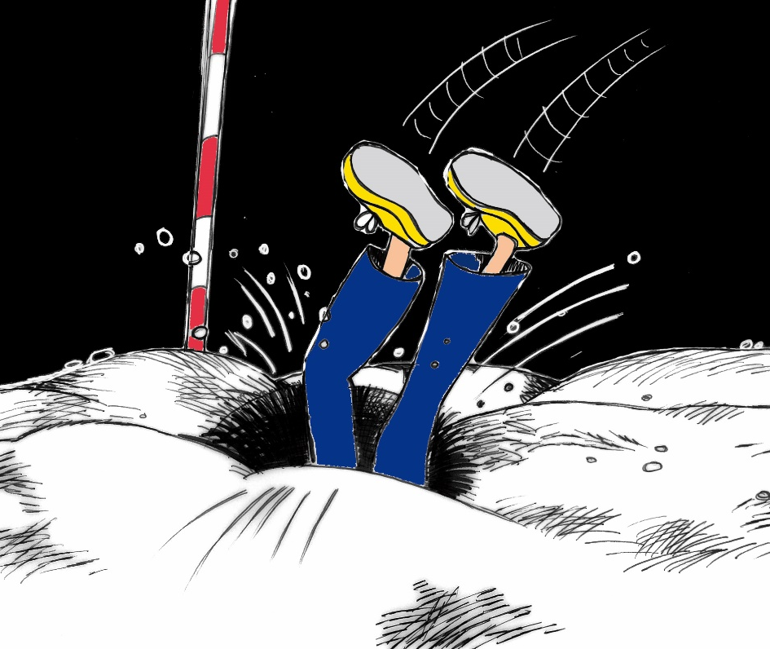
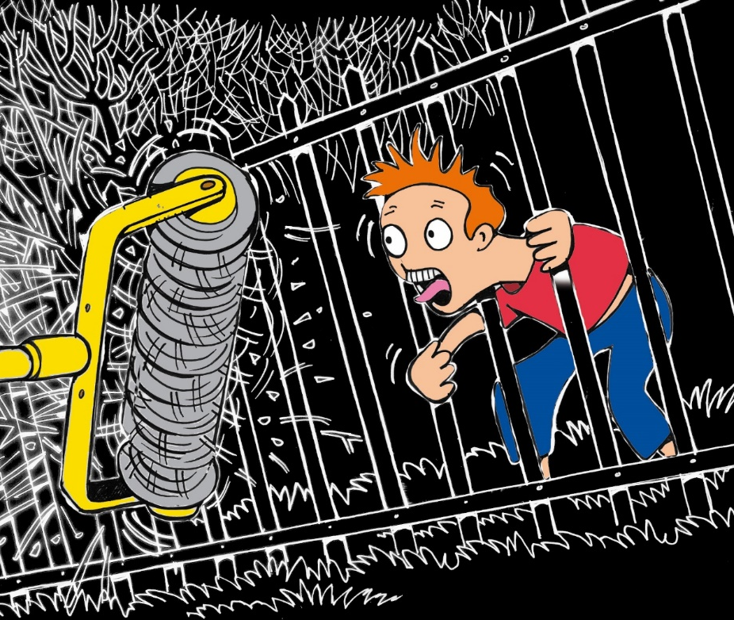
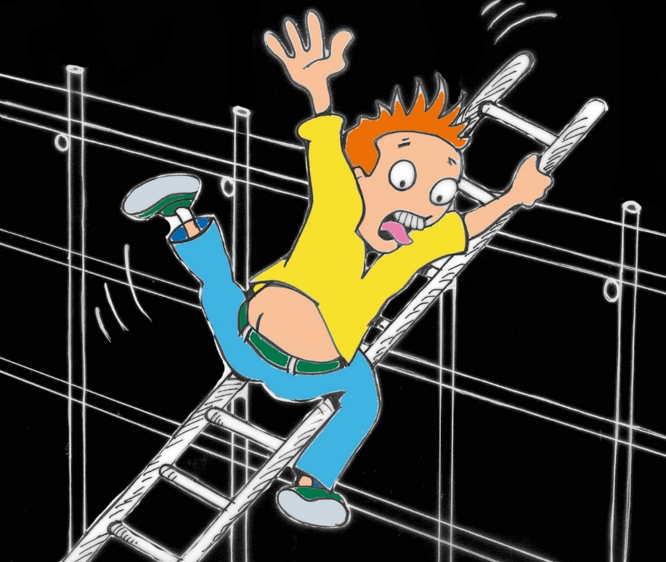
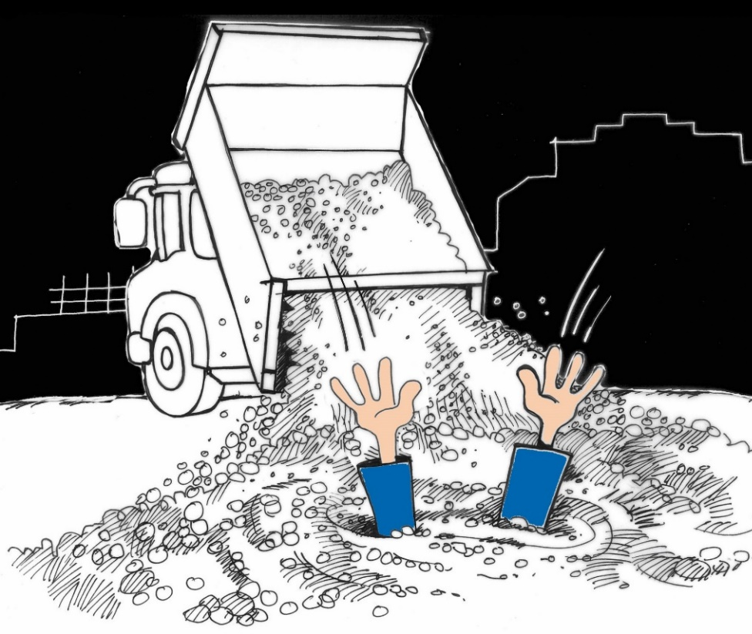
Notes:
Remember our engineers where PPE and are fully trained to work in these areas. We are not allowed in this area and we would be trespassing and could get in trouble with the police ,be hurt or we could be killed.

Slide 19

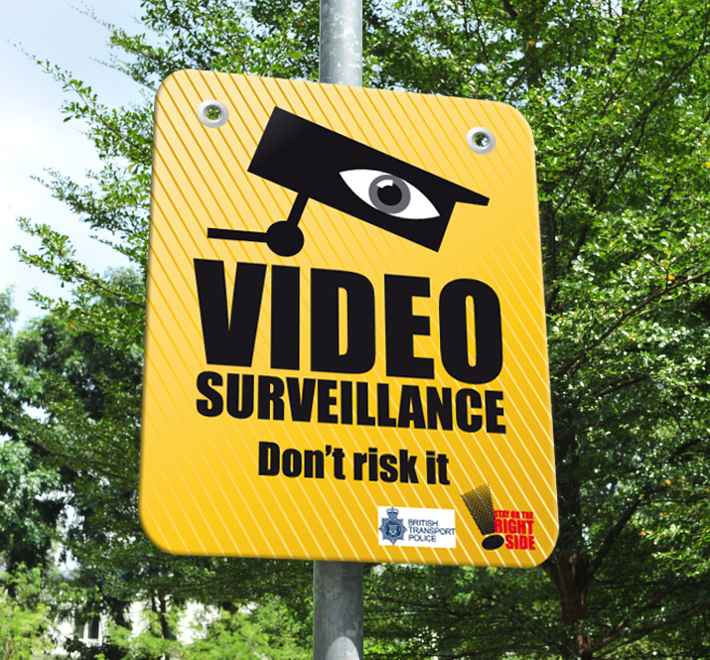
Notes:
We have loads of CCTV Cameras

Slide 20
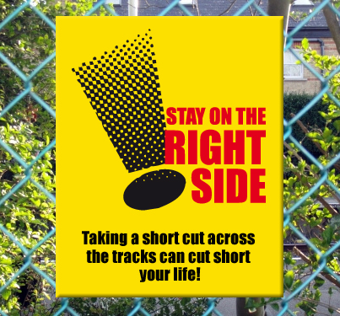
Notes:
Stay on the right side of the fence as short cuts could cost you your life

Slide 21
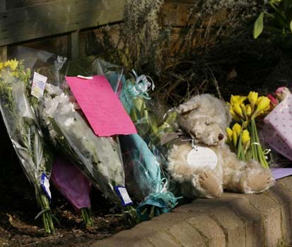
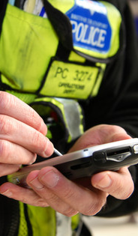
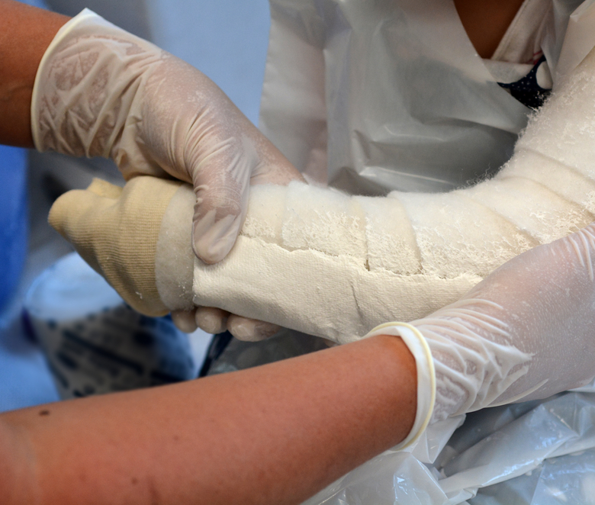
Notes:
Remember the consequences could effect your family and friends, teachers and the emergency services.

Slide 22
So think about what we have seen on these slides. And stay safe and well, DO NOT make the wrong decision or you and your friends and family may pay the terrible consequences.

