Slide 1


RWI Pink: Jay’s clay pot

Slide 2
f ff | l ll le | m mm | n nn kn | r rr | s ss se | v ve | z zz s | sh | th | ng nk
b bb | c k ck | d dd | g gg | h | j | p pp | qu | t tt | w wh | x | y | ch tch
Speed Sounds

Slide 3
a at | e hen | i in | o on | u up | ay day | ee y see | igh high | ow blow
oo zoo | oo look | ar car | or for | air fair | ir whirl | ou shout | oy boy
Speed Sounds

Slide 4
day | hay | away | play | stay | that
thing | long | hatch
Story Green Words

Slide 5
drag on | mass ive | rock -> rocks
crack -> cracking | sun -> sunny
Story Green Words

Slide 6
ago | flew | she | the
laid | of | one | story
I | hear
Red words

Slide 7
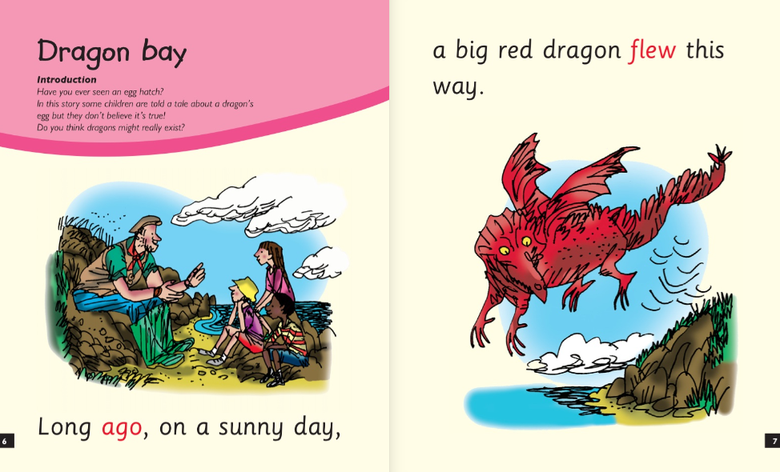

Slide 8
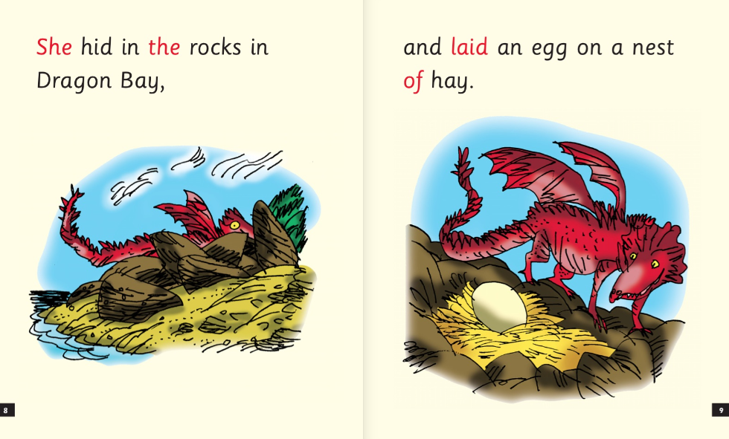

Slide 9
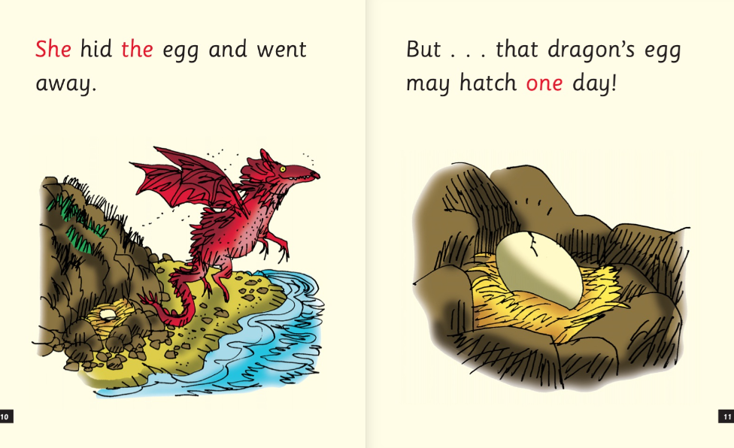

Slide 10
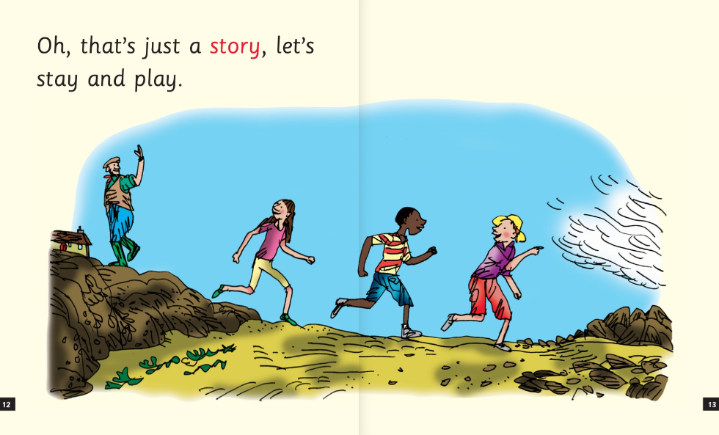

Slide 11
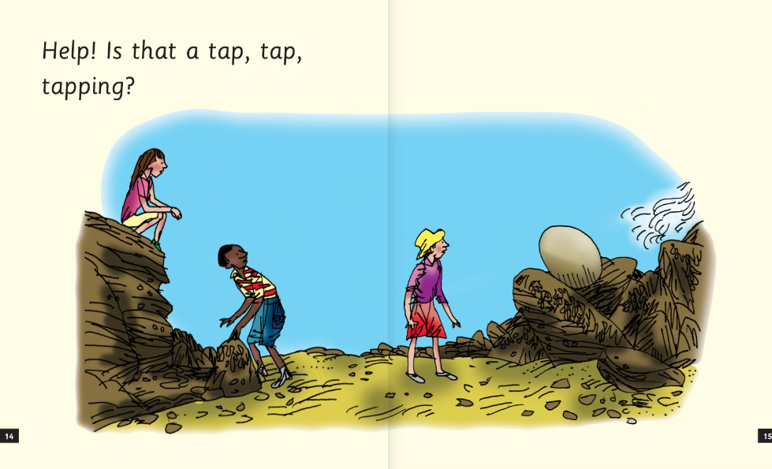

Slide 12
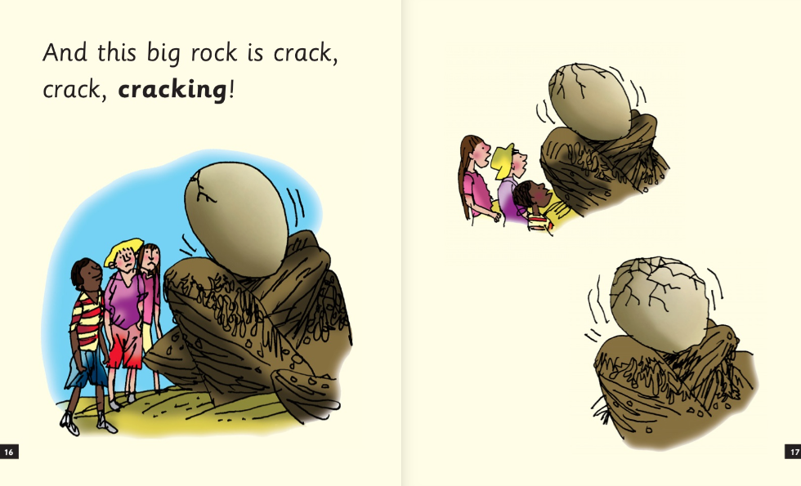

Slide 13
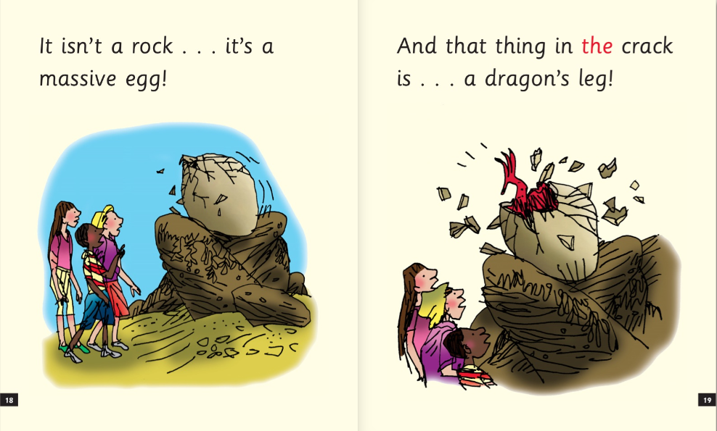

Slide 14
