Slide 1
Maths Alternative 1- To compare and order money
Problem solving challenge

Slide 2
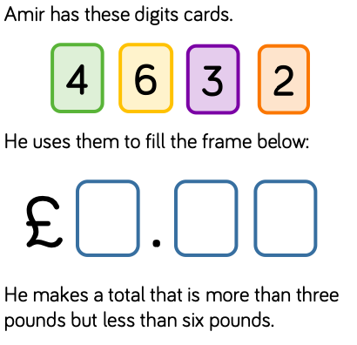
The Problem
Here is the question.
The main bits of information to take from this is that Amir is making amount with just 3 of these cards at a time because there are only 3 spaces.
It also says his total is more than £3 but less than £6.

Slide 3
There are then two tasks to complete
Task 1) Can you work out all the different amounts he can make using the information given?
I will tell you there are 12 answers in total.
The first thing that I would be doing is thinking about what the pounds parts could be?
If the answers must be more that £3 but less than £6, that tells me I can’t use 2 or 6 in the pounds part because this would break the rule.
Example I could make £3.46 because that follows the rules but I can’t make £6.32 because this breaks the rules.

Slide 4
Task 2) Can you order your amounts, smallest to largest?
For this question you need to take all your answers from task 1 then put them in order.
What I would do is look for what is the smallest pound amount then look at the pence.
Example £3.26 is less than £3.42 because even though the pound part is the same 26p is smaller than 42p.
I hope this helps you with the problem solving!

