Slide 1

Year 5
Art

Slide 2
Learning Objective
To know who the artist Akie Nakata is
To describe her art work

Slide 3
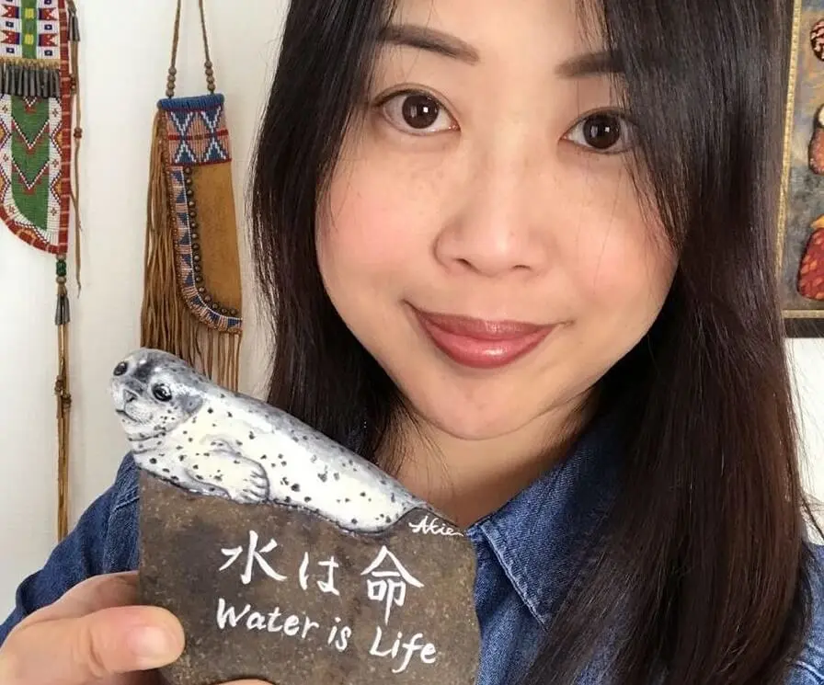
Here is the artist Akie Nakata.

Slide 4
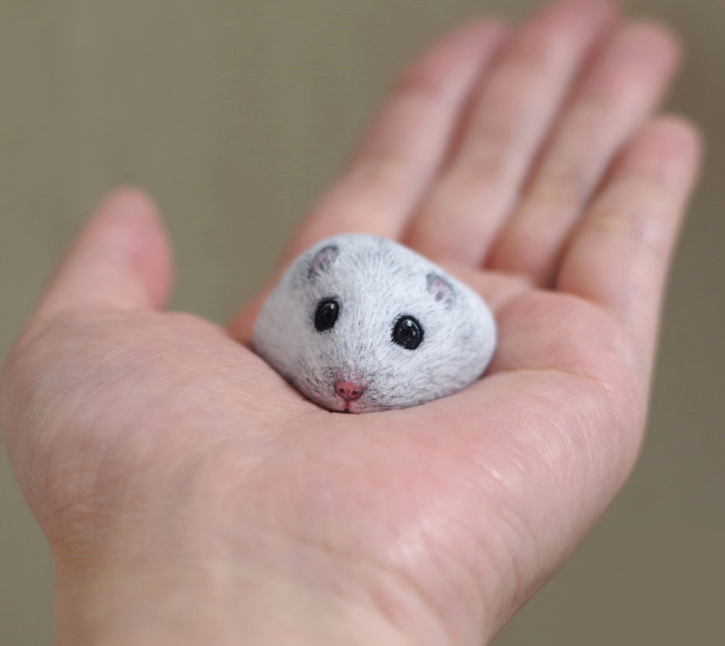
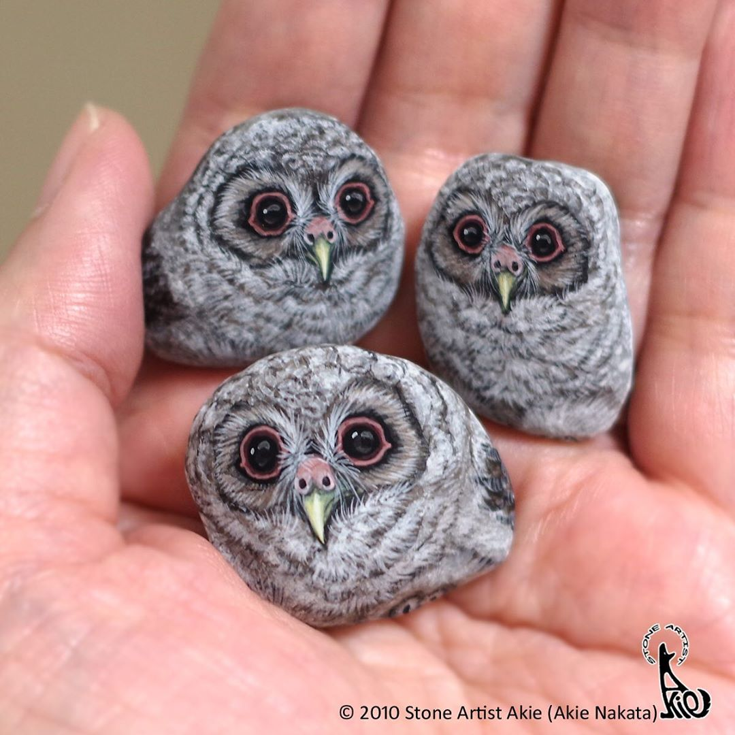
What do you think the mouse and the owls are created on?

Slide 5
They are sketched and painted on stones
Japanese artist Akie Nakata, has a unique way of looking at the world.
For the past nine years, she's taken ordinary stones and transformed them into something magical using paint.
Under her watchful eye, these rocks become highly realistic animals that fit into the palm of your hand.

Slide 6
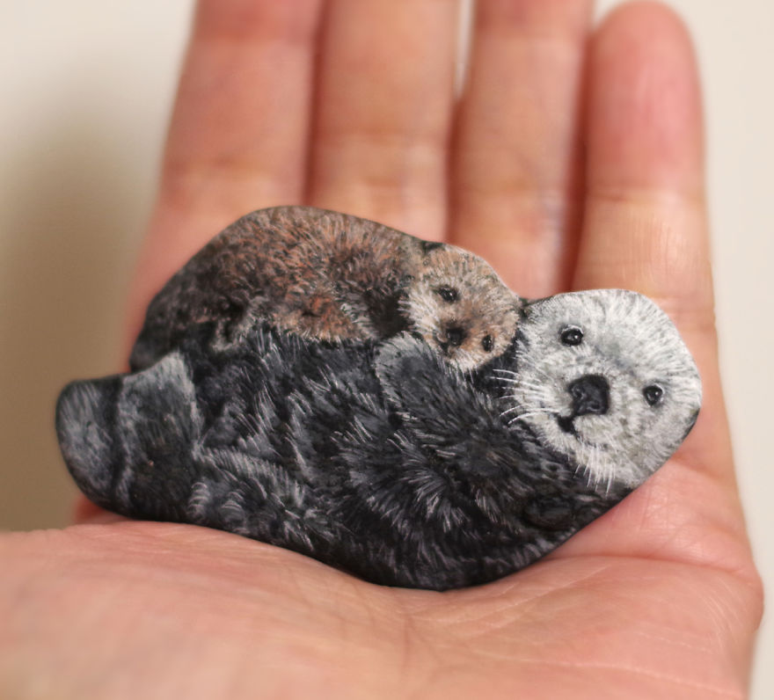
What do you think Akie uses to create the stones?

Slide 7
Akie uses acrylic paint working with tiny brushes. Akie carefully brings each animal to life.
In reality, the creative process begins from the moment she spots a rock. Its natural shape helps inspire what animal it will become.
“Stones have their own intentions, and I consider my encounters with them as cues to go ahead and paint what I see on them.”
Where could we find stones?

Slide 8
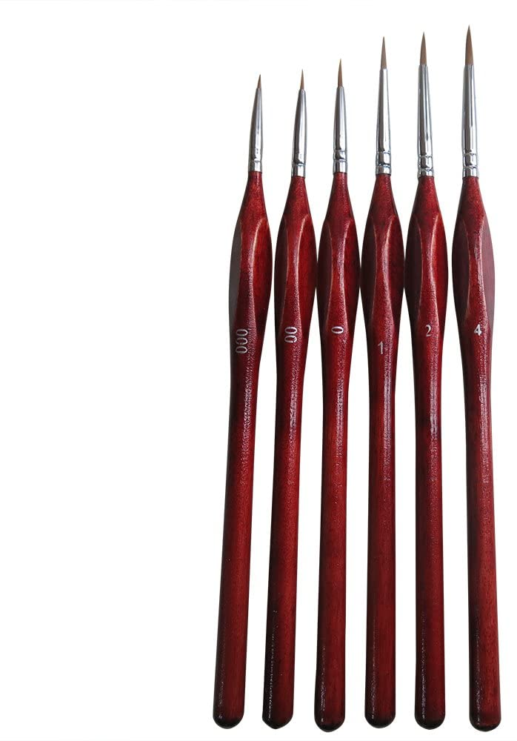

Here are some acrylic paints and an example of very small brushes that Akie uses to create her beautiful art work..

Slide 9
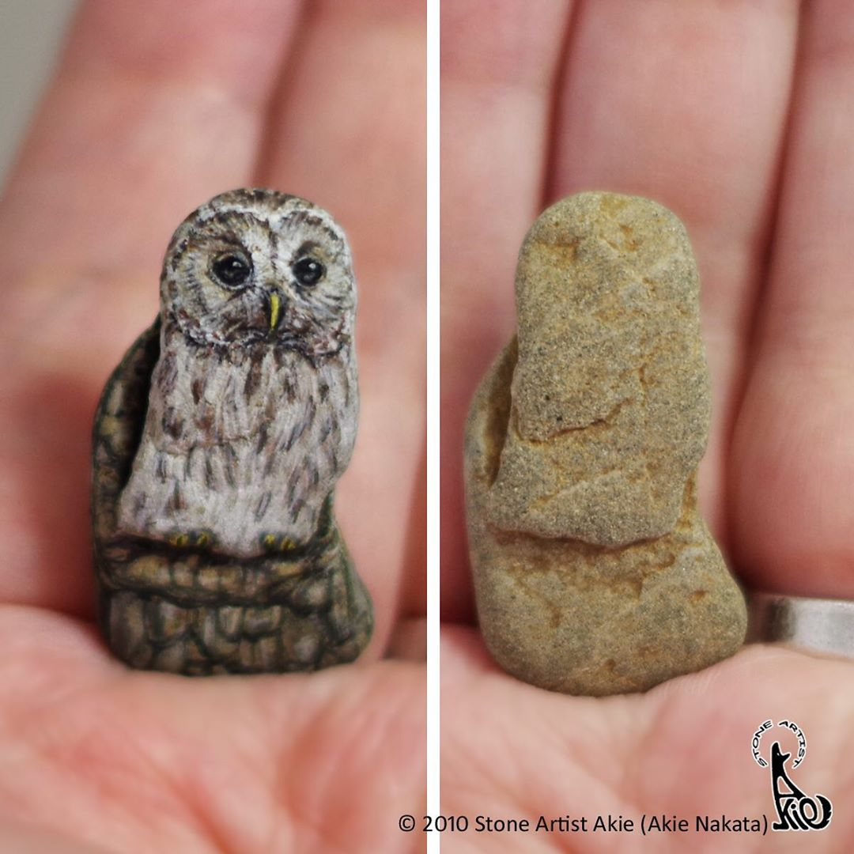
Here are some before and after examples.

Slide 10
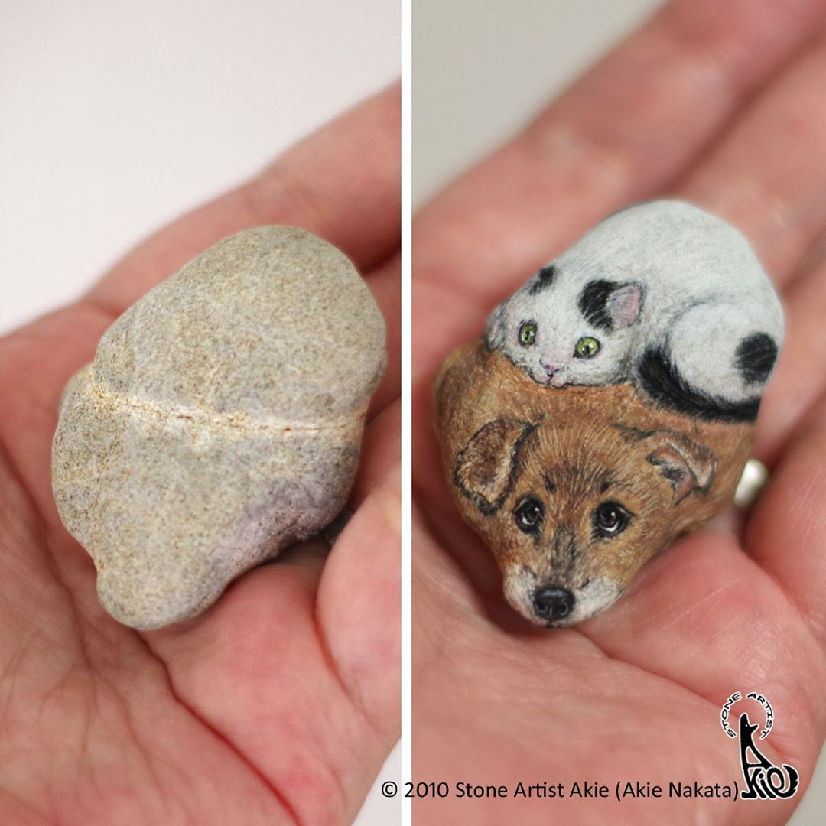

Slide 11
We are now going to look at some examples of Akie’s work . Could you think about what you notice about the art work, what do you like about the art work.

