Slide 1
Alternative Maths - Learning intention: to revisit properties of shapes.
Listen to the teacher read the quiz questions on the PowerPoint. Use what you remember about shapes to help you.
Remember:
vertices (corners)
sides
edges

Slide 2
1.Circle the 2D shapes. Remember 2D shapes are flat.
2. Name the 2D shape with only one side.
square circle triangle rectangle

Slide 3
3. Name the 2D shape that has 4 vertices and 4 sides that are the same.
square circle triangle rectangle
4. Which shape below has 0 vertices?

Slide 4
5. Name the 2D shape that has 1 curved side.
square circle triangle rectangle
6. Which shape below has 12 vertices?

Slide 5
7. Name the 3D shape that has 1 vertex (vertices).
cube cuboid sphere cone
8. Which shape below has 8 vertices?

Slide 6
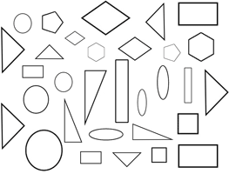
9. How many
triangles
are there?
10. Which shape below has no edges?

