Slide 1

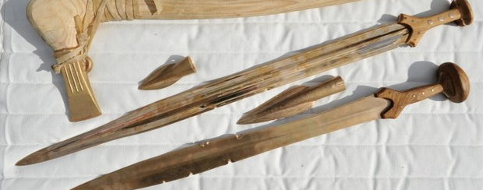

Bronze: how it was made and used in the Bronze Age
History

Slide 2
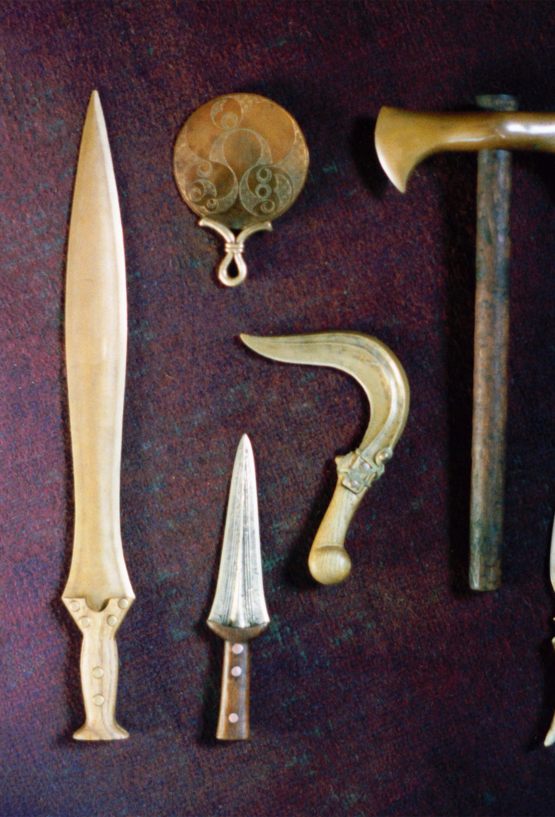
How is bronze made?
The Stone Age, the Bronze age and the Iron age were all named after the materials that were used to make tools throughout prehistory.
In this lesson we will find out how bronze is made and some of the tools that it was used for.

Slide 3
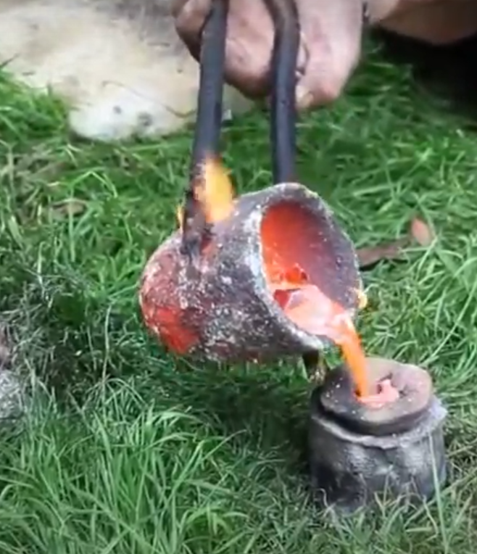
Task 1
Watch this video and then write a short explanation of how a Bronze Axe head is made. Use drawings and short sentences.
https://www.bbc.co.uk/teach/class-clips-video/history-ks2-discovering-metalwork-in-bronze-age-Britain/zb8b47h

Slide 4
Key vocabulary and Hints
Key vocabulary
Bronze copper tin ore(rock the metal is found in)
Bronze Age prehistoric BC smelting mould molten
Hint
There are 7 stages in the process. You will need to put them in the correct order!
heat chips of copper and tin ore together to create bronze
moulding the clay
heating the clay to harden it and melt the wax
finish by sharpening the axe head
pour the molten metal into the mould
carving the wax version
after it has cooled, break the mould open

Slide 5
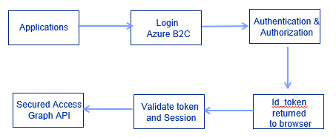
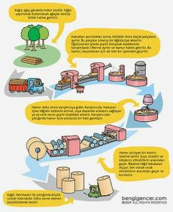
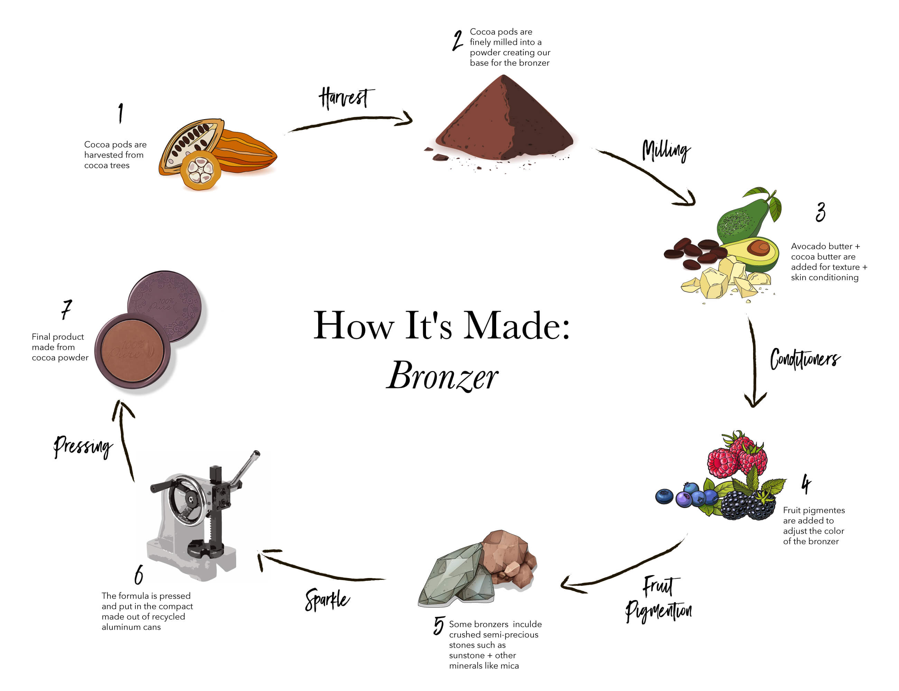
A few ideas for your layout

Slide 6
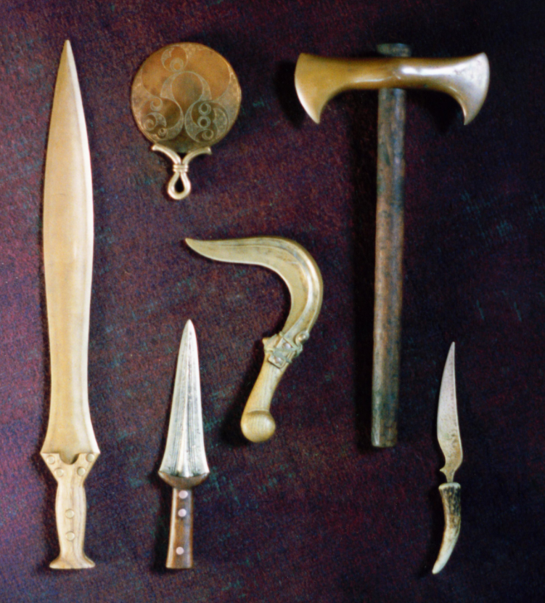
Task 2
Draw these Bronze age tools and label them.
What do you think they are and how were they used?
Imagine you are someone from the bronze age. What tools would you need when working with wood.
How would you hunt and prepare meat or animal skin and cut down the crops you have grown?
Also how would you defend yourself if you needed to?
Which one is which?
mirror scythe (used to cut down crops)
Bone handled knife dagger
axe short sword

Slide 7
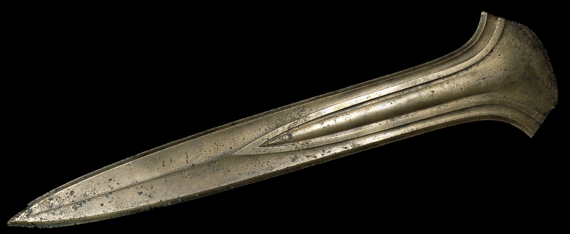
Well done

