Slide 1

Learning intention
Personal Opinion

Slide 2
Musical taste
The word often used to describe what your favourite music is, is your ‘taste in music.’
There is no ‘right and wrong’ musical tastes and you can like more than one sort of music.
Many people though follow one particular kind of music and it affects the way they live their lives to a great amount. Especially the clothes they wear!

Slide 3
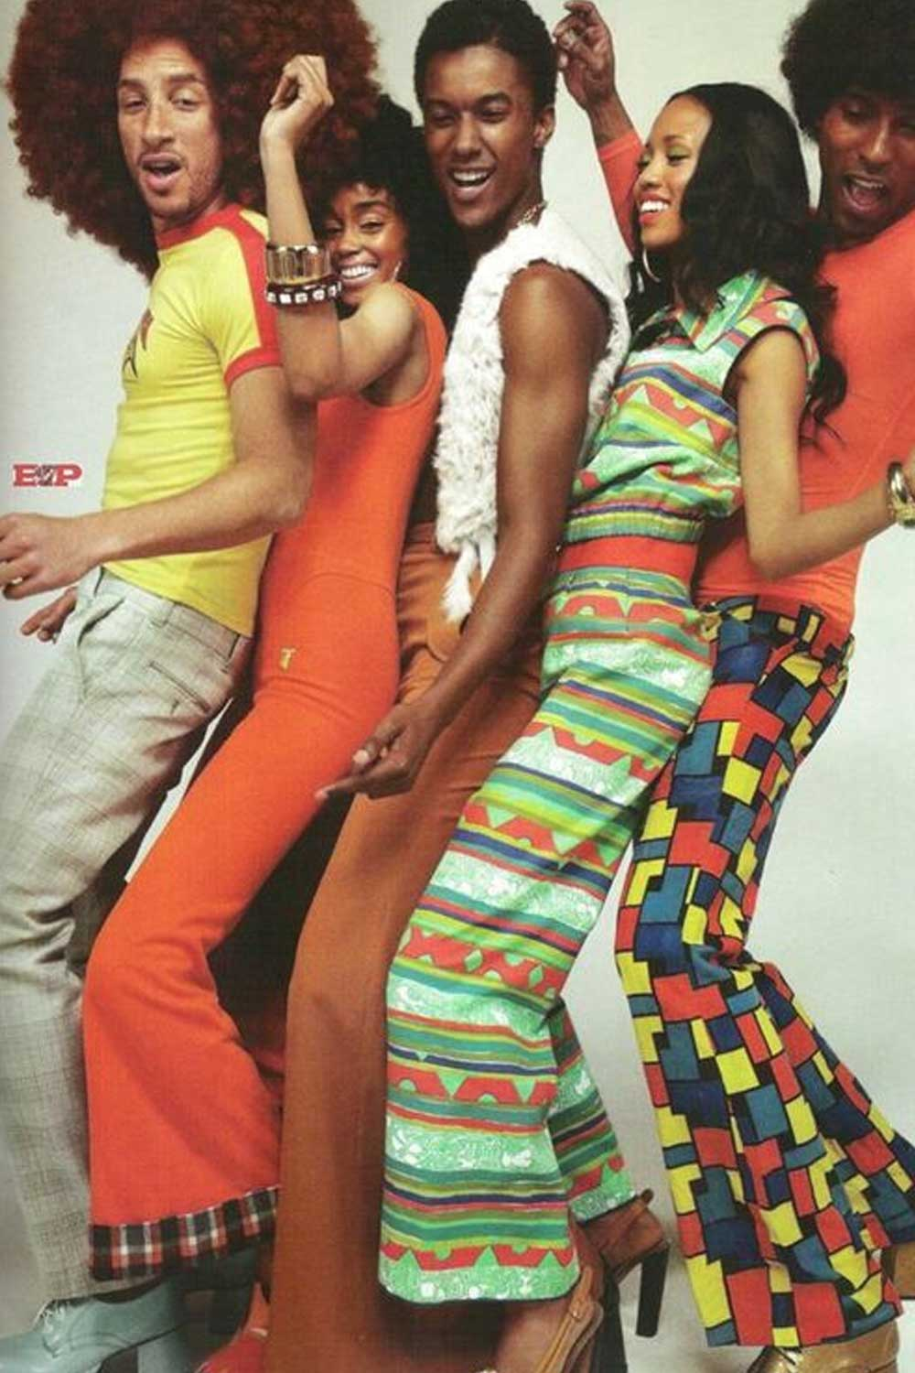
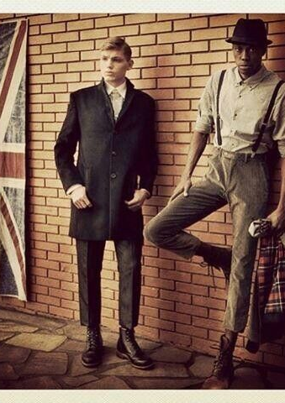
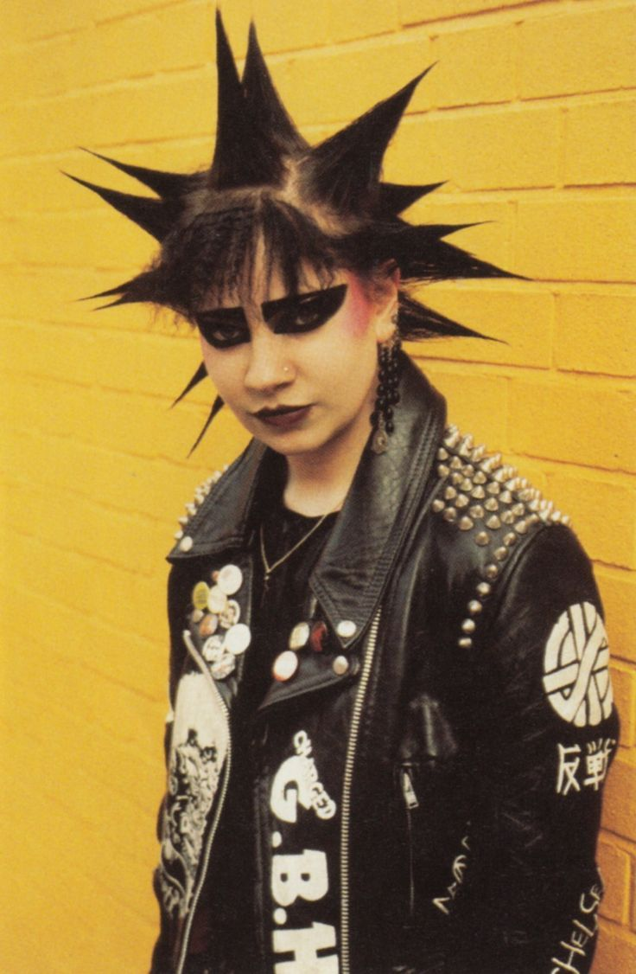
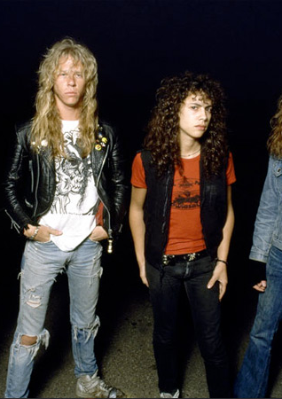
Disco Ska punk hard rock

Slide 4

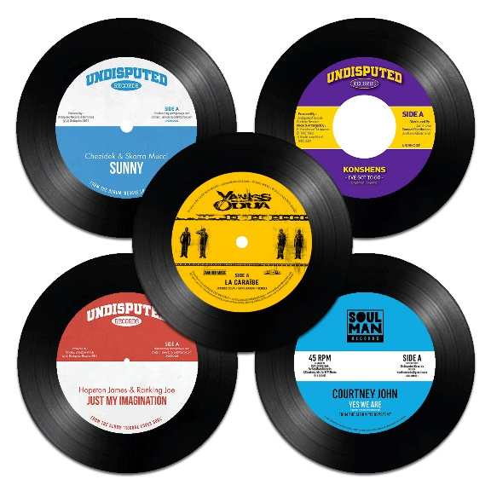
In the 70’s there was a TV show called Top of the Pops. Millions of people would watch it to find out the Top 10 biggest selling songs of that week.
.

Slide 5
Task
Today I want you listen to some of the music you have heard over the past two days.
Which do you like?
Which do you not like?
What is it about the songs that gave you this opinion.
Make a top three of the songs you have heard.
Do others agree with you?

