Slide 1
Learning intention: Identify personal pronouns

Slide 2
Listen to the words on the following slides and repeat what I am saying.

Slide 3
She

Slide 4
He

Slide 5
They

Slide 6
it

Slide 7
we

Slide 8
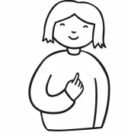
I

Slide 9
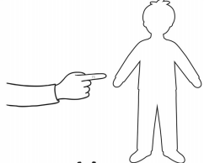
You

Slide 10
Her

Slide 11
Him

Slide 12
Them

Slide 13
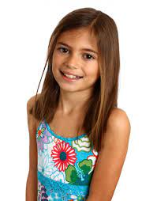
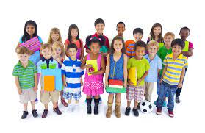
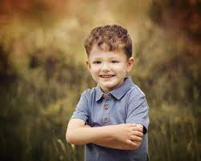
Match the picture to the correct pronoun:
he
she
they

Slide 14
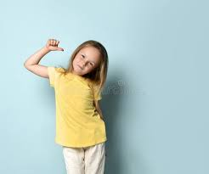
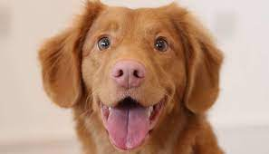
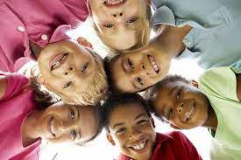
Match the picture to the correct pronoun:
we
I
it

