Slide 1


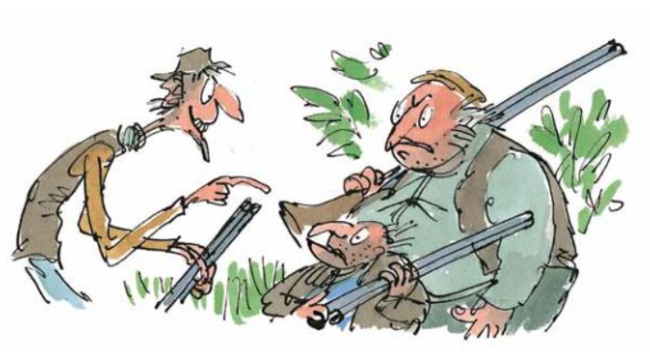
Direct speech
Never
never never!
We don’t let
him go!

Slide 2
Key vocabulary
Words that are used instead of said
shouted
declared
cried
yelled
asked
screamed
Characters
Inverted commas
Reporting clause
Speech marks
Conversation
Dialogue
Expression

Slide 3
Direct Speech
What is direct speech?
Direct speech is when characters in a story speak to each other or have a conversation. This is an example from chapter 3.
“Well my darling,” said Mr Fox. “What shall it be tonight?”
“I think we’ll have duck tonight,” said Mrs Fox. “Bring us two fat ducks, if you please. One for you and me, and one for the children.”
“Ducks it shall be!” said Mr Fox. “Bunces best!”

Slide 4
The first thing you will notice is that when ever someone speaks, what they say has this punctuation, “Well my Darling.” to tell you when they start to speak and when they stop.
“”these are called inverted commas as they look like commas but are at the top of the writing not at the bottom.
Three dogs, a cat, four owls and a fox lived in the castle. -Commas
“Watch out!” He shouted. -Inverted commas. You may know them as speech marks.

Slide 5
One other thing you will notice is that when ever someone starts to speak what they are saying always starts with the inverted commas punctuation followed by a capital letter. As you investigate this you will see this is always the same.
“Well my darling,” said Mr Fox. “What shall it be tonight?”
“I think we’ll have duck tonight,” said Mrs Fox. “Bring us two fat ducks, if you please. One for you and me, and one for the children.”

Slide 6
Our tasks today will start by reading chapter 7 of Fantastic Mr Fox.
You will then read back the chapter yourself and practise reading aloud with expression.
Reading with expression makes your reading more interesting and exciting whether you are reading quietly to yourself or reading out loud.
For example
“Watch out, he’s coming this way!” shouted Mr Fox.

Slide 7
After reading with expression, copy three examples of direct speech and label the punctuation (inverted commas, capital letters and any other punctuation) and the reporting clause.
The reporting clause is telling the reader who is speaking and how they are speaking.
“Well my darling,” said Mr Fox. “What shall it be tonight?”
Reporting clause

Slide 8
Fantastic Mr Fox – Chapter 7
“We’ll never let him go!”
At six o’clock in the evening, Bean switched off the motor of his tractor and climbed down from the driver’s seat. Bunce did the same. Both men had had enough. They were tired and stiff from driving the tractors all day. They were also hungry. Slowly they walked over to the small fox’s hole in the bottom of the huge crater. Bean’s face was purple with rage. Bunce was cursing the fox with dirty words that cannot be printed. Boggis came waddling up. ‘Dang and blast that filthy stinking fox!’ he said. ‘What the heck do we do now?’

Slide 9
‘I’ll tell you what we don’t do,’ Bean said. ‘We don’t let him go!’
‘We’ll never let him go!’ Bunce declared.
‘Never never never!’ cried Boggis.
‘Did you hear that, Mr Fox!’ yelled Bean, bending low and shouting down the hole. ‘It’s not over yet, Mr Fox! We’re not going home till we’ve strung you up dead as a dingbat!’ Whereupon the three men all shook hands with one another and swore a solemn oath that they would not go back to their farms until the fox was caught.
‘What’s the next move?’ asked Bunce, the pot-bellied dwarf.

Slide 10
‘We’re sending you down the hole to fetch him up,’ said Bean. ‘Down you go, you miserable midget!’
‘Not me!’ screamed Bunce, running away.
Bean made a sickly smile. When he smiled you saw his scarlet gums. You saw more gums than teeth. ‘Then there’s only one thing to do,’ he said. ‘We starve him out. We camp here day and night watching the hole. He’ll come out in the end. He’ll have to.’
So Boggis and Bunce and Bean sent messages down to their farms asking for tents, sleeping-bags and supper.

Slide 11
Reading with expression
‘I’ll tell you what we don’t do,’ Bean said. ‘We don’t let him go!’
‘We’ll never let him go!’ Bunce declared.
‘Never never never!’ cried Boggis.
‘Did you hear that, Mr Fox!’ yelled Bean, bending low and shouting down the hole. ‘It’s not over yet, Mr Fox! We’re not going home till we’ve strung you up dead as a dingbat!’ Whereupon the three men all shook hands with one another and swore a solemn oath that they would not go back to their farms until the fox was caught.

Slide 12
Examples of speech
Copy three examples of direct speech and label the punctuation (inverted commas, capital letters and any other punctuation) and the reporting clause.
The reporting clause is telling the reader who is speaking and how they are speaking.
“Well my darling,” said Mr Fox. “What shall it be tonight?”
Reporting clause

Slide 13
