Slide 1

Alternative Maths 1
Learning intention:
To identify and describe the properties of 3D shapes including faces, edges and vertices.

Slide 2
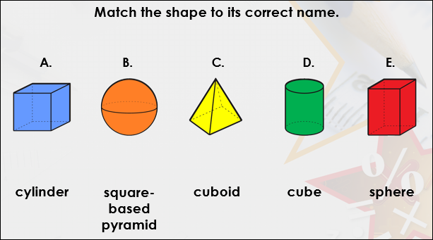

Slide 3
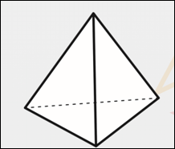
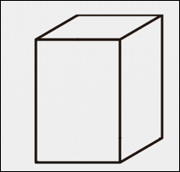
True or false? This is a cuboid.
True or false? This is a cone.
False. It is a pyramid
True

Slide 4
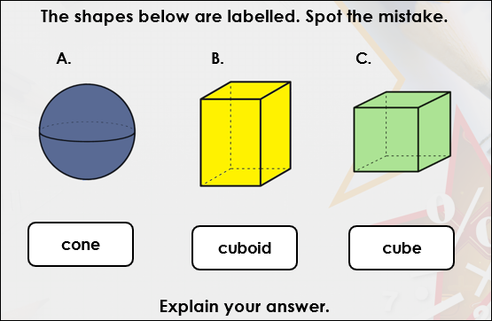
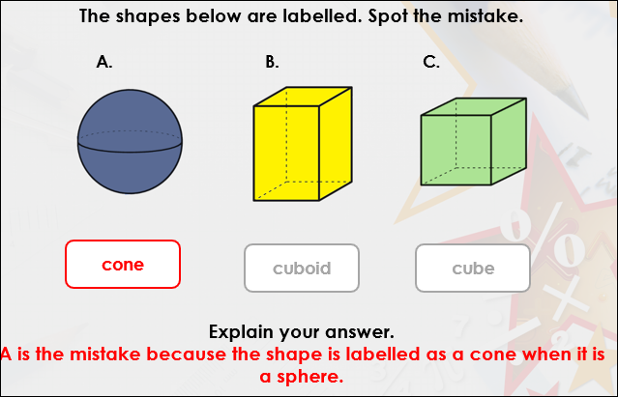

Slide 5
