Slide 1
Learning Intention:
To use descriptive language

Slide 2
What is descriptive language?
Adjectives
Adjectives are words that describe what you can sense about a noun including
sight, sound, smell, taste, touch, and how they feel.
We use these to make our writing more exciting for the reader.
We will be focusing on using expanded noun phrases today.

Slide 3
Expanded noun phrases
What is an expanded noun phrase?
An expanded noun phrase is when you use two adjectives in a sentence.
Here is an example
A tall, towering tree swayed in the wind.
Remember to include a comma after the first adjective !

Slide 4
Now it’s your turn. Can you talk to someone at home and share your adjectives about this animal.
What does the macaw sound like?
What does the macaw look like?

Slide 5
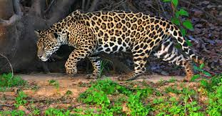
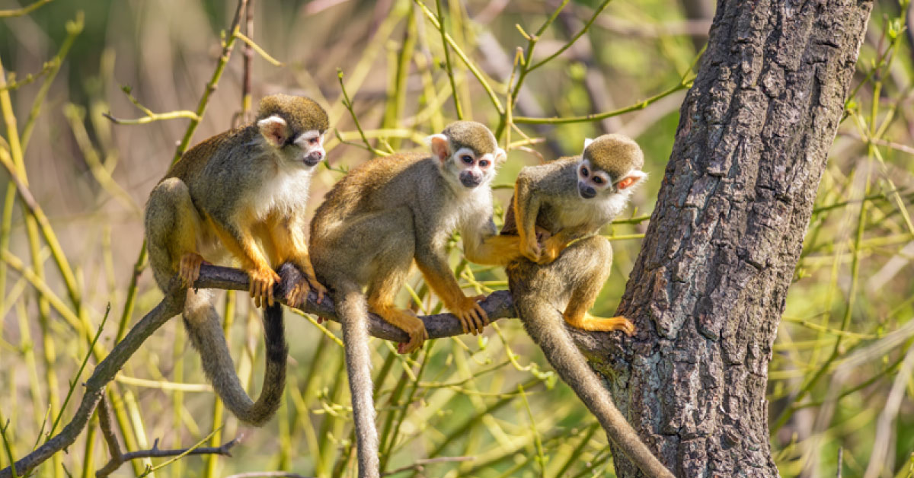
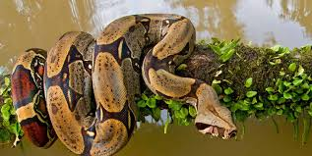
Now it’s your turn. Can you talk to someone at home and share your adjectives about these animals.

