Slide 1
To learn about music from the past

Slide 2
This week we have listened to some different music from the 1970’s.
We have also thought about the tempo of the music and how it makes you feel.
Today we are going to look at 3 musical artists, and find out some more about them.

Slide 3
Diana Ross
Diana Ross was born in America, in 1944.
She was in a band called The Supremes.
They sung music called Motown music.
Diana Ross left the band in the 1970’s to sing by herself.

Slide 4
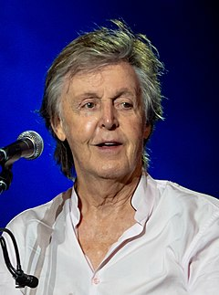
Paul McCartney
Paul McCartney was born in Liverpool, in 1942.
When Paul was 15 he made a band called The Beatles.
Paul used to write lots of songs for the band.
Paul left the band in 1971.

Slide 5
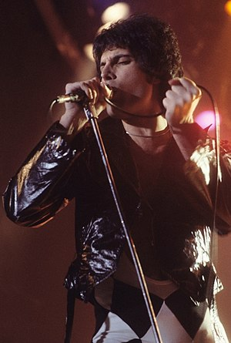
Freddie Mercury
Freddie was born in 1946 in a country called Zanzibar.
His real name is Farrokh Bulsara.
In 1970, Freddie formed a band called Queen and they played a type of music called Rock music.
They became one of the most famous bands in the world.
Unfortunately, Freddie died in 1991 when he was 45 years old.

Slide 6
Today’s task
Using the information in this PowerPoint can you tell me one interesting fact you have learnt about these musical artists.
You could also ask your parents or other family members as they may know some facts about these artists too!

