Slide 1
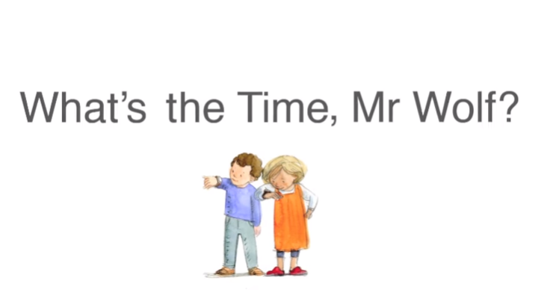
Year 1 maths
Time

Slide 2
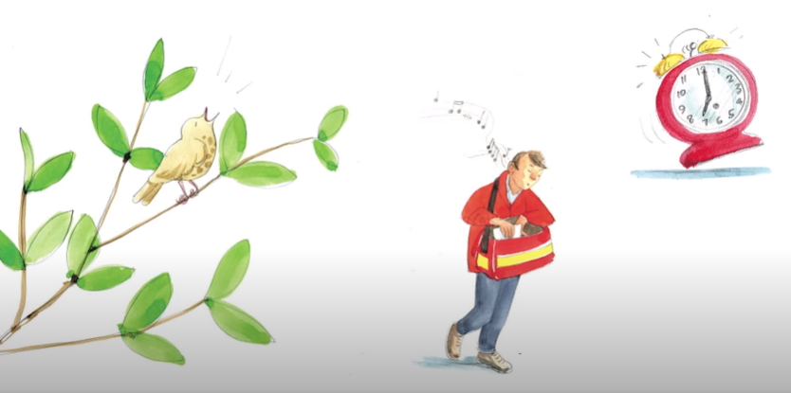
A bird is singing, an alarm clock ringing, a postman singing. What’s the time Mr wolf?

Slide 3
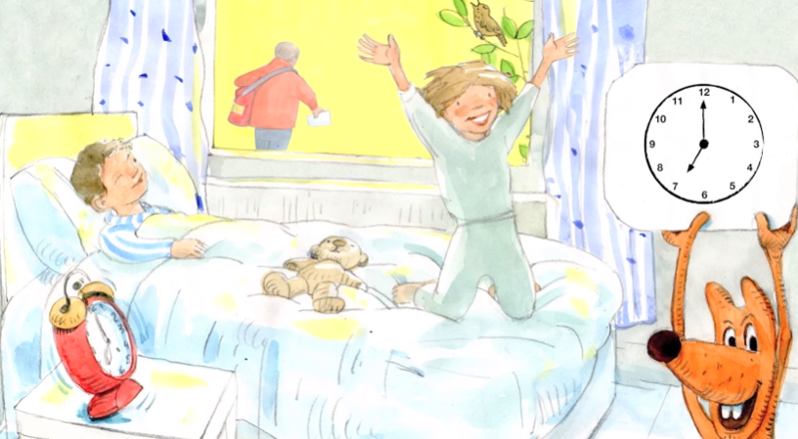
It’s time to get up. The hands on the clock say 7 o’clock.

Slide 4
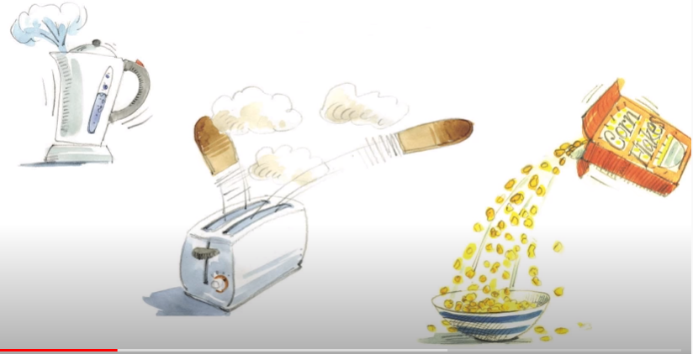
Kettle’s boiling, cornflakes pouring, toast is popping. What’s the time Mr wolf?

Slide 5
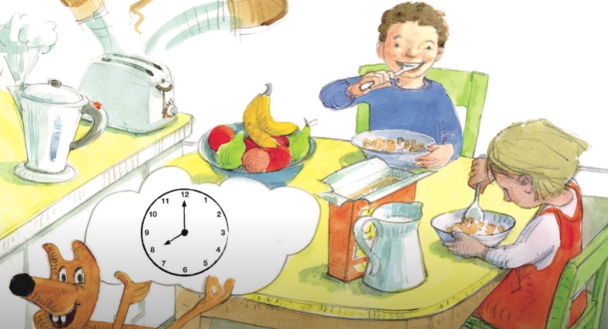
It’s breakfast time. The hands on the clock say 8 o’clock.

Slide 6
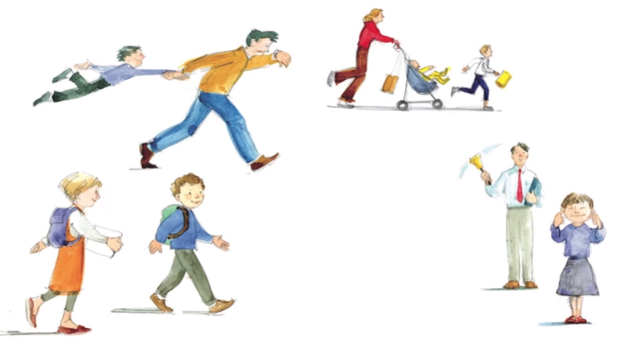
Parents hurrying, children scurrying, school bell thundering. What’s the time Mr wolf?

Slide 7
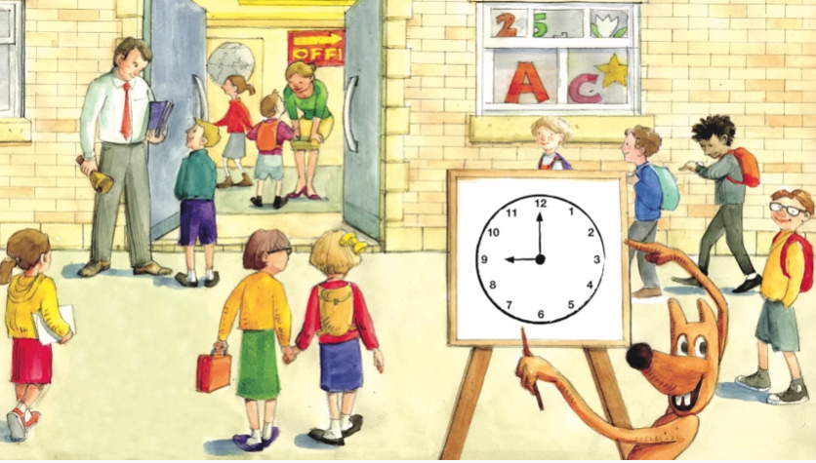
It’s time for school. The hands on the clock say 9 o’clock.

Slide 8
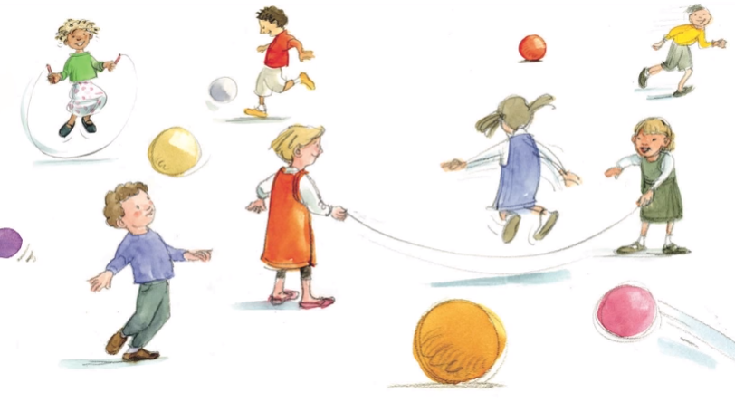
Girls are skipping, boys are chasing, footballs are whizzing. What’s the time Mr wolf?

Slide 9
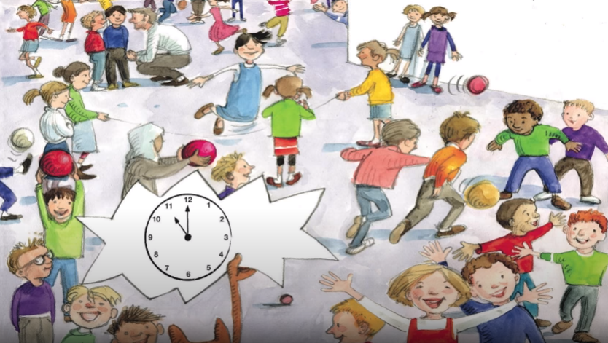
It’s playtime. The hands on the clock say 11 o’clock.

Slide 10
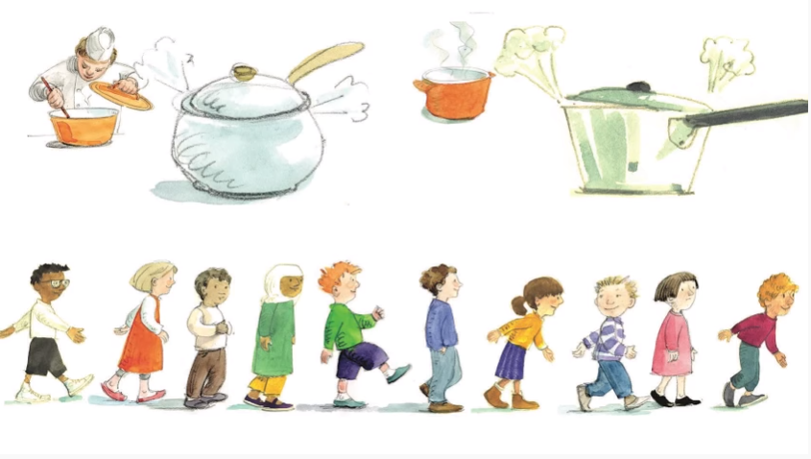
Saucepans simmering, tummy's rumbling, I’m hungry! What’s the time Mr wolf?

Slide 11
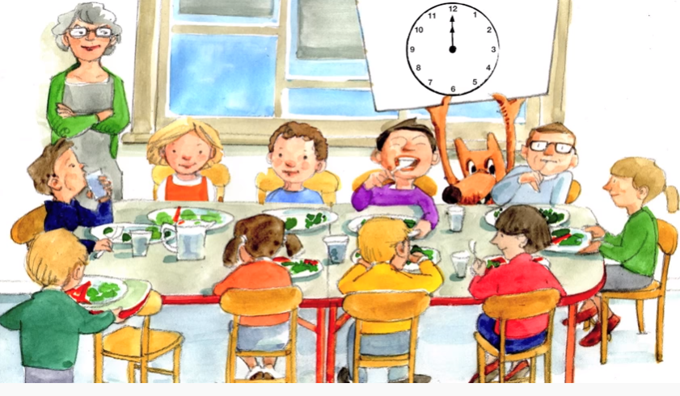
It’s lunchtime. The hands on the clock say 12 o’clock.

Slide 12
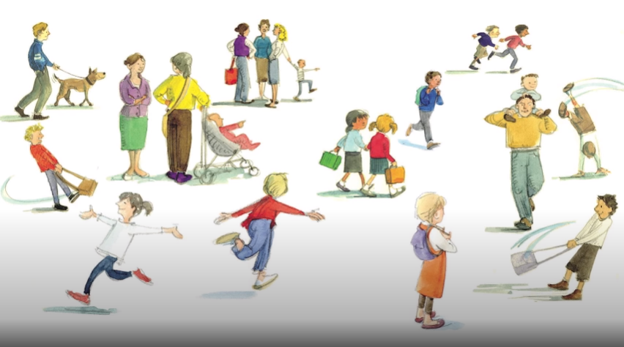
Mums and dads are gathering, school bags clattering, children scattering. What’s the time Mr wolf?

Slide 13
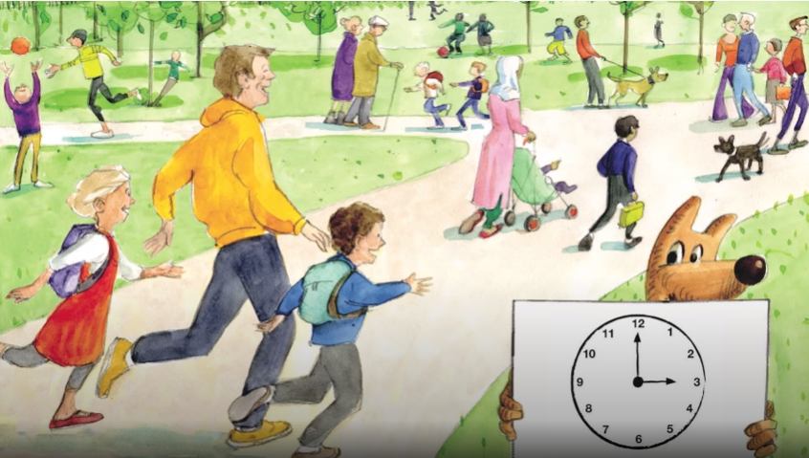
It’s time to go home. The hands on the clock say 3 o’clock.

Slide 14
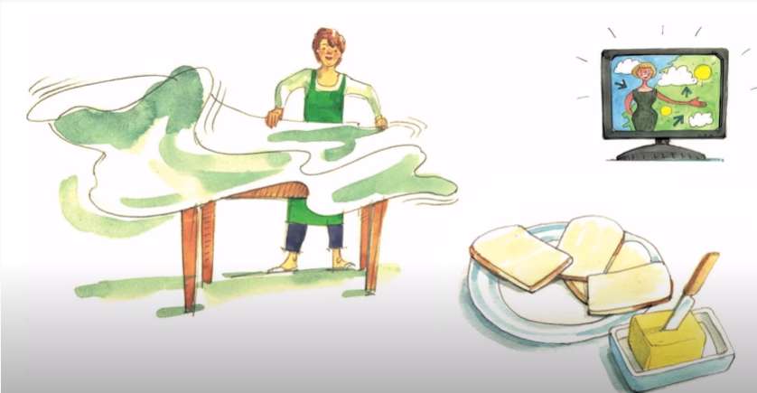
Table cloth fluttering, bread is buttering, TV muttering. What’s the time Mr wolf?

Slide 15
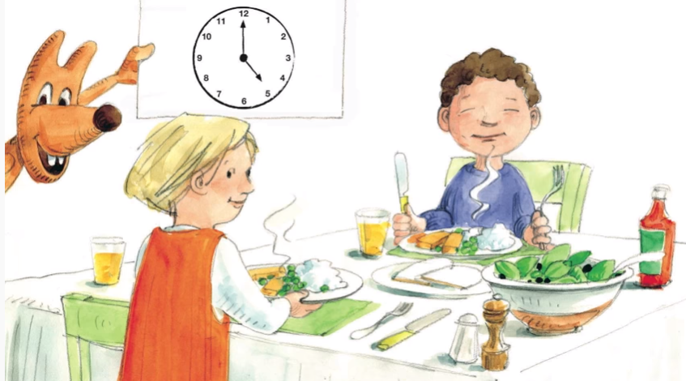
It’s tea time. The hands on the clock say 5 o’clock.

Slide 16
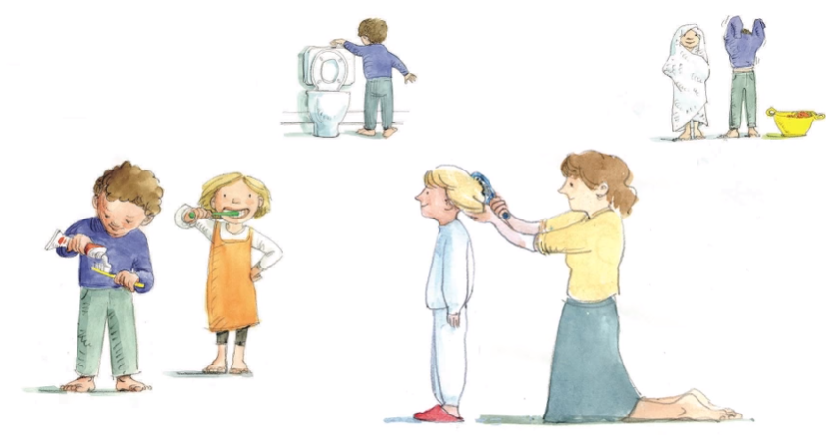
Teeth are scrubbing, towels are rubbing, hair is brushing. What’s the time Mr wolf?

Slide 17
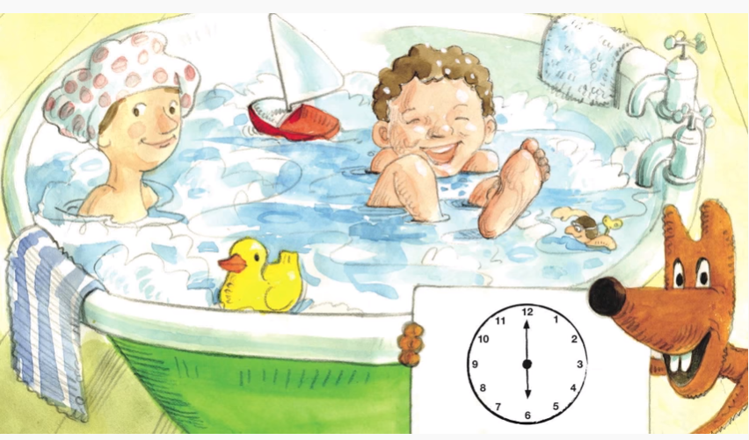
It’s bath time. The hands on the clock say 6 o’clock.

Slide 18
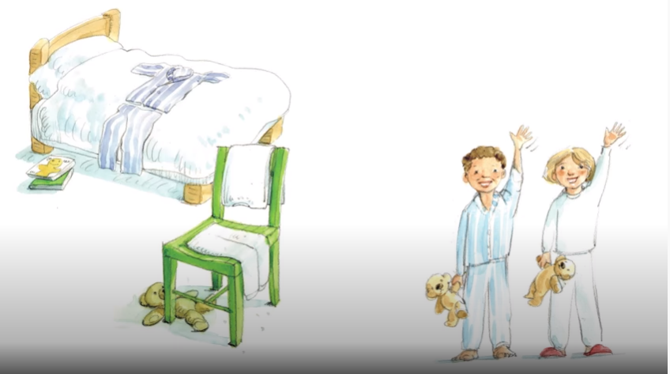
Pyjamas are ready, where’s my teddy? Goodnight everybody. What’s the time Mr wolf?

Slide 19
It’s bedtime. Goodnight, sleep tight.

