Slide 1



Learning intention: to know different word types including verbs
Nouns and verbs are types of word.
Nouns are people, places or things. Verbs are something you do.
Which is a noun?
Which is a verb?
run dog

Slide 2
Dog is a noun because it is a person, place or thing.
✓
run dog

Slide 3
Run is a verb because it is something we can do.
✓
run dog

Slide 4
Examples:
Nouns Verbs
dog run
man skip
boy sleep
Newcastle eat
Miss Thom talk
pen find

Slide 5
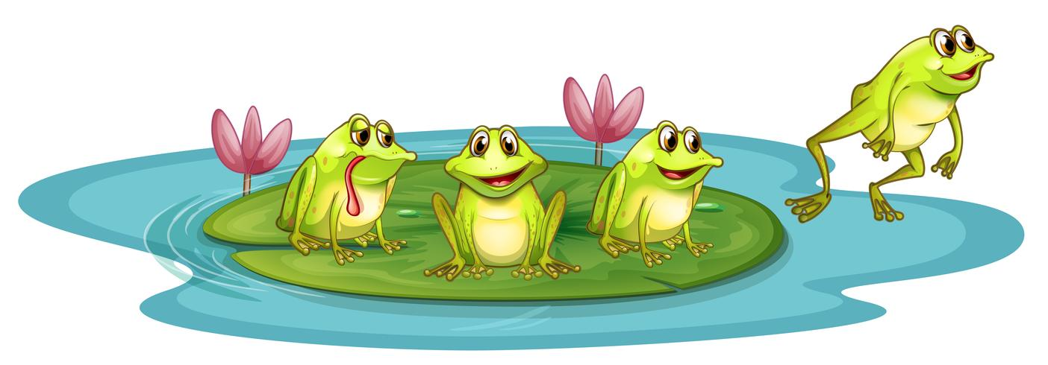
Which word is the noun and which is the verb in this sentence?
The frog can jump off.

Slide 6
The frog can jump off.
Frog is the noun because that is the name of the animal. Jump is the verb because that is what the frog is doing.
noun verb

Slide 7
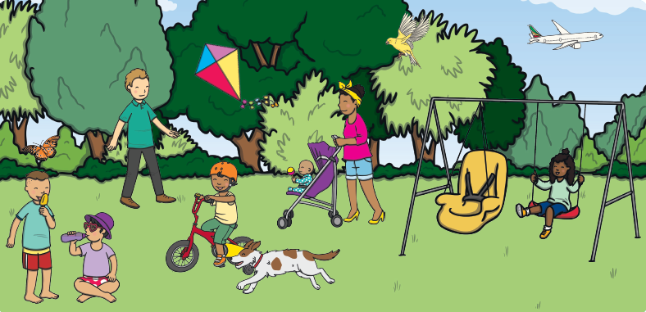
What nouns can you think of to go with this picture? What verbs can you think of?

Slide 8
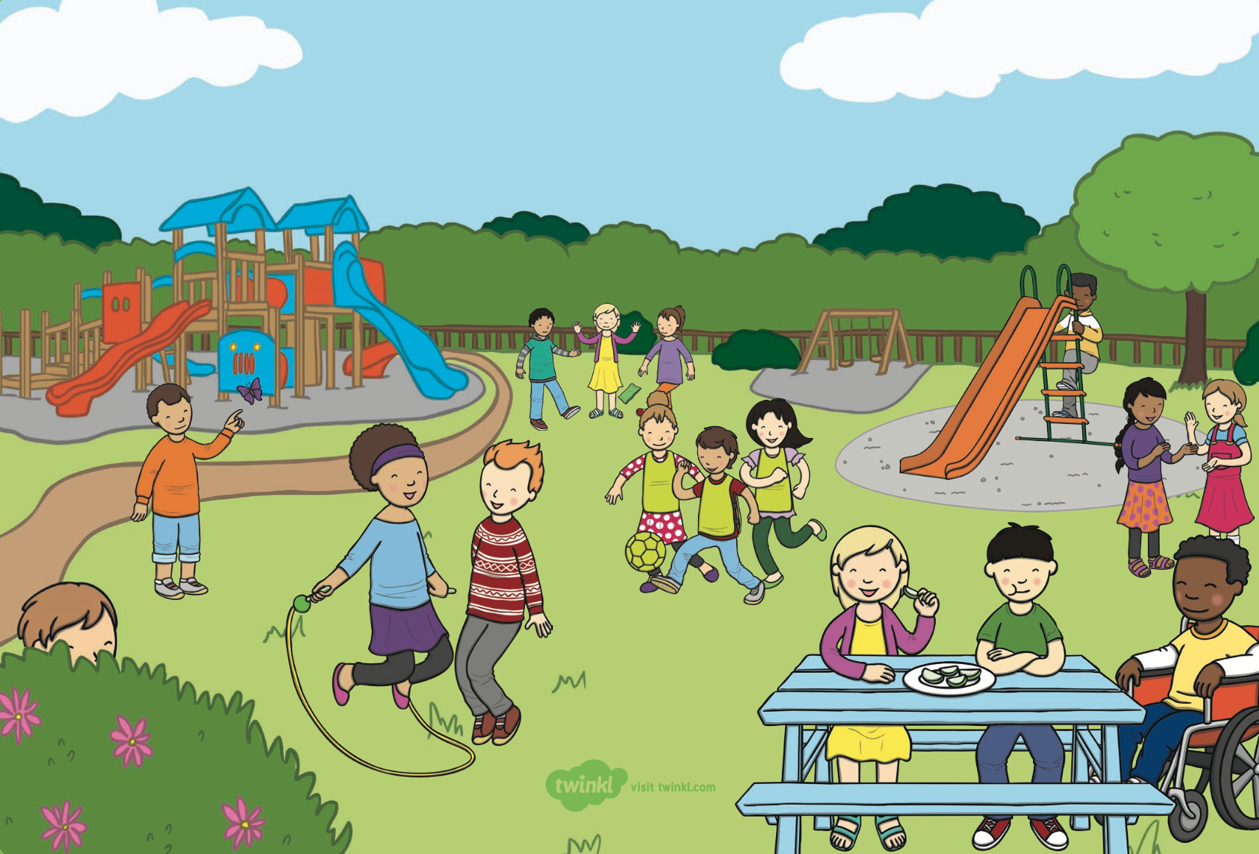
What nouns can you think of to go with this picture? What verbs can you think of?

