Slide 1
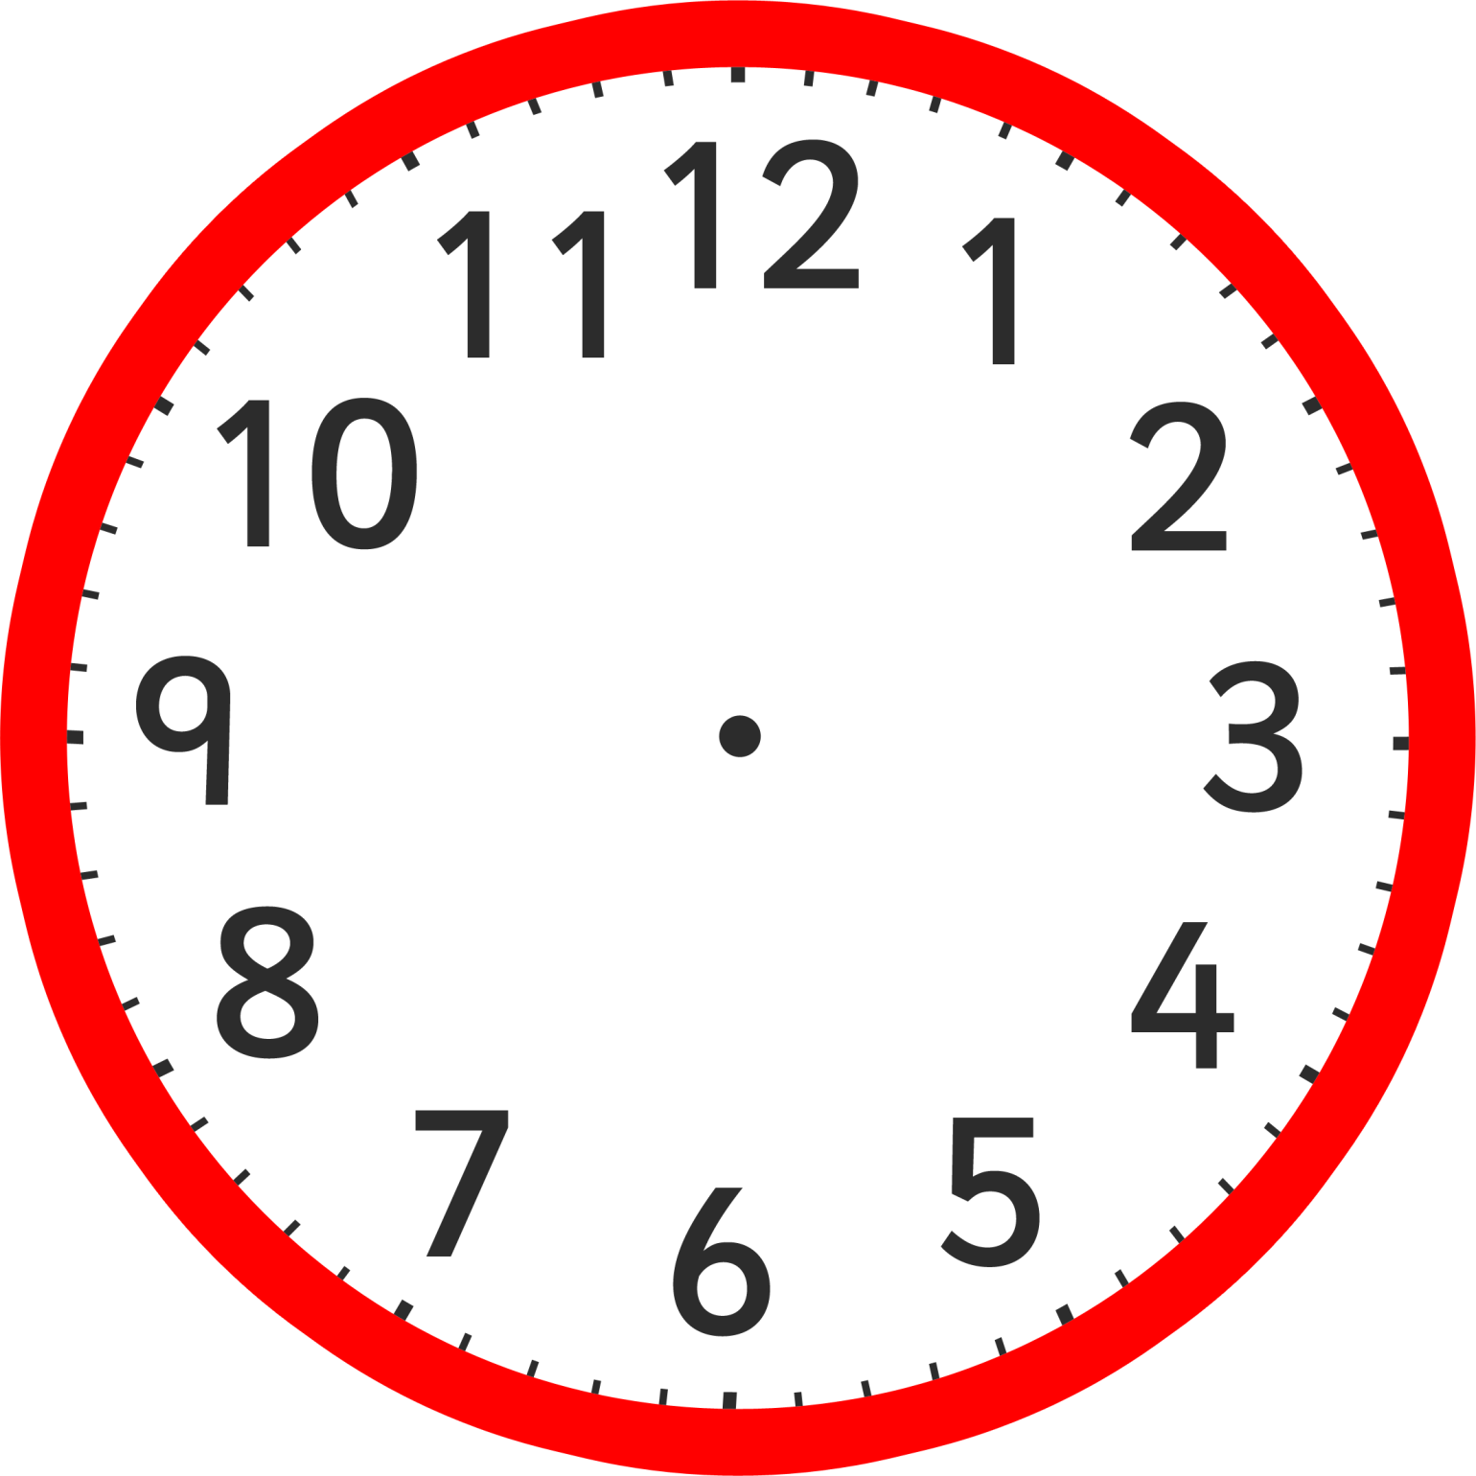
5
Telling the
Time in Blocks
Of 5 Minutes

Slide 2
Quiz
How many seconds are there in a minute?
How many minutes are there in an hour?
How many minutes are there in quarter of an hour?
How many minutes are there in half an hour?
How many months in a year?
How many days are there in a year?
How many days are there in a leap year?

Slide 3
Questions
There are 60 seconds in a minute?
There are 60 minutes in an hour?
There are 15 minutes in quarter of an hour?
There are 30 minutes are there in half an hour?
There are 12 months in a year?
There are 365 days in a year?
There are 366 days in a leap year?

Slide 4
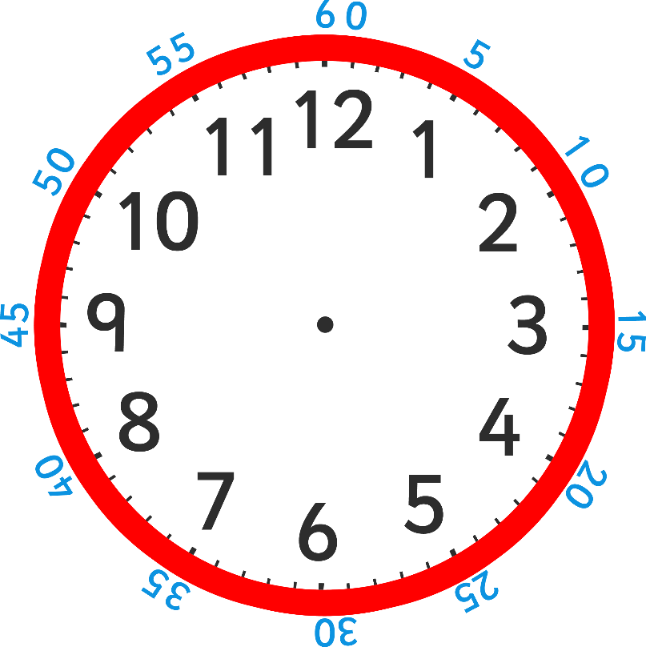
This clock shows the hours in black on the inside, and the minutes in
blue around the outside (most clocks don’t show the minutes).
Can you see a pattern between the hours on the inside and the
minutes on the outside?

Slide 5
How many minutes past does the blue hand show?
Does it show 2 minutes past or 10 minutes past?

Slide 6
Black numbers are the hours and blue numbers are the minutes.
We read the time as ‘minutes past or to the hour’.
Think of it as ‘blue minutes past or to black’.
The time is 10 minutes past 12.

Slide 7
How many minutes past is the minute hand pointing to?
What time does the clock show?
(hint – blue past black )

Slide 8
The time is 20 minutes past 1.

Slide 9
What time is this clock showing us?

Slide 10
The time is 25 minutes past 3.

Slide 11
How many minutes past does the minute hand show?
What is the proper name for this?

Slide 12
The clock is showing quarter past 1.

Slide 13
How many minutes past is this clock showing?
What is the proper name for this time?
Where is the hour hand pointing to?

Slide 14
The clock is showing half past 10.

