Slide 1
Microhabitats.
We will learn what a microhabitat is.
Vocabulary:
Habitat
Microhabitat.
Minibeast
Think about your previous learning:
What is a habitat?
Which habitats can you remember?

Slide 2
Many different mini-beasts live in many different microhabitats.
They are suited to live in that microhabitat because they can find the food, water and shelter they need.
Mini-beasts help to keep the microhabitat healthy.
Can you think of the names of 6 mini-beasts?

Slide 3
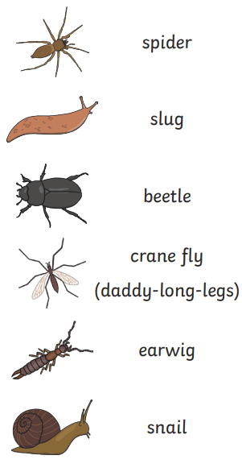
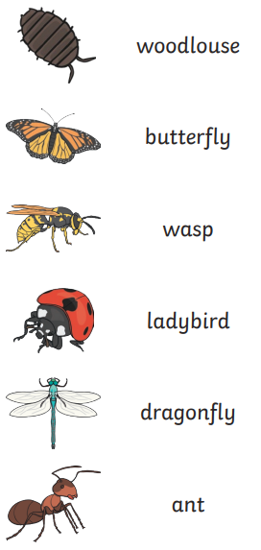
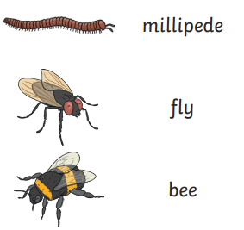
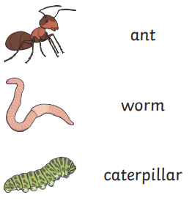

Slide 4
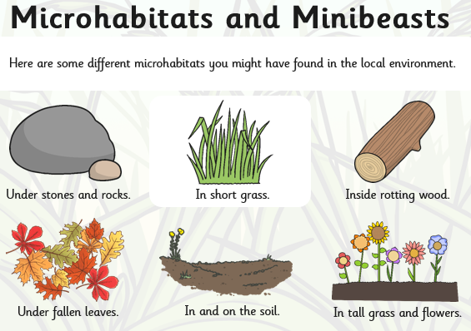

Slide 5
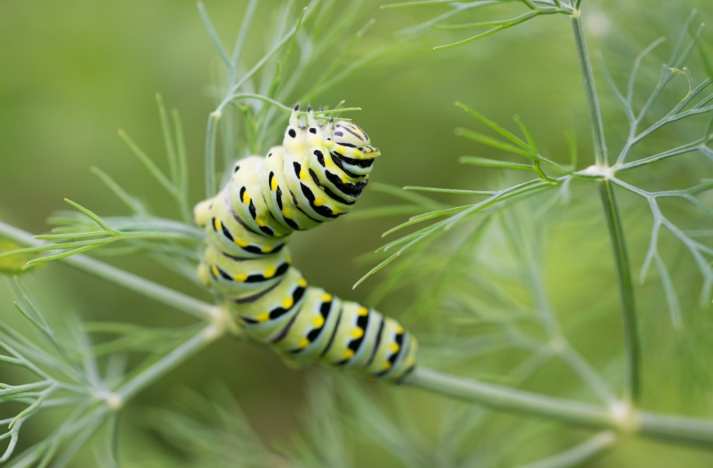
Caterpillars
Think about what you already know about caterpillars. Where would you find them? What do they eat?
Caterpillars like to live on top and underneath leaves.
This is so they can use their camouflage and blend into the leaf.
This helps protect them so they can not be seen by predators.
The caterpillars can then eat the leaves.
Vocabulary:
Camouflage- a way of hiding so it looks like the things around it. The caterpillar blends into the leaf because it is a similar colour.
Predator- An animal that hunts other animals for food.

Slide 6
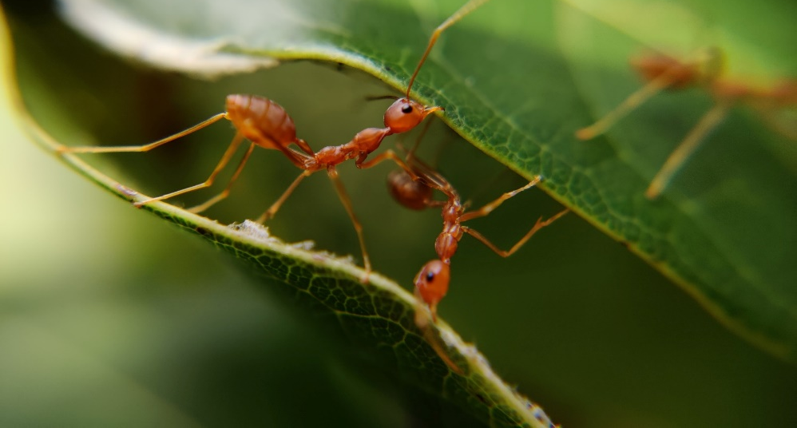
Ants
Think about what you already know about ants. Where would you find them? What do they eat?
Ants mostly live underground.
They live in big families.
There are lots of insects to eat underground.
Ants don’t have ears.
Ants "hear" by feeling vibrations in the ground through their feet.

Slide 7
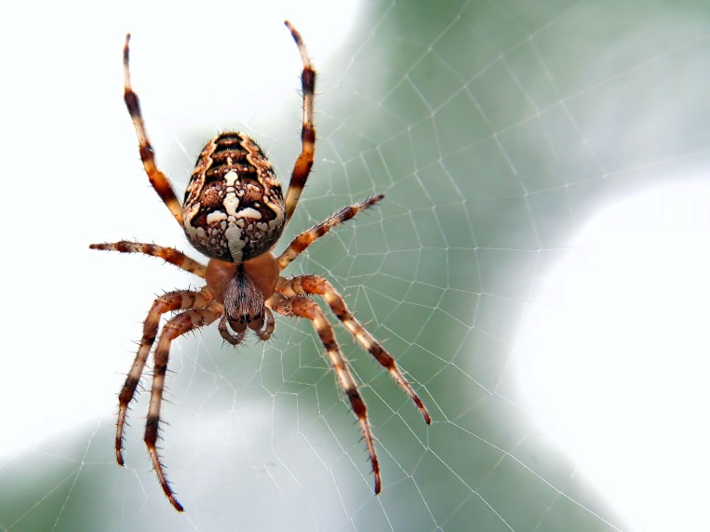
Spider
Think about what you already know about spiders. Where would you find them? What do they eat?
Spiders are able to live just about anywhere.
They do well in all types of habitats but they do have to find shelter when the weather gets colder.
Their body colours help them blend in well to their surroundings.
Spiders build webs to catch small insects to eat

Slide 8
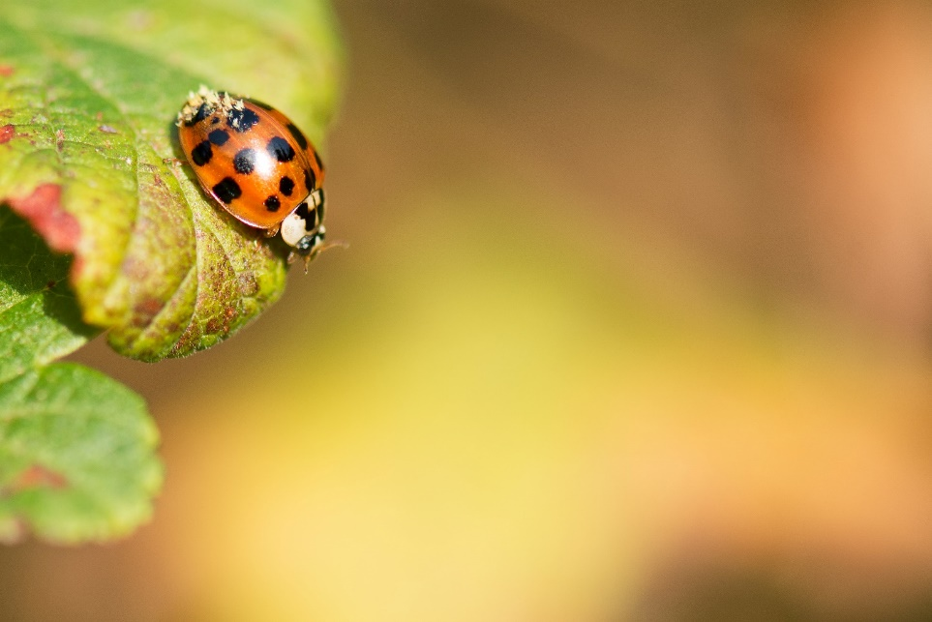
Ladybird
Think about what you already know about ladybirds. Where would you find them? What do they eat?
During the summer, ladybirds live in branches and flowers.
When the weather gets colder they find protective hiding places, such as tree stumps or cracks in wood. This then becomes a place to hibernate–at the base of a tree, under a fallen tree, or even under a rock.
They crawl under leaves to protect themselves from the winter cold.
When hibernating ladybirds huddle together to keep warm.

Slide 9
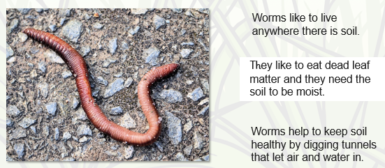
Worms

Slide 10
Task:
Think about what you have learnt this lesson.
What is a habitat?
What is a microhabitat?
What does camouflage mean?
Why do caterpillars live underneath leaves?
Where do ants live?
True or false? Ants hear with their feet.
True or false? A spider prefers an underground habitat.
Do spiders camouflage themselves?
Do worms prefer dry areas?

