Slide 1
Today we are reading…..
A mouse in the house

Slide 2
How to find the book:
Go to the Oxford Owl website.
Login using your username and password given to you for your account.
Press on eBooks at the top.
Click on Read Write Inc. eBook library.
Choose…A mouse in the house. ( yellow book )
Click on the arrow to open the book, ready to read.

Slide 3
Story Green Words

Slide 4
Red words

Slide 5
Have a think…..
Do you know the meaning of these words?
spout
water feeder
scoop
amount
pounce
proud

Slide 6
spout
water feeder
scoop
amount
pounce
proud
………… a pipe
……..something that holds water for the mouse to drink
……..use a spoon to get something out
……..how much there is of something
….. jump
……...pleased to have something special

Slide 7
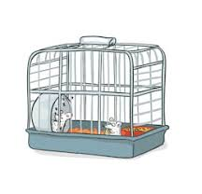
Page 9
Question: Where does a mouse live?

Slide 8
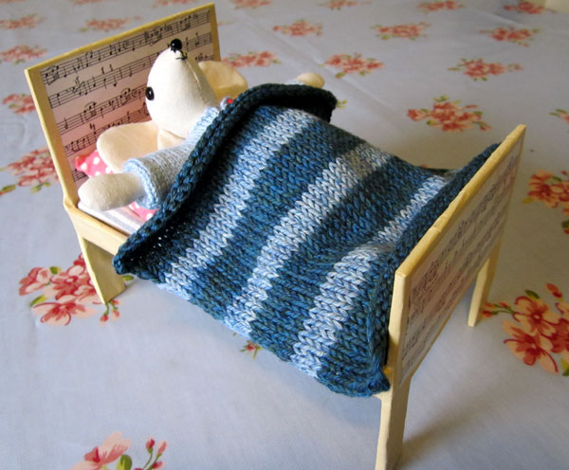
Page 10
Question: Where does a mouse sleep?

Slide 9
Page 11
Question: How often should you clean out the mouse’s house?

Slide 10
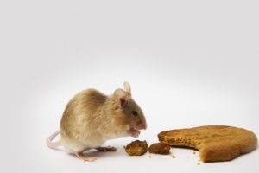
Page 13
Question: Where can you buy mouse food?

Slide 11
Page 13
Question: Where can you let mice run?

Slide 12
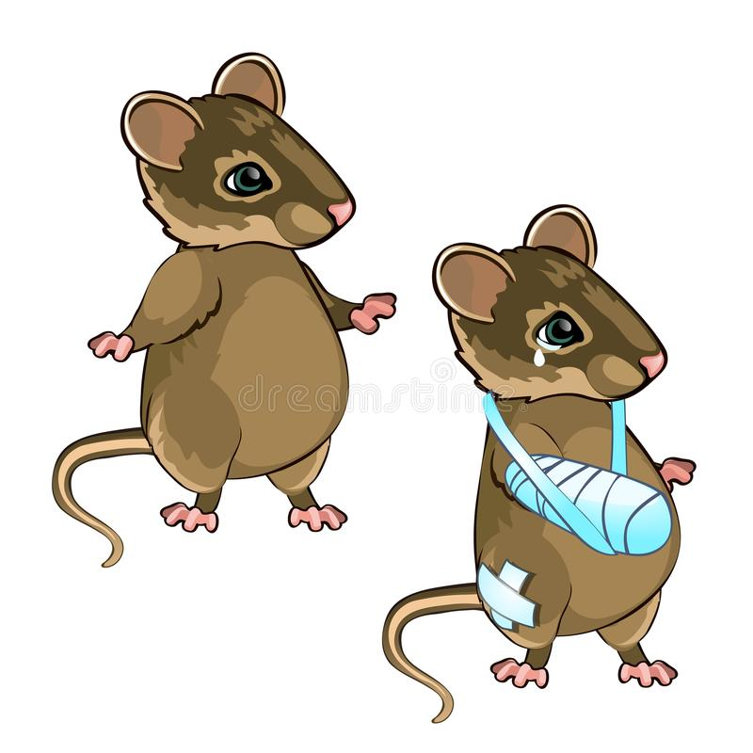
Page 15
Question: Think of three ways that a mouse might get hurt.

Slide 13
Well done!!

