Slide 1
Hello girls and boys we are going to look at number 2

Slide 2
I am thinking of a number and its on top of my tongue. What can it be?

Slide 3
2

Slide 4
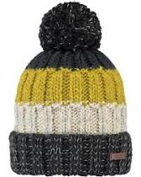
Can you tell someone how many hats you can see?

Slide 5
Yes you are right. There is 2 hats
1
2

Slide 6
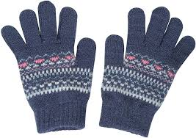
Can you tell someone how many gloves you can see?

Slide 7
Yes that’s right you can see 2 gloves.
1
2

Slide 8
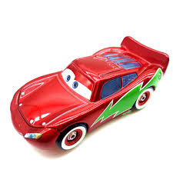
Can you tell someone how many cars you can see?

Slide 9
Yes that’s right you can see 2 cars.
1 2

Slide 10
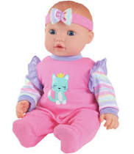
Can you tell someone how many dolls you can see?

Slide 11
Yes that’s right you can see 2 dolls.
1 2

Slide 12
This is great work boys and girls as you have been learning the number 2. Well done.

Slide 13
1 2
. . .

