Slide 1
Rhyming words in poetry

Slide 2
The Highway Man
In the poem ‘The Highway Man’, there are lots of rhyming words (words that sound the same).
Some are rhyming couplets, where the rhyme comes at the end of each line, one after the other.
e.g. The wind was a torrent of darkness among the gusty trees,
The moon was a ghostly galleon tossed upon cloudy seas
Trees and seas are rhyming words. They sound the same.

Slide 3
Some of the rhyming words are alternating. The rhyming word does not rhyme with the next line, it misses it and then rhymes with the line after that.
E.g. Yet, if they chase me quickly, and follow me through the day,
Then look for me by moonlight, watch for me by moonlight,
I'll come to you by moonlight, though they will bar the way.
Day and way are the rhyming words in this part of the poem.

Slide 4
Rhyming words
I am going to give you some words from the Highway man poem. You need to collect as many rhyming words as you can that rhyme with the given words.
Use the picture and the table on the next slide to help you.

Slide 5
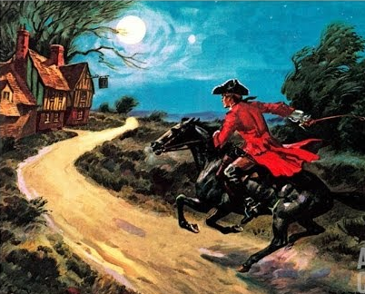
dark | moon | star | man | howl | shot

