Slide 1
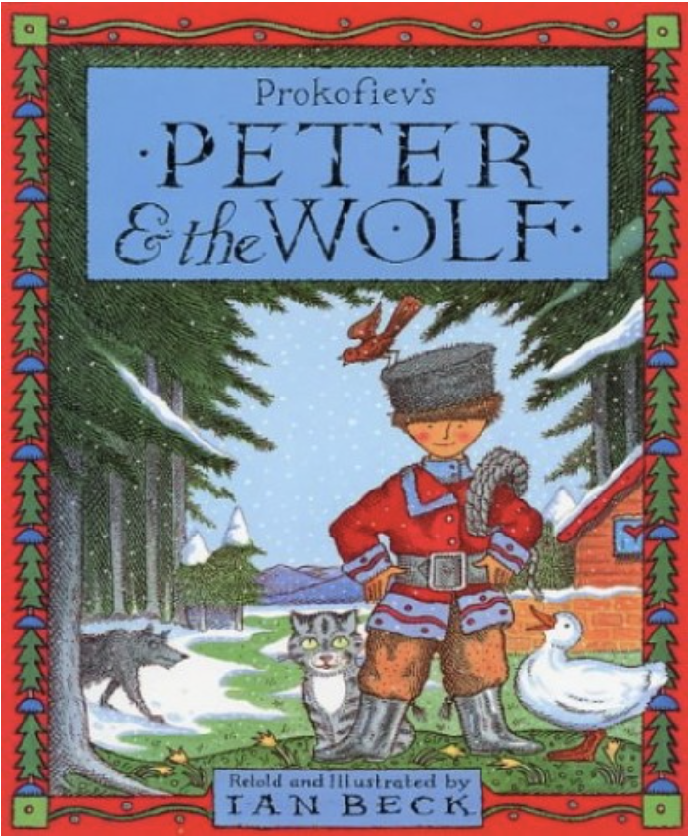
What can you remember about Peter and the Wolf?
Notes:
Before we look at the middle of the story, what can you remember about Peter and the Wolf?

Slide 2
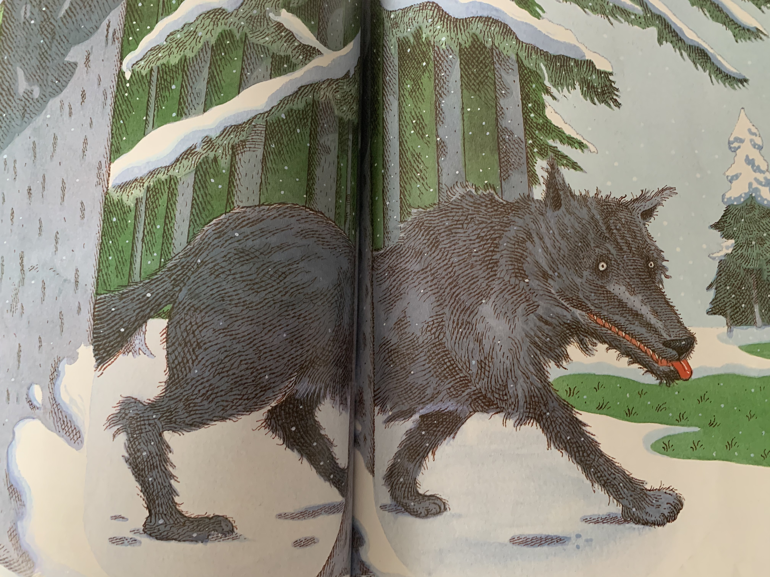
Quick prediction – what will happen next?
Notes:
Quick prediction – what is going to happen next?

Slide 3
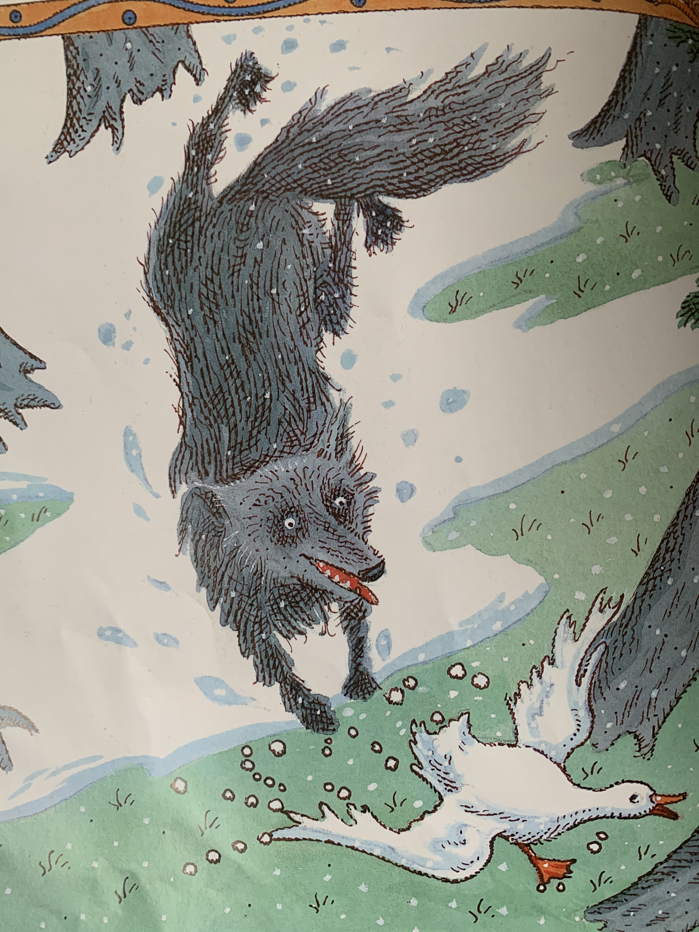
Notes:
In a flash, the cat climbed the tree. The duck quacked and flapped and jumped out of the pond. But no matter how hard the duck ran, she couldn’t escape the wolf. With every step, he was getting nearer and nearer…

Slide 4
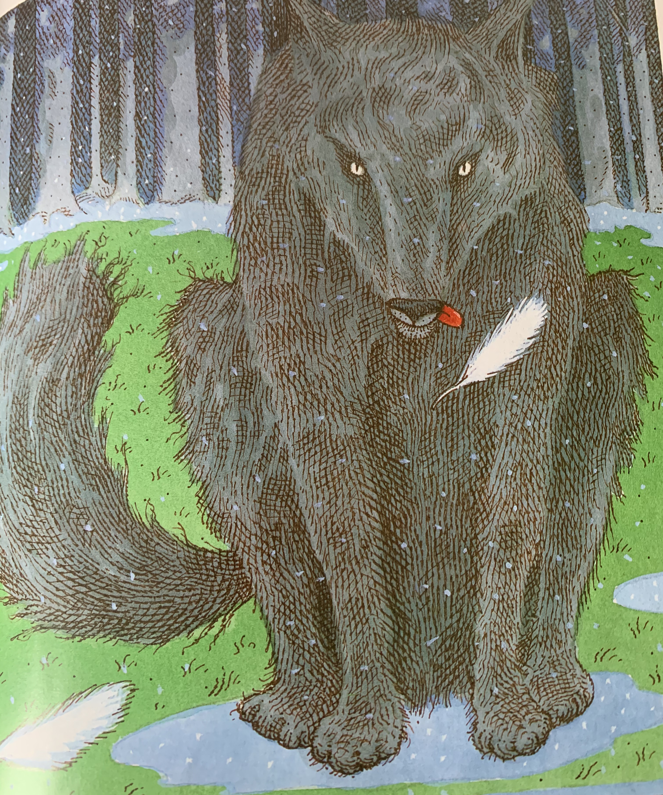

Slide 5
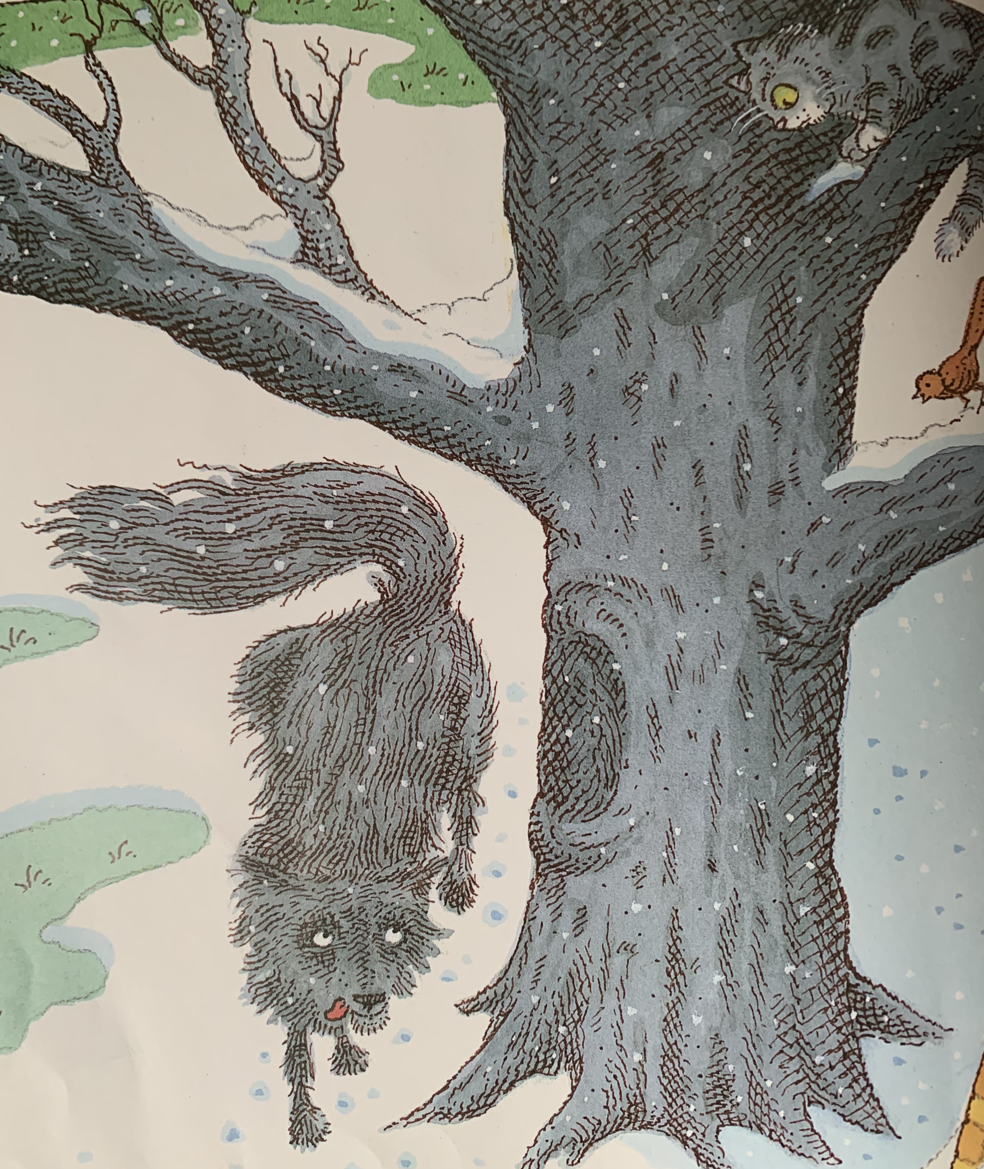

Slide 6
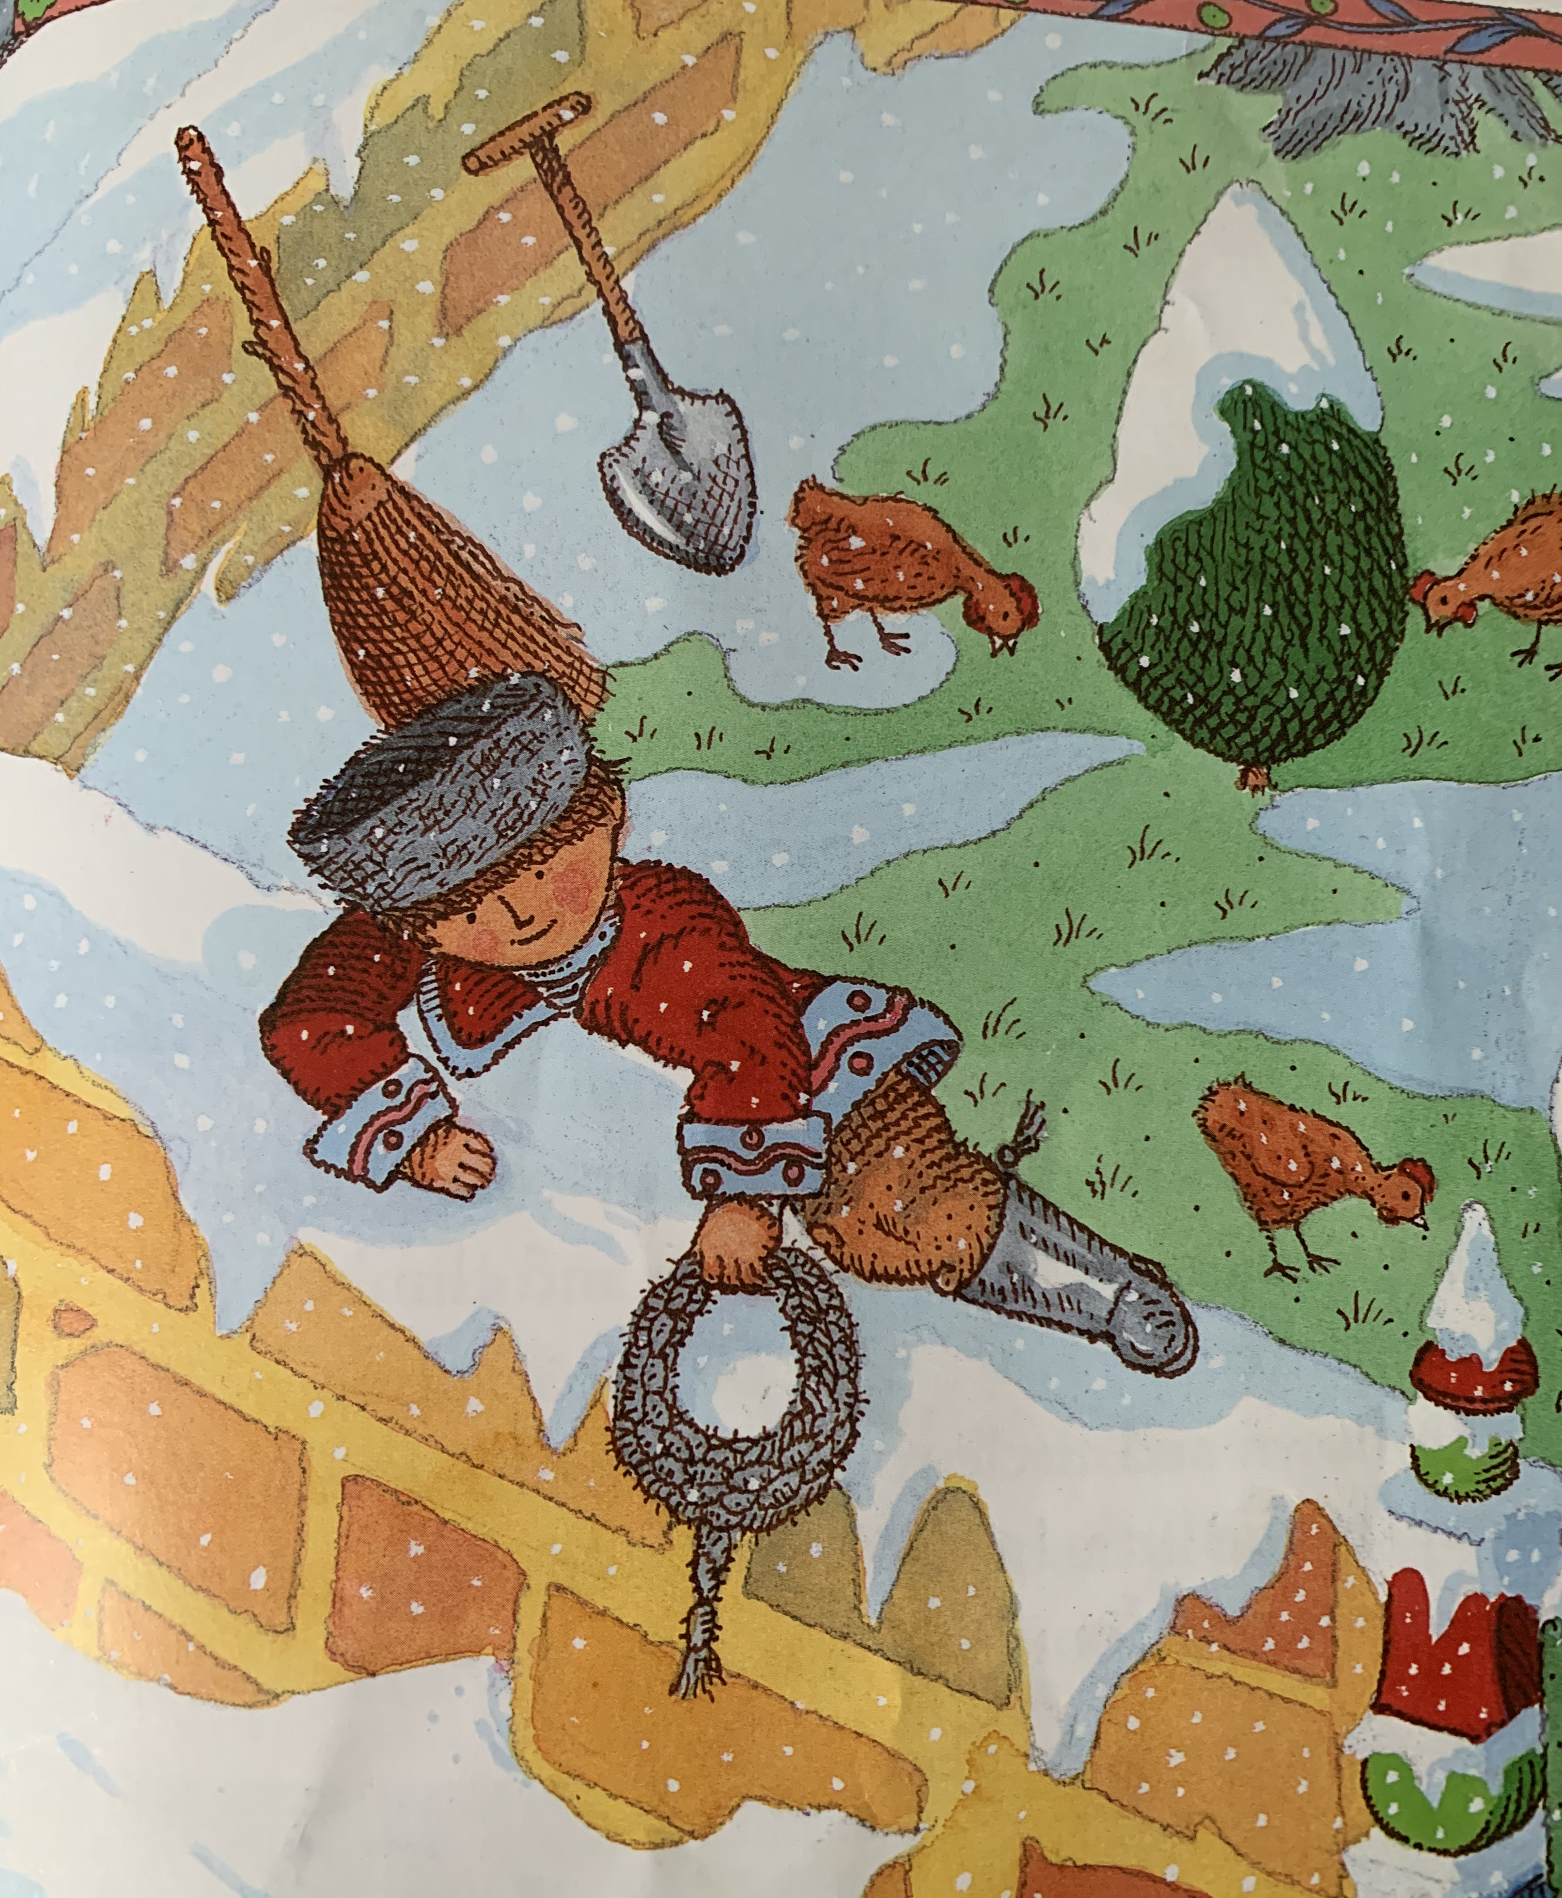

Slide 7
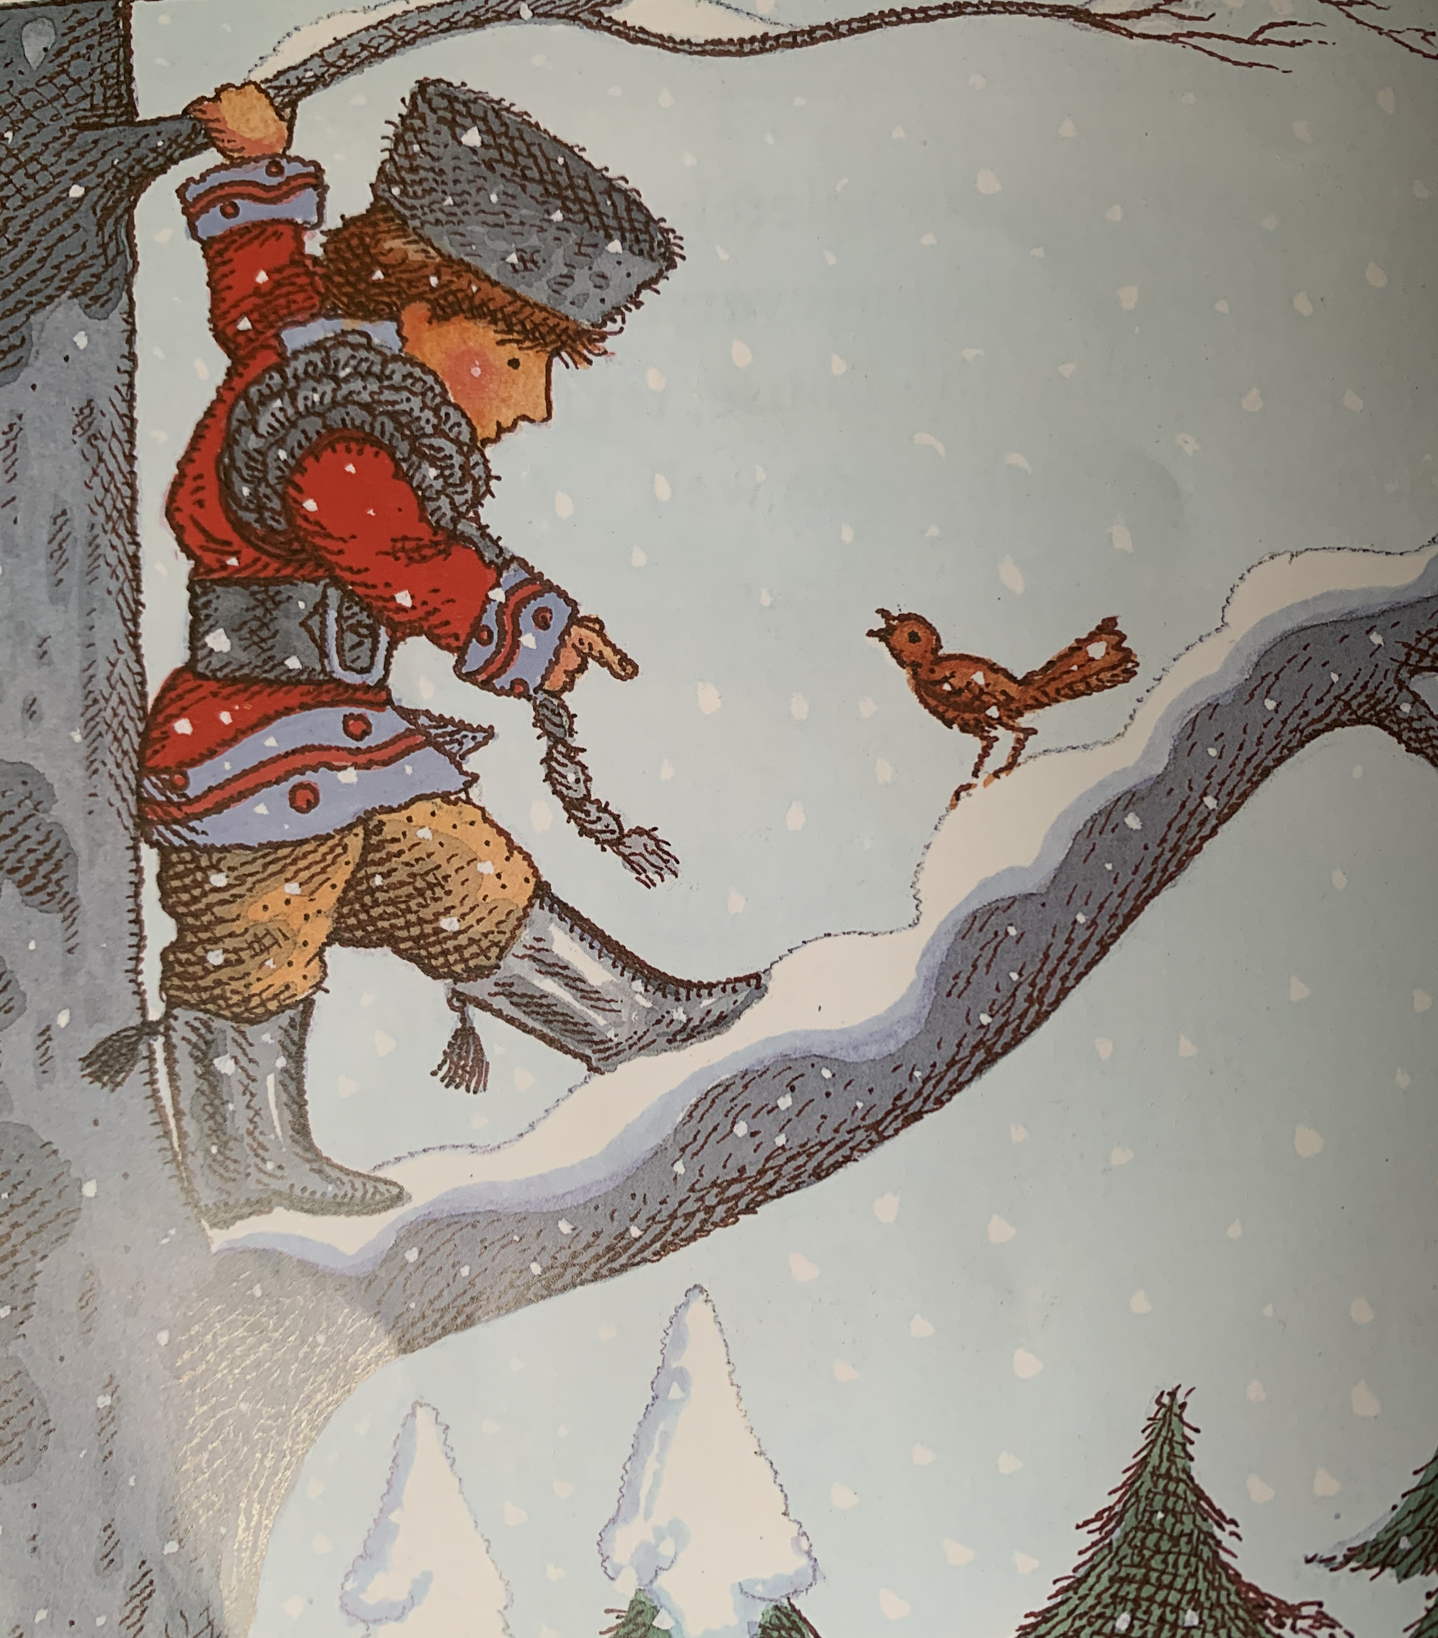

Slide 8
Where is the duck?
Do you like the wolf? Why or why not?
Why does Peter have a rope?
What will happen to the wolf?
Notes:
Where is the duck? Do you like the wolf? Why or why not? Why does Peter have a rope? What will happen to the wolf?

Slide 9
Commentary:
Slide 1: Before we look at the middle of the story, what can you remember about Peter and the Wolf? Slide 2: Quick prediction – what is going to happen next? Slide 3: In a flash, the cat climbed the tree. The duck quacked and flapped and jumped out of the pond. But no matter how hard the duck ran, she couldn’t escape the wolf. With every step, he was getting nearer and nearer…
Slide 4: Finally, he caught her! And with one huge gulp, swallowed her! Slide 5: Now this is how things were: the cat was sitting on one branch of the tree and the little bird on another (not too close to the cat) while the wold walked round and round the tree, looking up at them with greedy eyes.
Slide 6: All this time, Peter, completely fearless, stood behind the closed gate, watching everything that was going on. He ran quickly into the house, fetched a strong rope and climbed the high stone wall. Slide 7: One of the branches of the tree around which the wolf was prowling stretched up over the wall. Peter grabbed hold of the branch and climbed on to the tree. “Fly down and circle round the wolf’s head,” he said to the little bird. “Only watch out that he doesn’t catch you!”
Slide 8: Where is the duck? Do you like the wolf? Why or why not? Why does Peter have a rope? What will happen to the wolf?

