Slide 1
Learning Intention – To learn about the South West of England

Slide 2
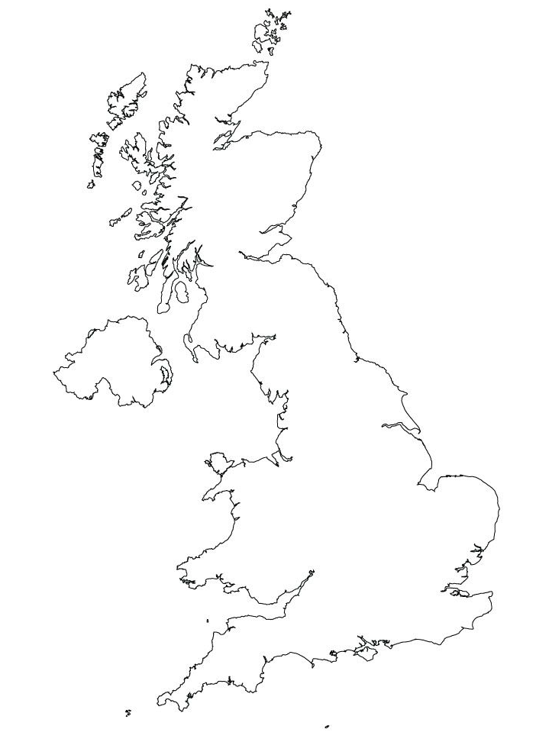
Cornwall
We are going to be learning about Cornwall over the next few lesson, an area in the South West of England.
Can you find Cornwall on a map or using the internet with websites like google Earth.

Slide 3
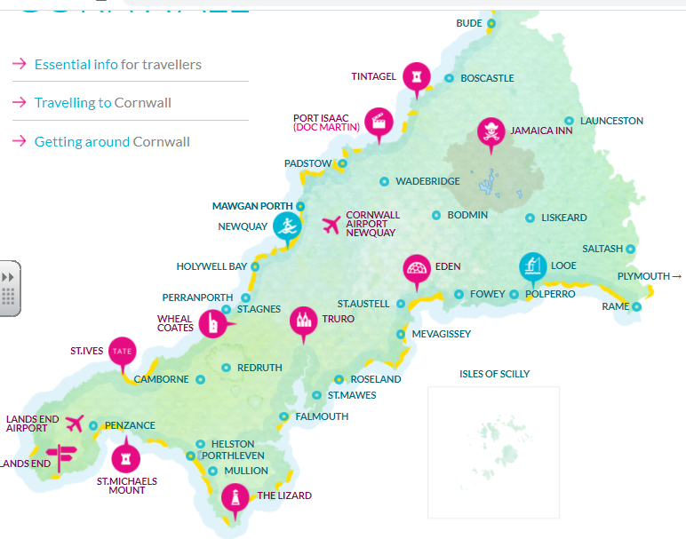
Cornwall
Cornwall is a beautiful part of England, with many different things to see and do. Have a look at this map, what do you think the symbols mean?

Slide 4
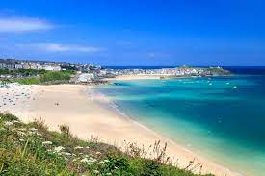
Why do people go there?
One of the main reasons that people go to visit Cornwall is for its warm, sunny beaches with great surfing waves.
Do you like the beach?

Slide 5
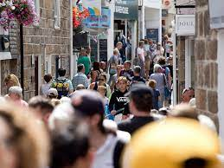
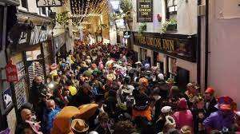
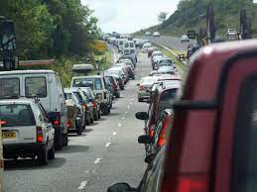
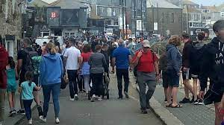
The problem with this warm climate.
Cornwall is a very attractive place to visit but this brings with it a problem, too many people. Many of the towns in Cornwall are quite small so they can’t cope with lots of people.

Slide 6
Your task today.
I want you to complete a tourism study of Cornwall. I want to think about three reasons why people want go to Cornwall then tell me the problem with all these people coming to visit.
There is space on the next slide to record your ideas.

Slide 7
Cornwall Tourism Study
Three reasons why people visit Cornwall:
1 ……………………………………………………………………………………………………..
2 ……………………………………………………………………………………………………..
3 ……………………………………………………………………………………………………..
What is the problem with all these extra people coming to visit?
……………………………………………………………………………………………………..
……………………………………………………………………………………………………..

