Slide 1
Set 2 Sounds
ou
Notes:
Lets practise our set 2 sounds, today;’s sound is ou

Slide 2
Notes:
What is going on here? That’s right, they shout it out

Slide 3
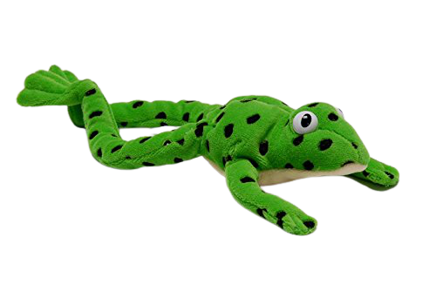
Notes:
Lets fred talk! Sh-ou-t, shout, ou-t, out, m-ou-th, mouth

Slide 4
Notes:
This is our new sound ou. It has 2 letters but 1 sound, it’s a special friend

Slide 5
Notes:
Lets practice ou. My turn first…..

Slide 6
Notes:
Now can you practice ou? Off you go

Slide 7
out
_
.
shout
_
_
.
round
_
.
.
.
Notes:
Lets read some green words! First lets use fred talk then read the word

Slide 8
Notes:
Let’s practice writing our sound - ou

Slide 9
Notes:
Let’s practice writing words with the ou sound in them loud found shout

