Slide 1
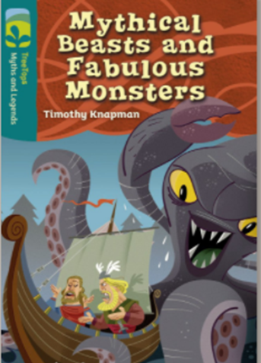
Today you are going to read a story from this book.

Slide 2
Here’s how to find the book
Log in to Oxford Owl using the details provided in your learning pack
Click on ‘Read Oxford Owl eBook library’
Type the name of the book in the box and click to search
Scroll down until you find the book
Click on

Slide 3
Before you start reading, have a look at the front cover. What might you discover inside? Have you come across any mythical beasts or fabulous monsters in other stories?
How does the blurb at the back of the book draw the readers attention? What is its purpose?

Slide 4
Why not share it with another person in your home so that you might be able to discuss some of the interesting parts! You never know they might enjoy it and it’s fun to read together!

Slide 6
Chapter 1
What season is it?
What impression do you get about the King from his name?
Find and write one sentence that tells you the Vikings were hungry?
Compare and write the differences between the brothers.

Slide 7
Chapter 2
Who are the main characters?
Which brother is more excited about going? Support your answer with evidence from the text.
Has the author used a variety of sentence structures?

Slide 8
Chapter 3
Find and write down as many adjectives as you can find that describe the Kraken.
Which character would you most likely want to be in this situation? Give your reasons.
How does the author encourage you to read the rest of the text?

Slide 9
Chapter 4
Summarise how Snorri and Halfdan became heroes.
Do you agree that both of them were heroes? Give reasons.
Explain how the relationship between the brothers has changed from the beginning of the story. Support your answer with evidence from the text.

Slide 10
If you wrote a story about a mythical creature or monster, what would it look like? Can you described it? Maybe draw a picture.
I hope you enjoyed reading this story.
How many stars would you give it?

