Slide 1

Learning intention: To solve division problems.

Slide 2
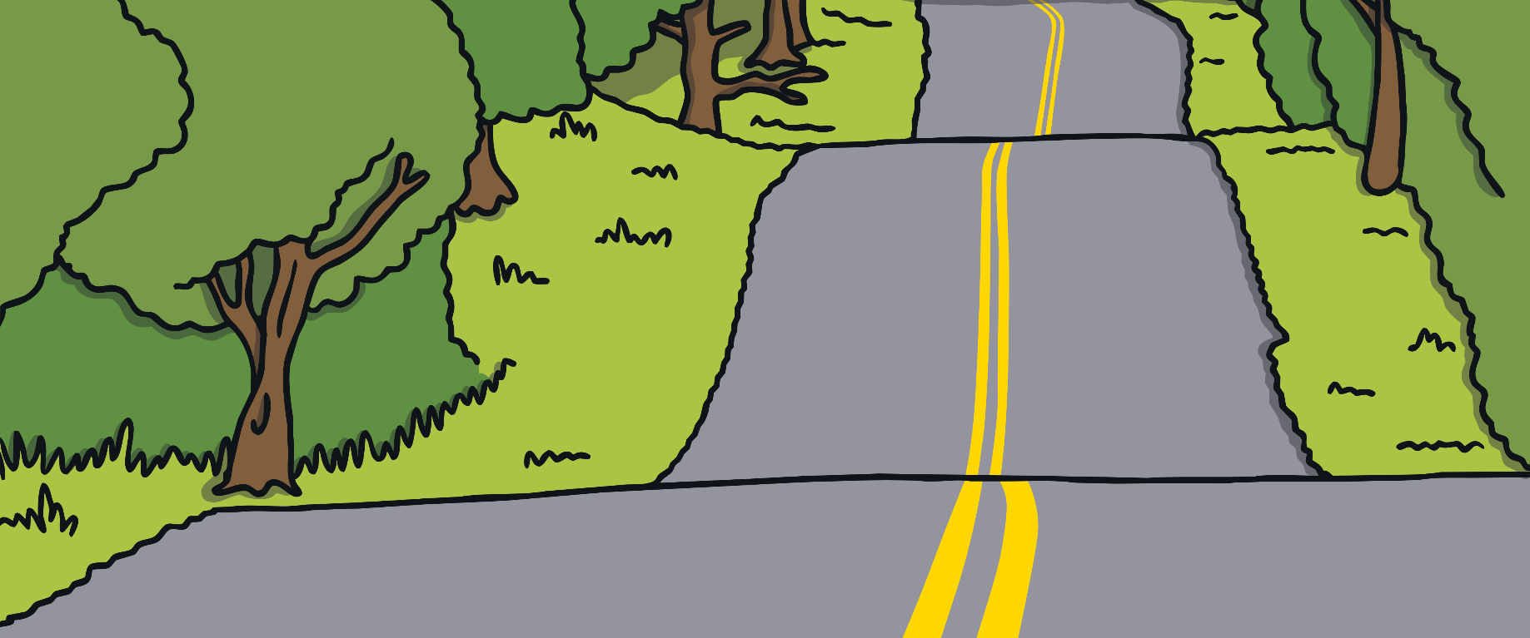



Class 2 are going on a school trip to the Woods.
Mrs Busfield has a problem!
The coach has broken down!
There are 35 children.
5 children can fit in each car.
Several parents have offered to drive, but how many cars does she need?
Can you help her?

Slide 3





There are 7 groups of 5 in 35.
I counted in 5s 7 times to get to 35.
I drew jumps on a number line.
+5
+5
+5
+5
+5
+5
+5
0
5
10
15
20
25
30
35
35 ÷ 5 = 7.
I drew a picture.
5
5
5
5
5
5
5

Slide 4
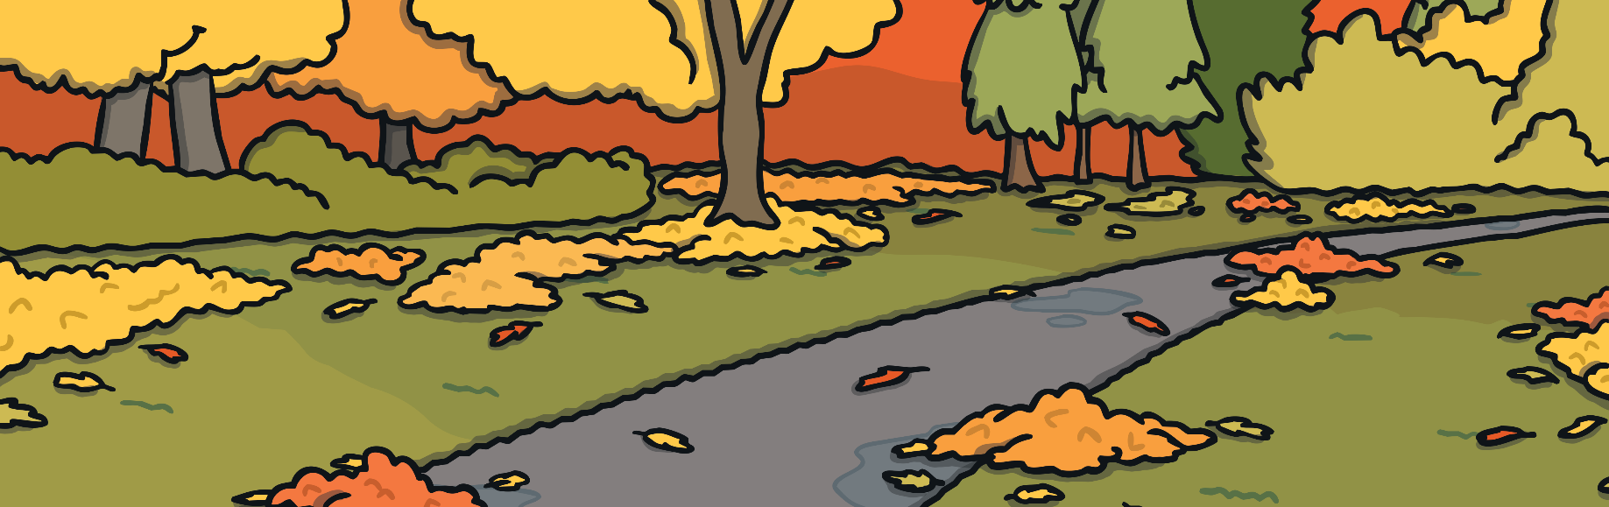

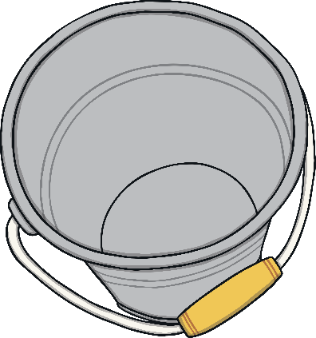
Buckets
Oh no, we nearly forgot the buckets!
We need to take 20 buckets for 10 children.
How many buckets do they need each?
How do you know?

Slide 5










Buckets
1 for each child
another for each child
0
1
2
3
4
5
6
7
8
9
10
11
12
13
14
15
16
17
18
19
20
10
10
There are 2 groups of 10 in 20.
20 ÷ 10 = 2

Slide 6

Twigs
I need you to chop some branches up for a game. Make them exactly 5cm long.
This branch is 60cm long. How many twigs do you think I can make from it?
Can you help Adam with his problem?

Slide 7
Twigs
60 is 12 groups of 5.
60 ÷ 5 = 12
+5
+5
+5
+5
+5
+5
+5
+5
+5
+5
+5
+5
0
5
10
15
20
25
30
35
40
45
50
55
60
60cm
5cm | 5cm | 5cm | 5cm | 5cm | 5cm | 5cm | 5cm | 5cm | 5cm | 5cm | 5cm

