Slide 1
Learning intention: To understand why a microhabitat is suited to a minibeast.

Slide 2
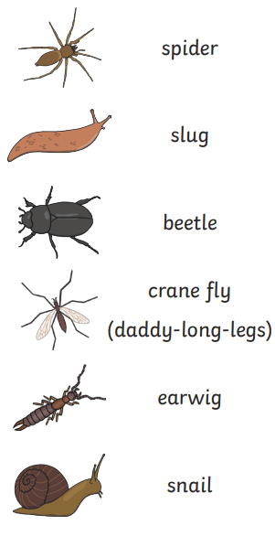
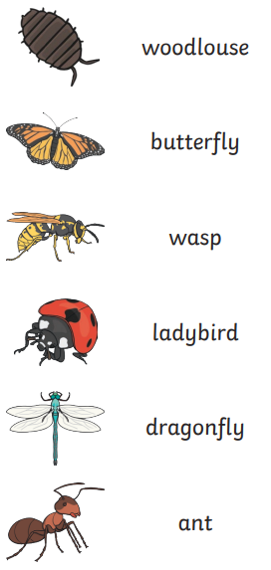
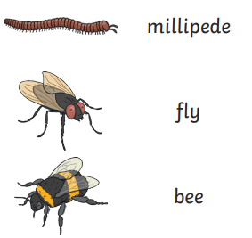
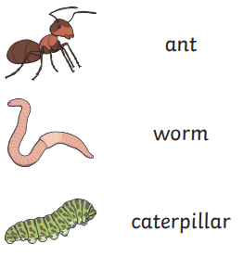
Remind yourself about some minibeasts and think about where you might find them.
Your might want to look back at the work we did last week.

Slide 3
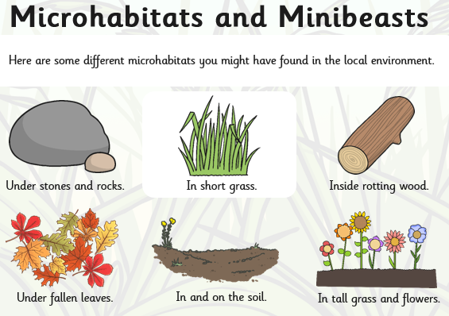

Slide 4
Use your knowledge of minibeasts and microhabitats to design your own bug house or bug hotel. We might be able to build these only when it is safe to do so at school.
These are some ideas for you.
Bug Hotel
If you have bricks or wood you could build a hotel with lots of floors.
Divide it into sections and stuff each with different natural materials for different minibeasts.
For example: dry leaves, twigs,dead grass, pine cones and bits of bark from trees. These will help make dry and warm spaces.
Good for: ladybirds, bees, woodlice and spiders.
Log pile lodge
Decaying wood is really important for some minibeasts.
Collect small logs, large sticks and pieces of rotting wood. Pile them up in a damp and shady area, then stuff some dead leaves into the space to make it cosy.
Good for: centipedes, woodlice and beetles who like to hide in decaying wood.

Slide 5
Pine cone palace.
Gather some pine cones and bundle them together tightly. Stuff some dried leaves in the gaps.
Put these in a quiet corner of garden shed.
Good for: ladybirds who will love to crawl and hide in the small spaces amongst the leaves.
Pot pad.
Collect dried out twigs and hollow stems and pack them into a plant pot. You will need to break them so they are the correct length and make sure they are packed together tightly so they don’t fall out.
Find a dry spot that catches a little bit of sun and make a nest for your pot using a pile of stones. Make sure you the pot is facing downwards so it doesn’t fill with rain.
Good for: bees who lay their eggs in the end of the sticks or hollow stems and cover them with mud.
Twig tower block.
Gather some sticks and put them in a quiet and sheltered space. Pile them up and stuff the gaps with smaller twigs and dry leaves.
Good for: ladybirds who will love to crawl and hide in the small spaces amongst the leaves.

Slide 6
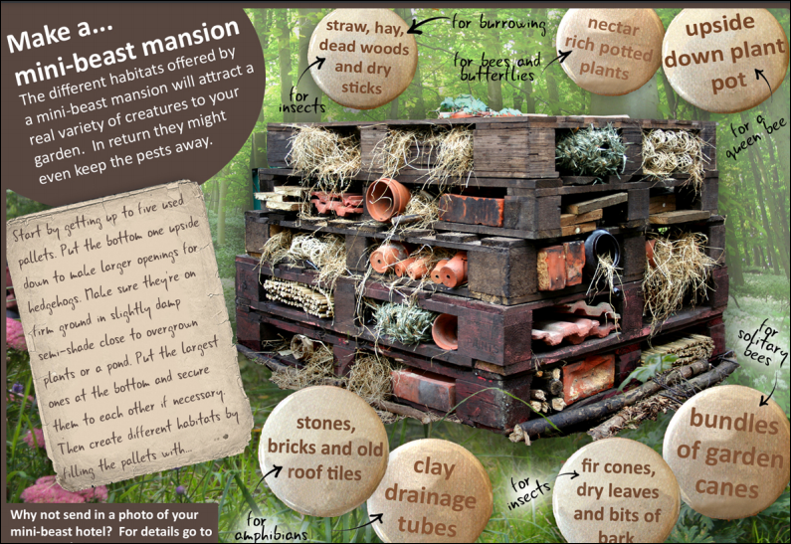

Slide 7
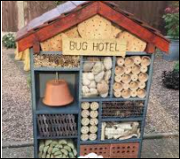
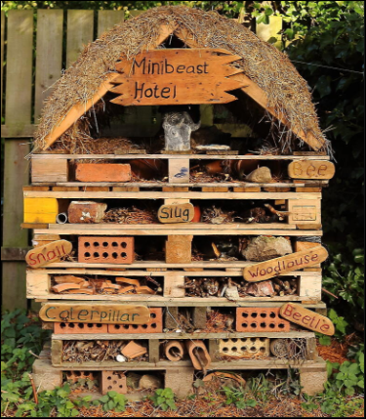
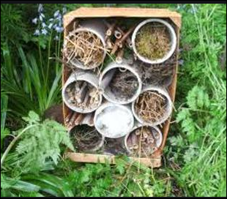

Slide 8
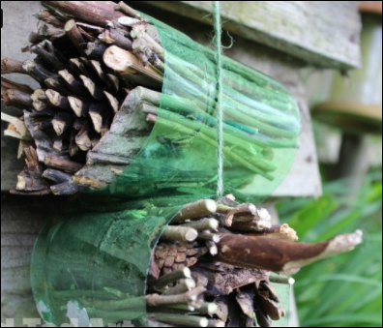
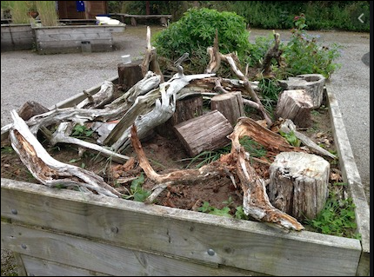
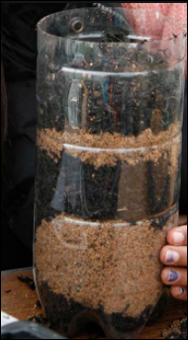
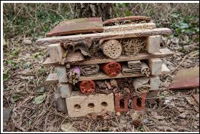

Slide 9
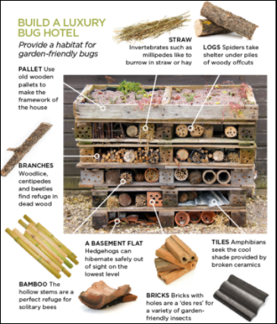
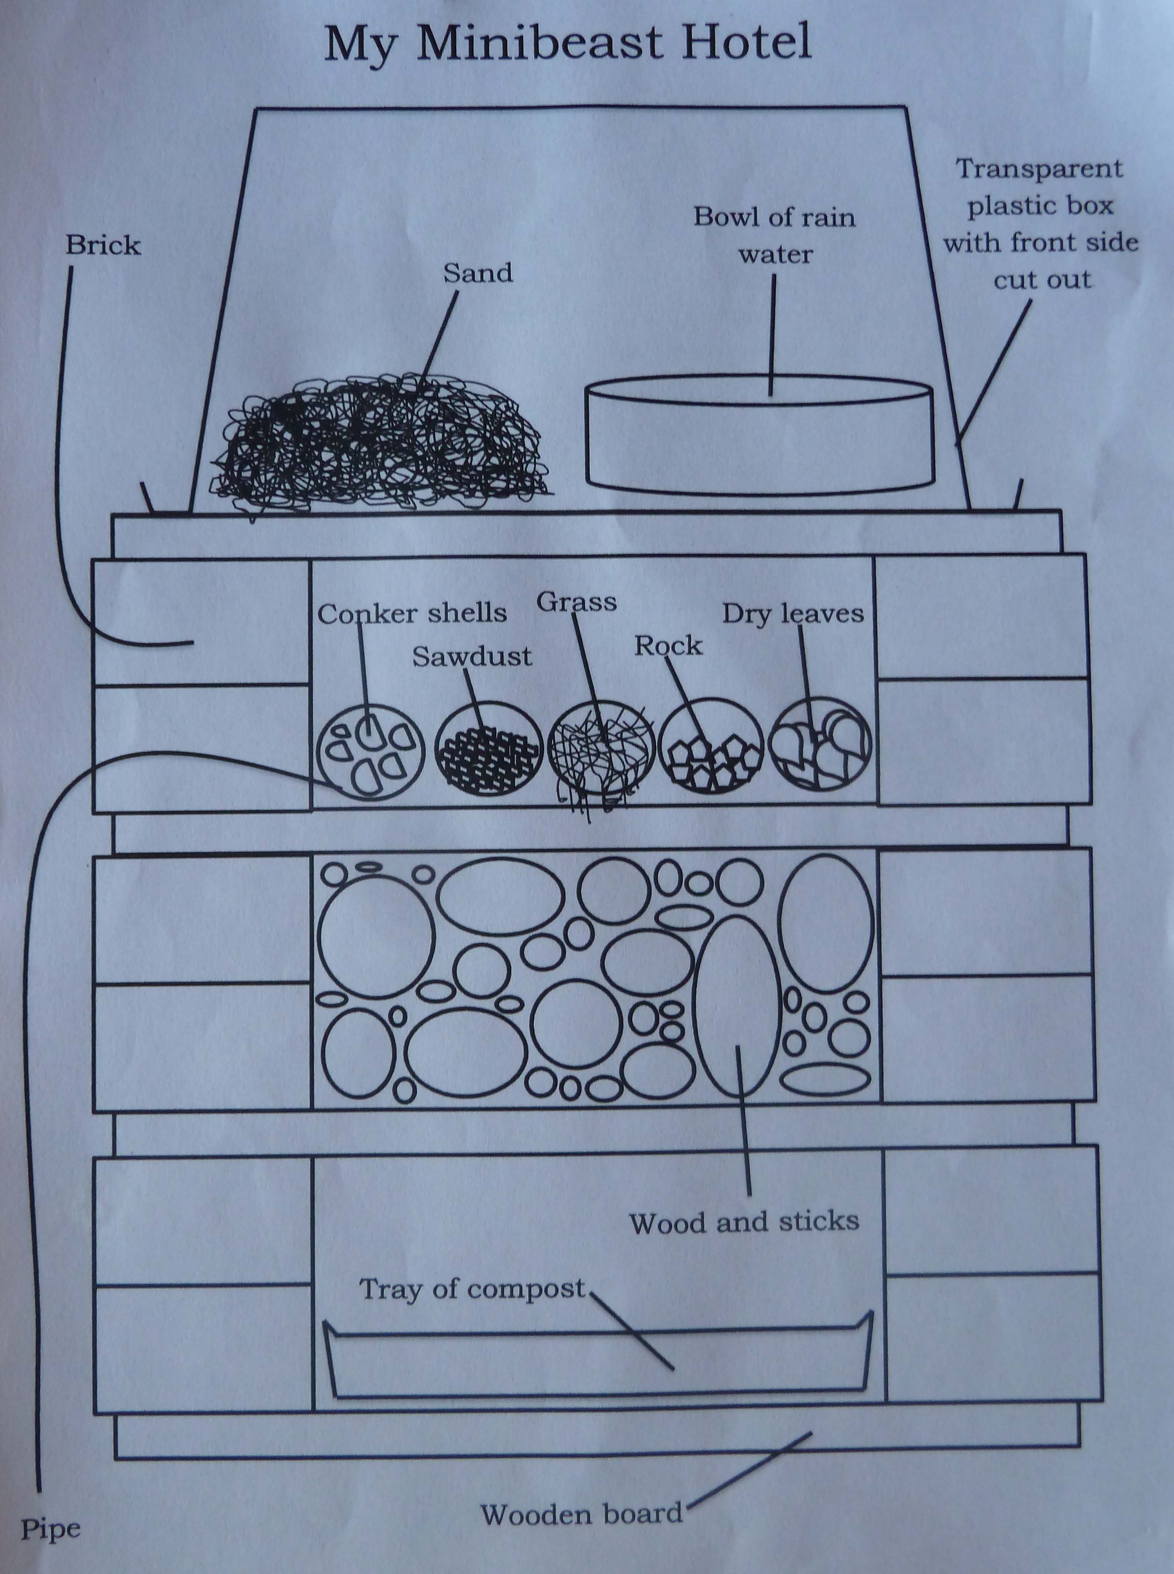
Use your knowledge and some of these ideas to design and label your minibeast house.
You could make it for one type of minibeast or make a minibeast hotel for lots of different ones.

Slide 10
Task:
Draw your design of a minibeast house.
Tell an adult about it.
Label it with the materials you will use.
Write underneath which minibeast would visit it and say why.
For example: A worm might visit the room that has damp soil and sand in and is dark. This is because they like to burrow into the soil and hide away from the sun.

