Slide 1
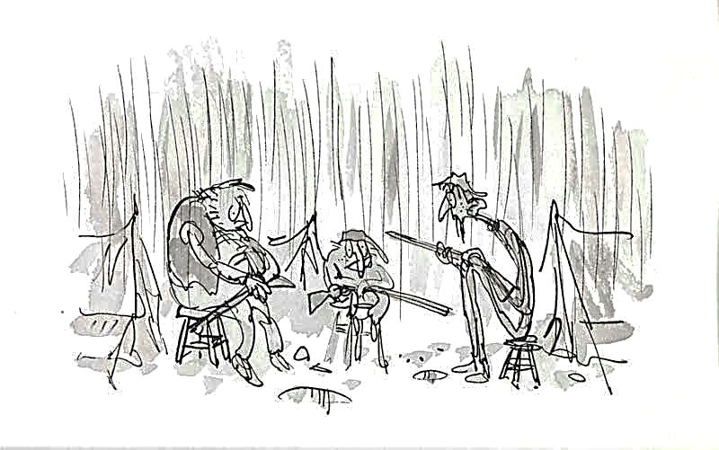

Learning intention Reading for understanding Ordering events

Slide 2

Listen to and read this chapter. You will need to order the events of this chapter when you have read it.

Slide 3
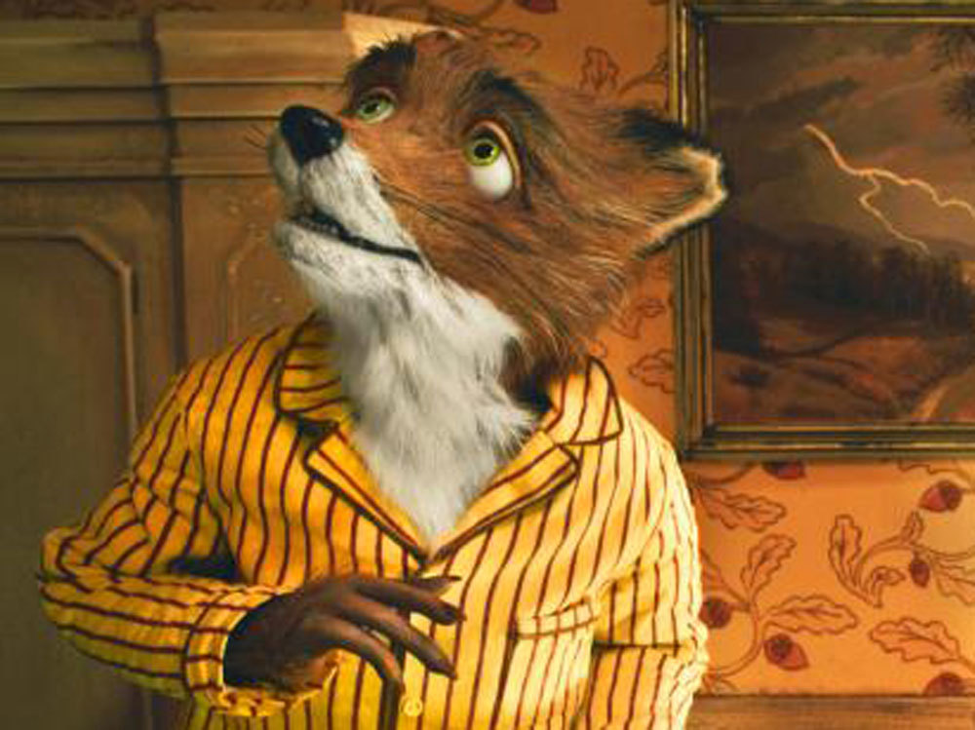
Fantastic Mr Fox Chapter 8 The Foxes begin to starve

Slide 4
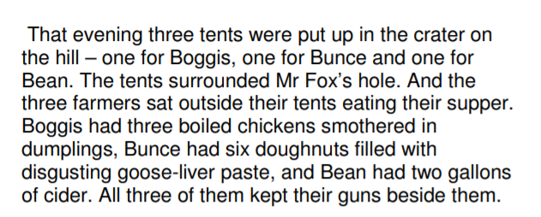

Slide 5
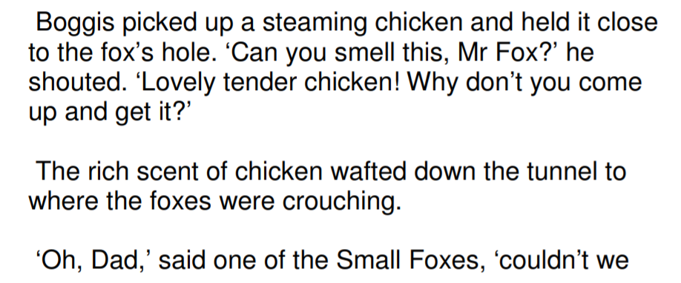
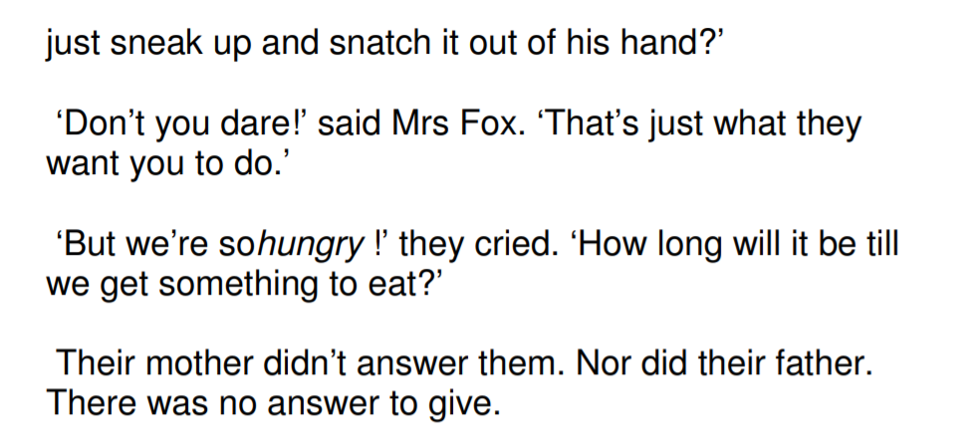

Slide 7
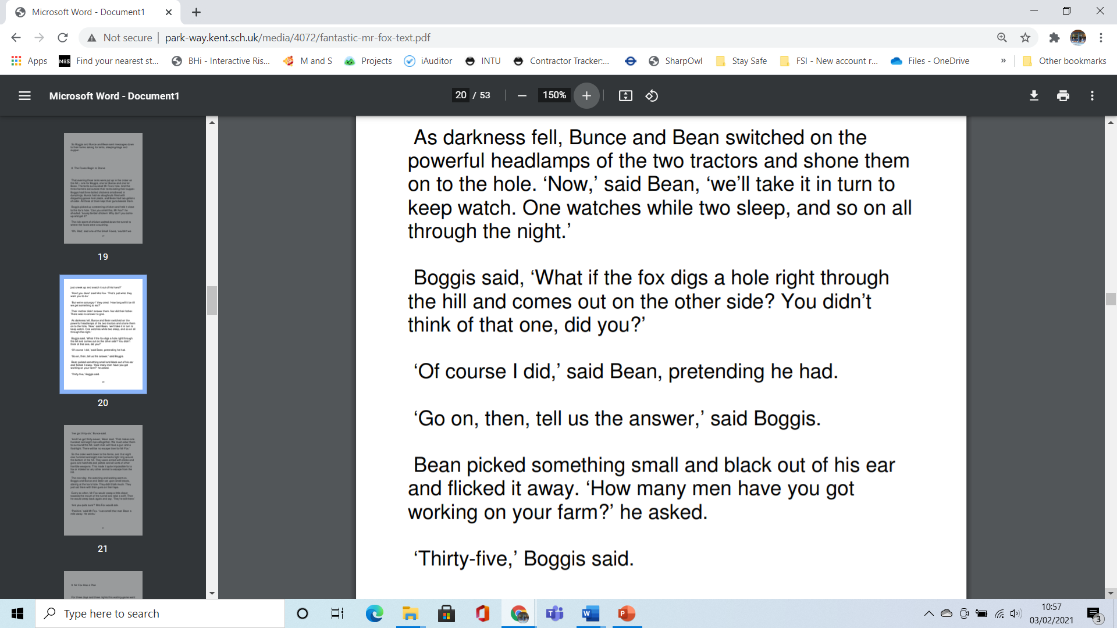

Slide 9
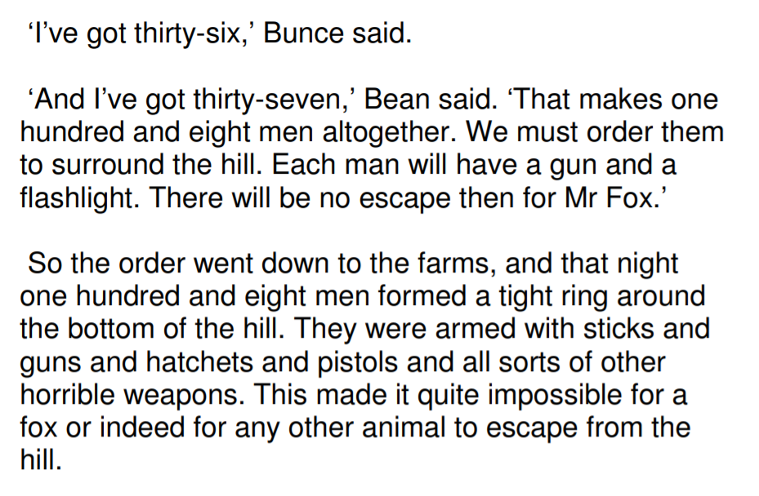

Slide 10
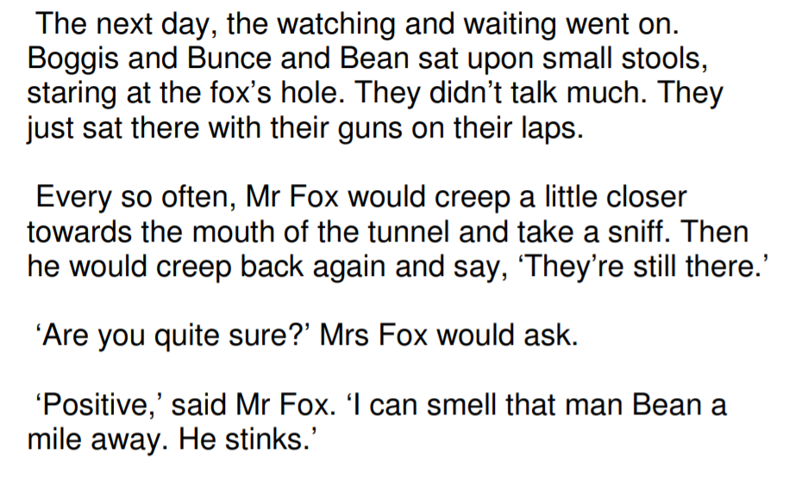

Slide 11
Now find the sheet English Chapter 8 Alternative 1. The key events of this chapter need to be ordered correctly. Which happened first , next, after that and so on until the end of the chapter.

