Slide 1
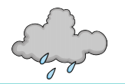
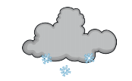
Year 1 Science
The Weather

Slide 2
We have been learning about four types of weather, can you name them?

Slide 3
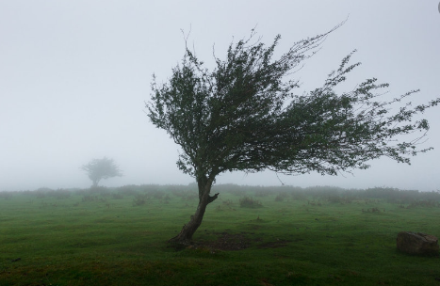
What can you see?

Slide 4
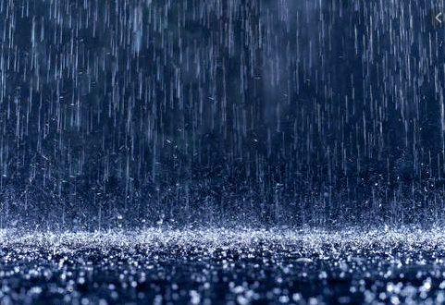
What can you see?

Slide 5
What can you see?

Slide 6
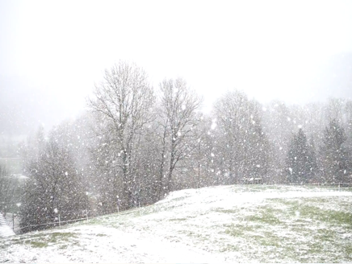
What can you see?

Slide 7
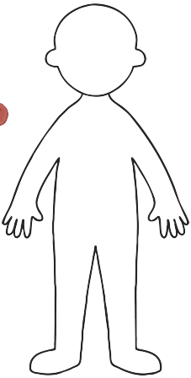
What should we wear in the sun?

Slide 8
What should we wear in the rain?

Slide 9
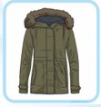
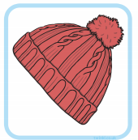
What should we wear in the snow?

Slide 10
Slide 1 – Hello year 1, today we are going to learn about the weather.
Slide 2- We have been learning about four types of weather, can you name them? That’s right, the wind, the rain, the sun and the snow.
Slide 3 – What can you see? What type of weather do you think this is?
Slide 4 - What can you see in this picture? What type of weather do you think this is?
Slide 5 - What can you see in this picture? What type of weather do you think this is?
Slide 6 - What can you see in this picture? What type of weather is this? Have you seen this weather before?
Slide 7 – Now we are going to have a think about the clothes we wear in different weathers. I want you to think about sun, can you point to the clothes you might wear in the sun?
Slide 8 – This time can you point to the clothes I might wear in the rain, would I wear my flip flops in the rain?
Slide 9 – Finally can you point to the clothes you would wear in the snow, would I wear my sun hat in the snow?

