Slide 1
Learning intention: To identify and describe the properties of 3D shapes, including the number of edges, vertices and faces.
Can you quickly think of the names of five 3D shapes?

Slide 2
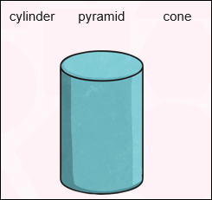
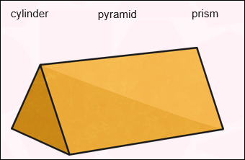
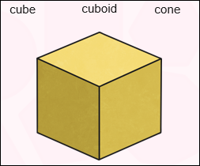
A
B
C

Slide 3
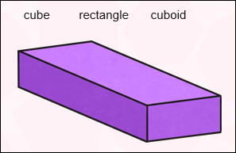
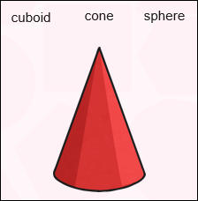
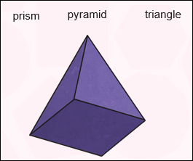
A
B
C

Slide 5
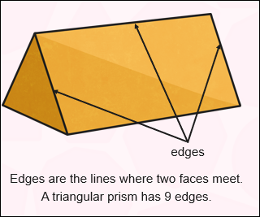
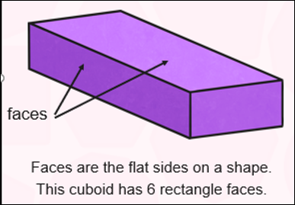
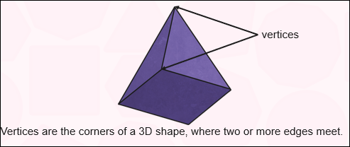
Faces, edges, and vertices

Slide 6
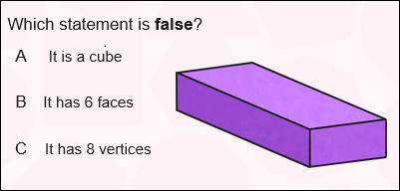
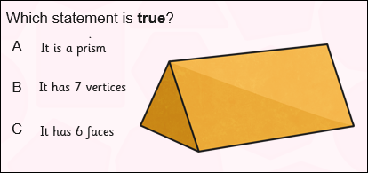

Slide 7
Task:
Look around your home and find an example of a cuboid. For example a cereal box.
Describe the shape to an adult using the words: edges, vertices, faces.
Find an example of a cylinder. For example a tin of beans or tube of crisps
Describe the shape to an adult using the words: edges, vertices, faces.
Find an example of a cube. For example a dice from a game.
Describe the shape to an adult using the words: edges, vertices, faces.
See if you can find a cone, pyramid, prism and describe them.

