Slide 1

English
Features of a newspaper report

Slide 2
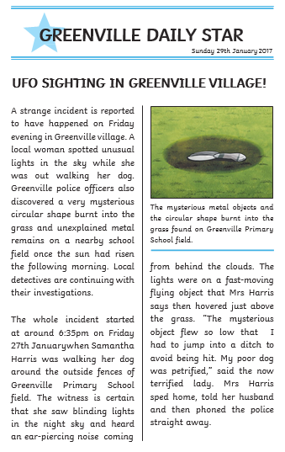
What is the purpose of a newspaper report?
The purpose of a newspaper report is to inform the reader about important events which are happening locally or around the world.

Slide 3
Headline
Little Red Nearly Dead
Petrol Prices Plummet

Slide 4
Past tense
discovered
saw
was
spotted

Slide 5
Introduction
What?
Who?
Where?
When?

Slide 6
Chronological order
Time adverbs:
At 6:35pm
Then
Next
A few minutes later
Finally

Slide 7
Witness statements
“The mysterious object flew so low that I had to jump into a ditch to avoid being hit,” Mrs Harris reported.

Slide 8
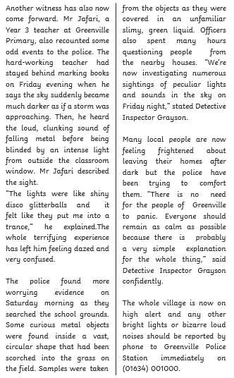
Conclusion

