Slide 1
Learning intention: Predict soil’s permeability.

Slide 2
What am I?
Read the clues and guess
How many clues will you need?

Slide 3
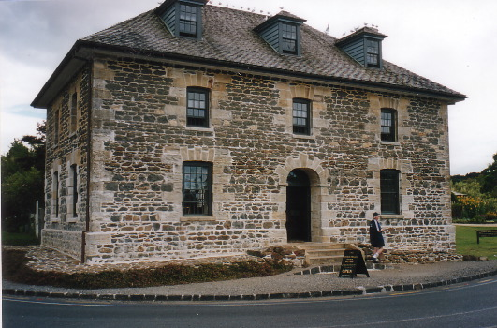
I am made of rock
I am very precious
But I’m not a building
But I’m not a diamond

Slide 4
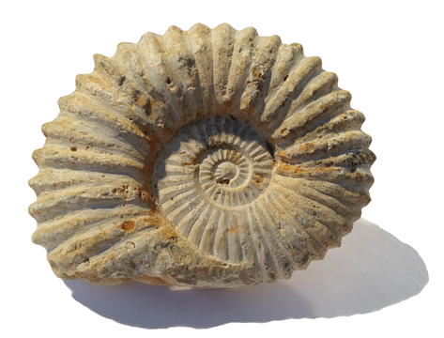
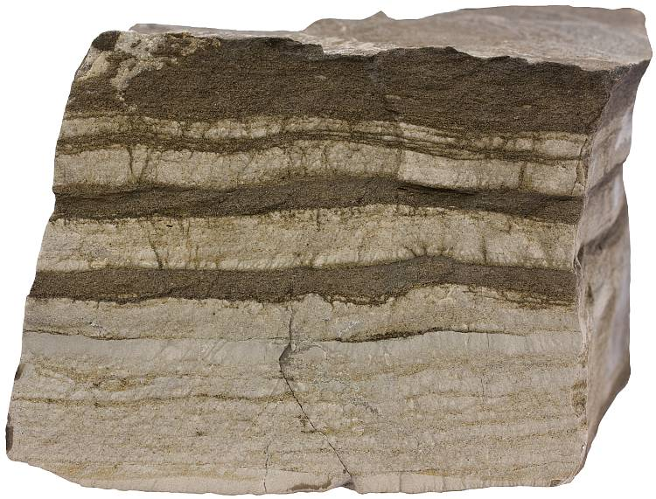
It takes 500 years to make an 2cm of me
I am made of different layers
But I’m not a fossil
But I am not sedimentary rock

Slide 5
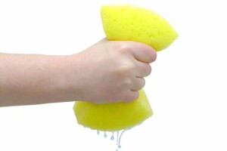
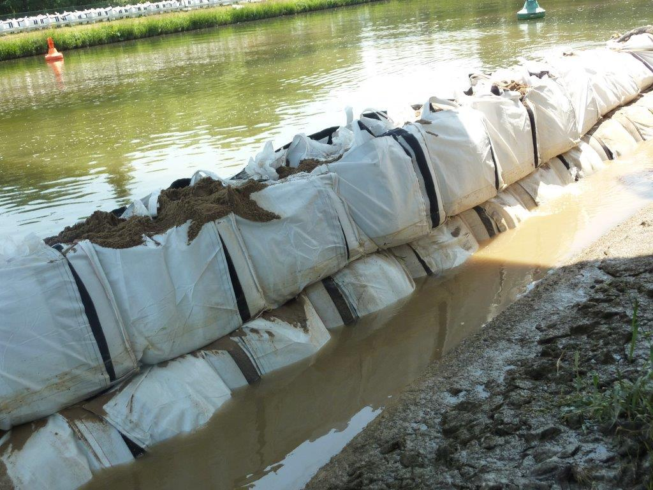
Half of me is made of air and water
I can help prevent flooding
But I’m not a wet sponge
But I’m not a flood barrier

Slide 6
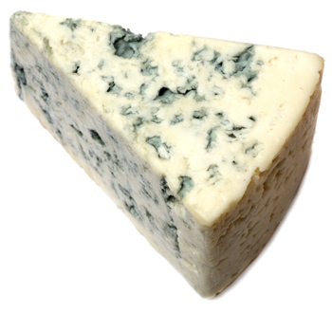
A handful of me contains more micro-organisms than there are people on the Earth
I am home to many creatures
But I’m not mouldy cheese!
But I’m not a zoo or a farm

Slide 7
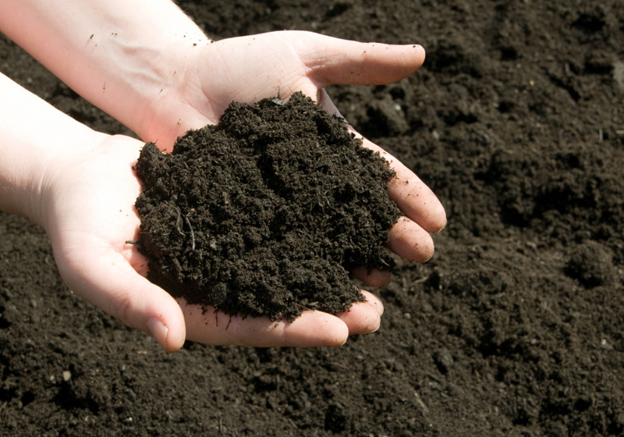
?
Have you guessed what I am?
Soil

Slide 8
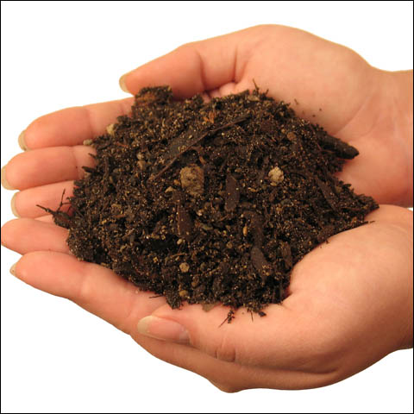
A handful of soil contains more micro-organisms than there are people on the planet
Without soil there would be no life on Earth
It can help prevent flooding because it can absorb large amounts of water
Is made from rock and other things
Is very precious because everything needs it to survive
Half of it is made of air and water
Soil
It takes more than 500 years to make 2cm of soil
Is made of different layers in the ground

Slide 9
Permeable and impermeable
Can you remember what these words mean? Discuss it with somebody at home.
Permeable: If a soil is permeable, water can pass through it easily.
Impermeable: An impermeable soil does not allow water to pass through it easily.

Slide 10
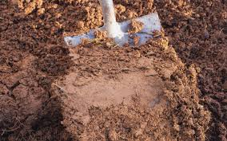
Soil 1
Have a look at the different soils on the next slides.
Talk to someone at home about what you can see.
Try to name the different properties of each soil type.
Write your ideas on the sheet attached called ‘Science- prediction’.

Slide 11
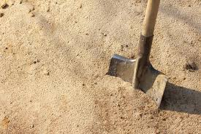
Soil 2

Slide 12
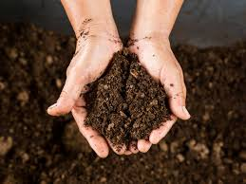
Soil 3

