Slide 1
Let’s practice counting to 20!
Notes:
Let’s practice counting to 20, let’s go forwards first … and then backwards!

Slide 2
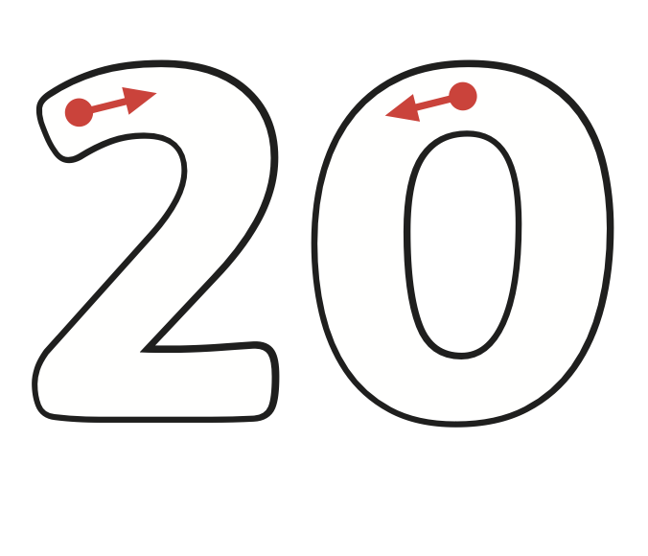
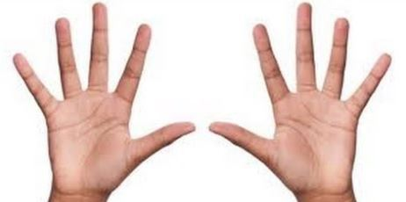
Notes:
We have the number 20 (trace it), two base 10 rods because 10 + 10 = 20, 4 hands (count the fingers and thumbs), 2 Numicon 10s and 2 tens frames.

Slide 3
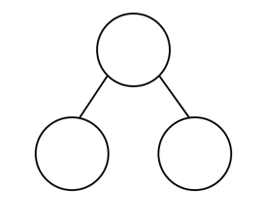
Let’s find more ways to 20!
20
?
?
Notes:
2 parts make a whole! What + what = 20? Let’s find out!

Slide 4
16
+
=
20

Slide 5
15
+
=
20

Slide 6
7
+
=
20

Slide 7
20
-
=
12

Slide 8
20
-
=
14

Slide 9
20
-
=
9

Slide 10
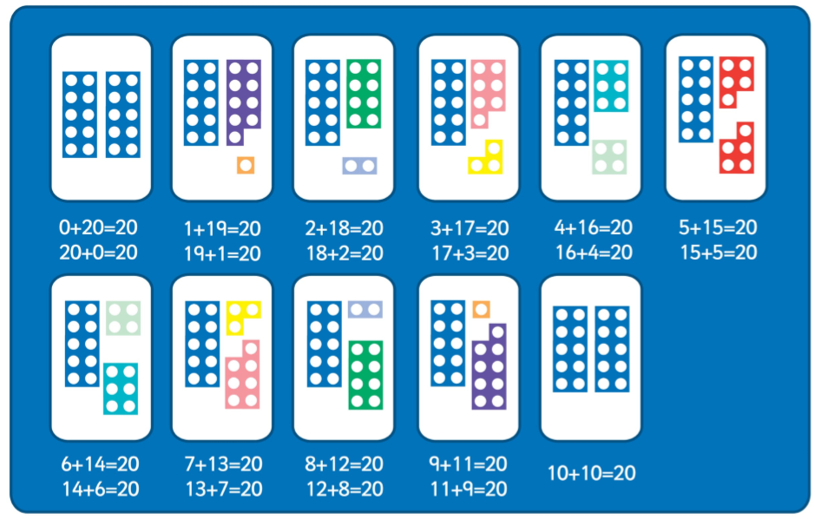
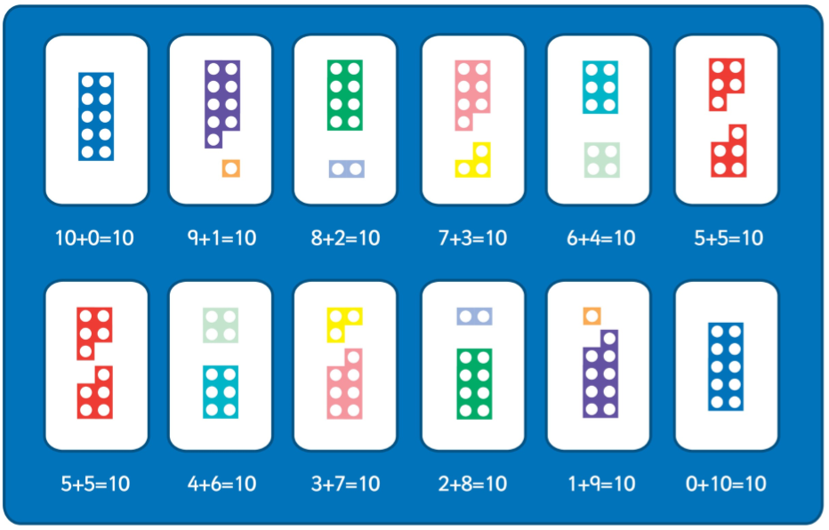
Can you spot the pattern?

Slide 11
Commentary:
Slide 1: Let’s practice counting to 20, let’s go forwards first … and then backwards!
Slide 2: We have the number 20 (trace it), two base 10 rods because 10 + 10 = 20, 4 hands (count the fingers and thumbs), 2 Numicon 10s and 2 tens frames. Slide 3: 2 parts make a whole! What + what = 20? Let’s find out! Slide 4: Count from 16 up to 20 using the number line Slide 5: Count from 15 to 20 using the number line Slide 6: Count from 7 to 20 using the number line Slide 7: Count down from 20 to 12 using the number line Slide 8: Count down from 20 to 14 using the number line Slide 9: Count down from 20 to 9 using the number line Slide 10: Can you spot the pattern? Look at the first number in each calculation

