Slide 1
Understanding how a timeline works

Slide 2
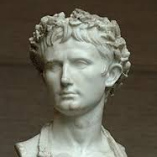
What does BC and AD mean?
BC and AD are letters that are often found at the end of the dates written in years such as…
31BC: Augustus became the Roman Emperor
79AD: Mount Vesuvius erupts
BC are initials that stands for Before Christ
AD are initials for Anno Domini

Slide 3
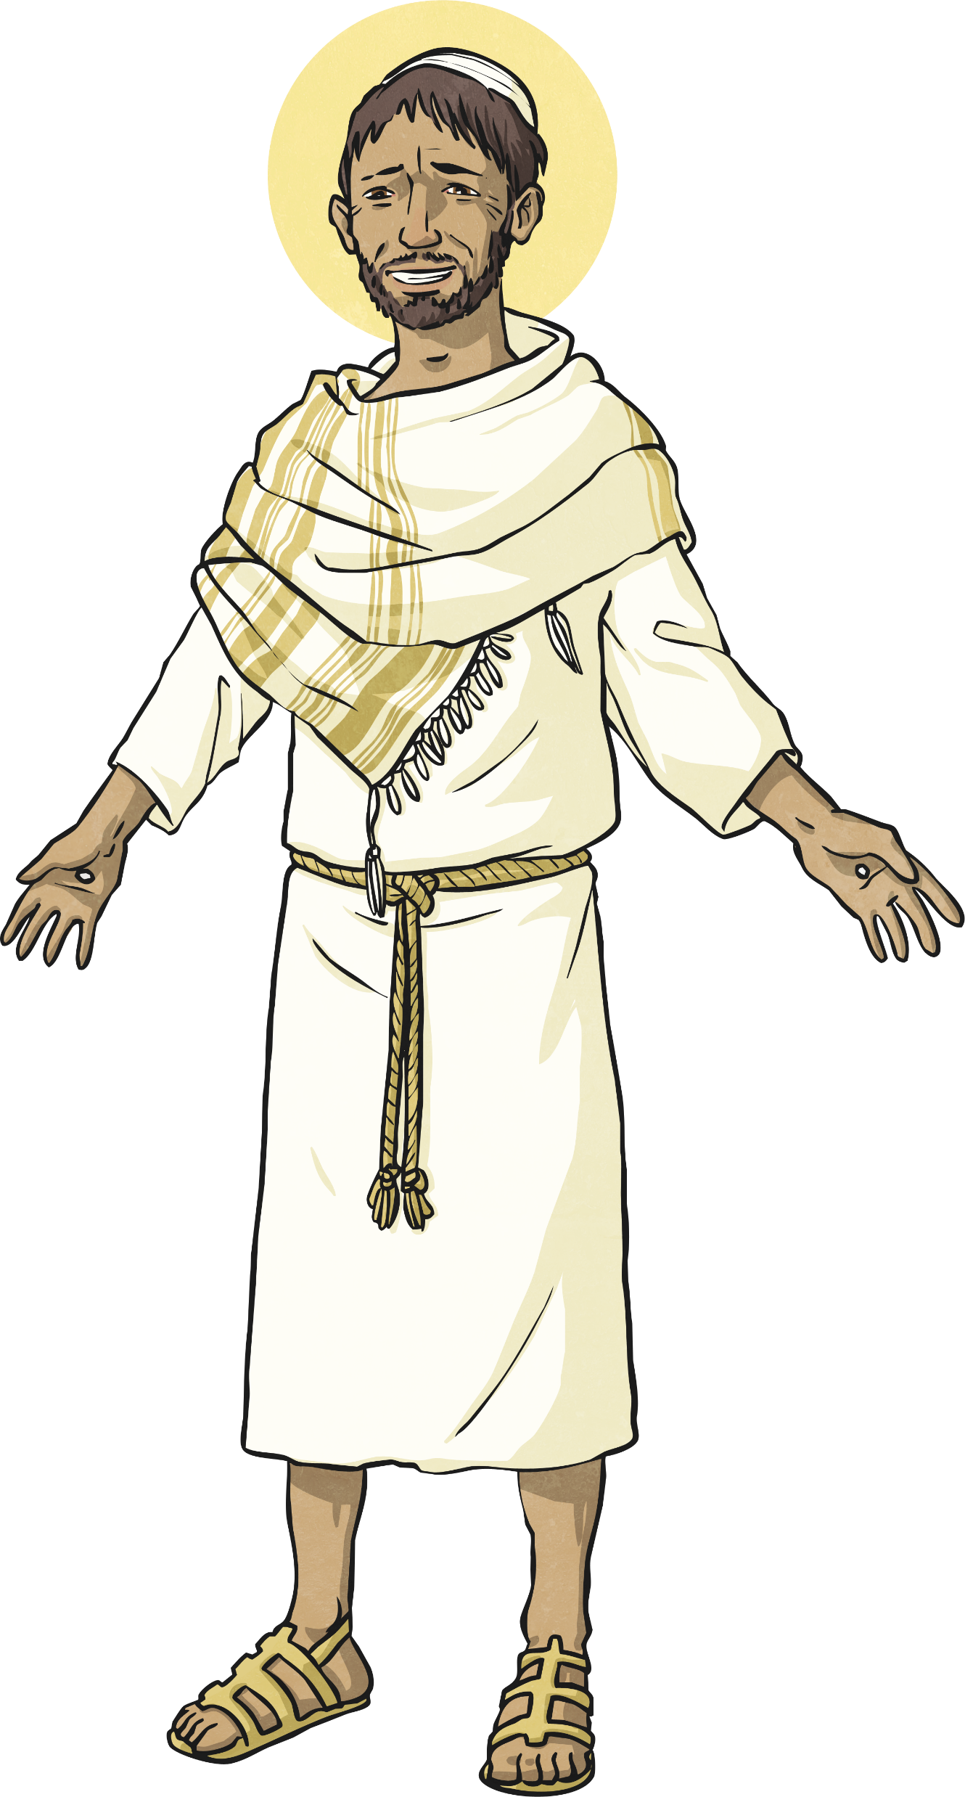
When is BC and AD?
BC refers to the years that come before the year 1.
AD refers to the years from year 1 onwards.
Did You Know…?
There is no year 0!
The year 1 BC is followed by AD 1.
1 BC
1 AD
BC
AD

Slide 4
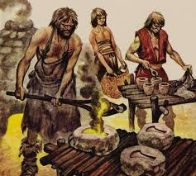
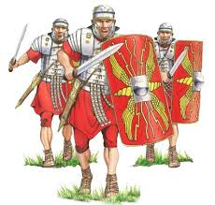
Be careful with BC and AD!
With BC years, the larger the year, the further back in history that is.
So for example something that happened in 800BC (the start of the Iron Age) happened a long time before something that happened in 43AD (the Romans arriving in Britain).

