Slide 1
Alternative maths 22.1.21
Telling the time using an analogue clock.
Quarter past

Slide 2
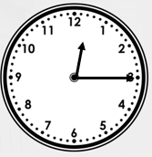
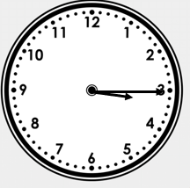
Quarter past times
A
B
It is quarter past 12.
The minute (long hand) is pointing to the 3.
The hour (short hand) is pointing between the 12 and 1.
It is quarter past 3.
The minute (long hand) is pointing to the 3.
The hour (short hand) is pointing between the 3 and 4.

Slide 3
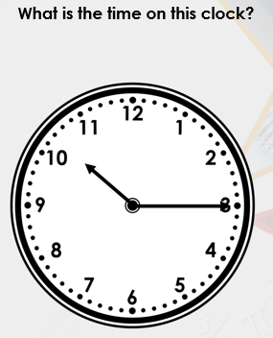

Slide 4
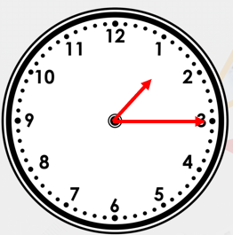
What time is on the clock?

Slide 5
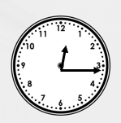
What time is on the clock?

Slide 6
Task-
Complete the work sheet identifying quarter past times

