Slide 1
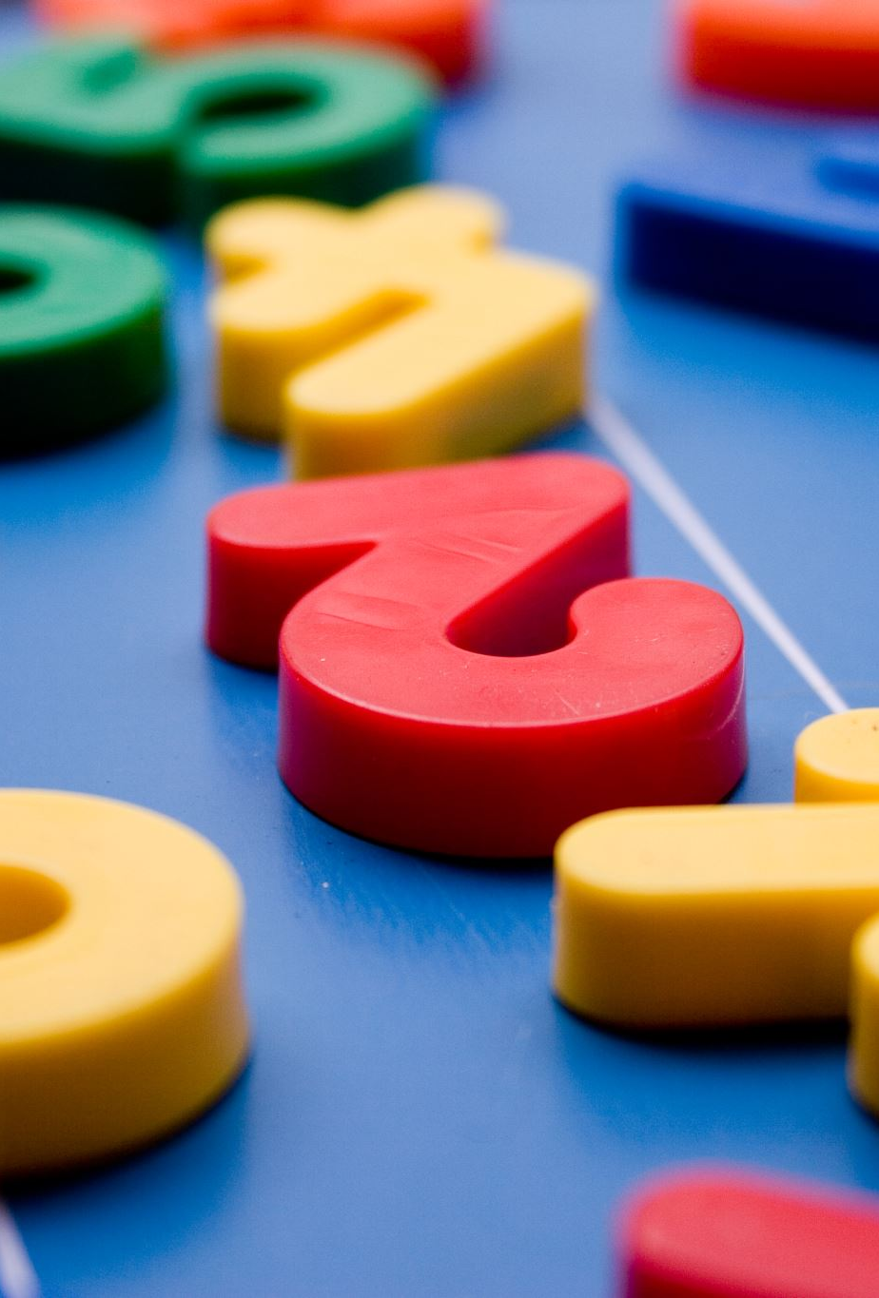

Adding two digit numbers using column addition

Slide 2
What is a digit?
1 8 3
4 2
9 7 5
0 6

Slide 3
Warm up
Can you remember the place value columns?
hundreds | tens | ones
6 | 4 | 2
So, 642 has 6 hundreds, 4 tens and 2 ones

Slide 4
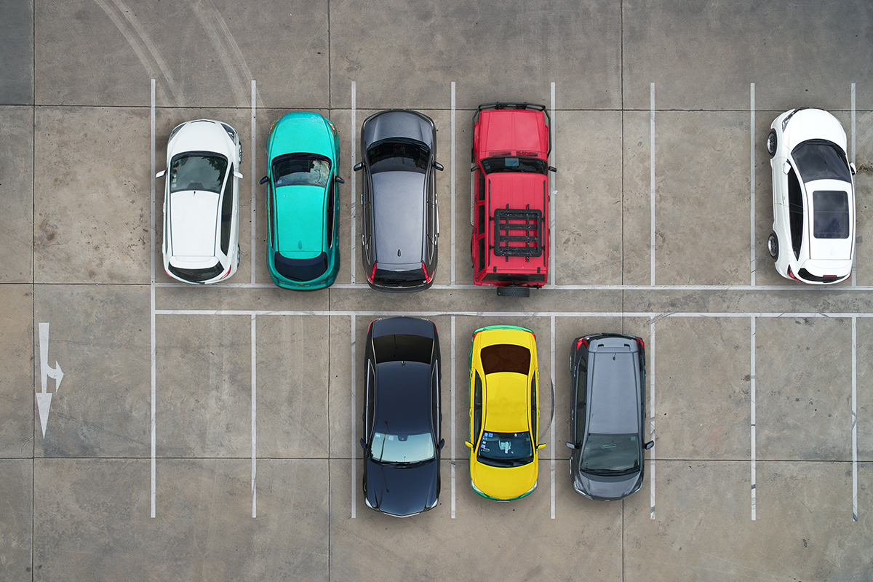
Adding two, two digit numbers
Question:
There are 42 cars in a car park.
23 more arrive.
How many cars are there altogether?

Slide 5
42 has 2 ones and 4 tens
23 has 3 ones and 2 tens
tens | ones
4 | 2
2 | 3
Start by adding the ones column digits.
2 + 3 = 5 (5 ones – 5)
Put the 5 in the ones column place
+
6
5
Now add the digits in the tens places.
4 + 2 = 6 (6 tens – 60)
Put the 6 in the tens column place.
So, 42 + 23 = 65

Slide 6
53 has 3 ones and 5 tens
31 has 1 one and 3 tens
tens | ones
5 | 3
3 | 1
Start by adding the ones column digits.
3 + 1 = 4 (4 ones – 4)
Put the 4 in the ones column place.
+
8
4
Now add the digits in the tens places.
5 + 3 = 8 (8 tens – 80)
Put the 8 in the tens column place.
So, 53 + 31 = 84

Slide 7
Your turn
Tens | ones
2 | 4
1 | 5
Tens | ones
4 | 2
2 | 6
Tens | ones
4 | 4
3 | 5
Tens | ones
6 | 5
2 | 3
Tens | ones
7 | 1
1 | 8
+
+
+
+
+

Slide 8
Answers
Tens | ones
2 | 4
1 | 5
3 | 9
Tens | ones
4 | 2
2 | 6
6 | 8
Tens | ones
4 | 4
3 | 5
7 | 9
Tens | ones
6 | 5
2 | 3
8 | 8
Tens | ones
7 | 1
1 | 8
8 | 9
+
+
+
+
+

Slide 9
Well done!

