Slide 1
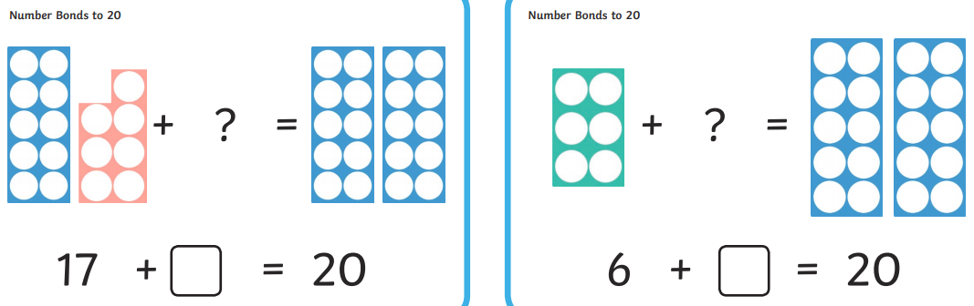

Learning Intention
Addition and subtraction
Number bonds to 20

Slide 2
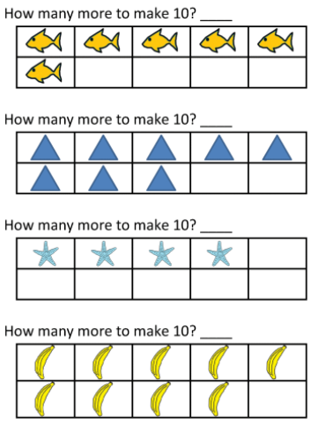
Number bonds to 10
Click to find your answers

Slide 3
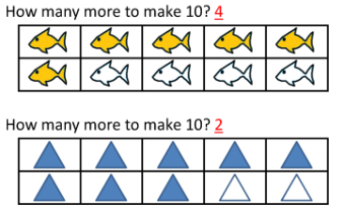
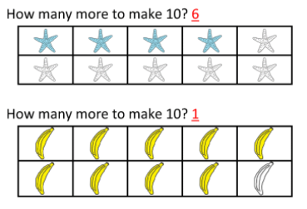
Well done if you were right.

Slide 4
Number bonds to 20
Number bonds to 20 are pairs of numbers that add to 20.
Like 17 + 3 = 20 or 6 + 14 = 20
3 14

Slide 5
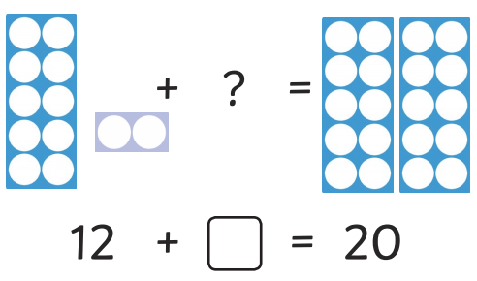
8
So the number bond for 12 to 20 is 8
12 + 8 = 20
So to find the number bond to 20 for 12.
Start at 12
Count on until you get to 20
How many have you counted on?
x
0 | 1 | 2 | 3 | 4 | 5 | 6 | 7 | 8 | 9 | 10 | 11 | 12 | 13 | 14 | 15 | 16 | 17 | 18 | 19 | 20

Slide 6
Find the sheet, Maths alternative 2 activity.
Find the number bonds to 20 for the questions on the sheet.
If you are not sure then you can go through the PowerPoint again.

