Slide 1
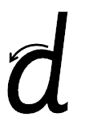

Your turn! Write d in your book using the lines.
d – Make a curve, go all the way up, come back down and flick.

Slide 2
Your turn! Write d in your book using the lines.
Then try:
duck
dot
dab

