Slide 1


Focus: oo
o – make a curve, go all the way round
o – make a curve, go all the way round

Slide 2
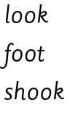
Your turn! Write oo in your book using the lines.
Then try:

