Slide 1
Antarctica

Slide 2
Antarctica is one of seven continents. How many others can you name?

Slide 3
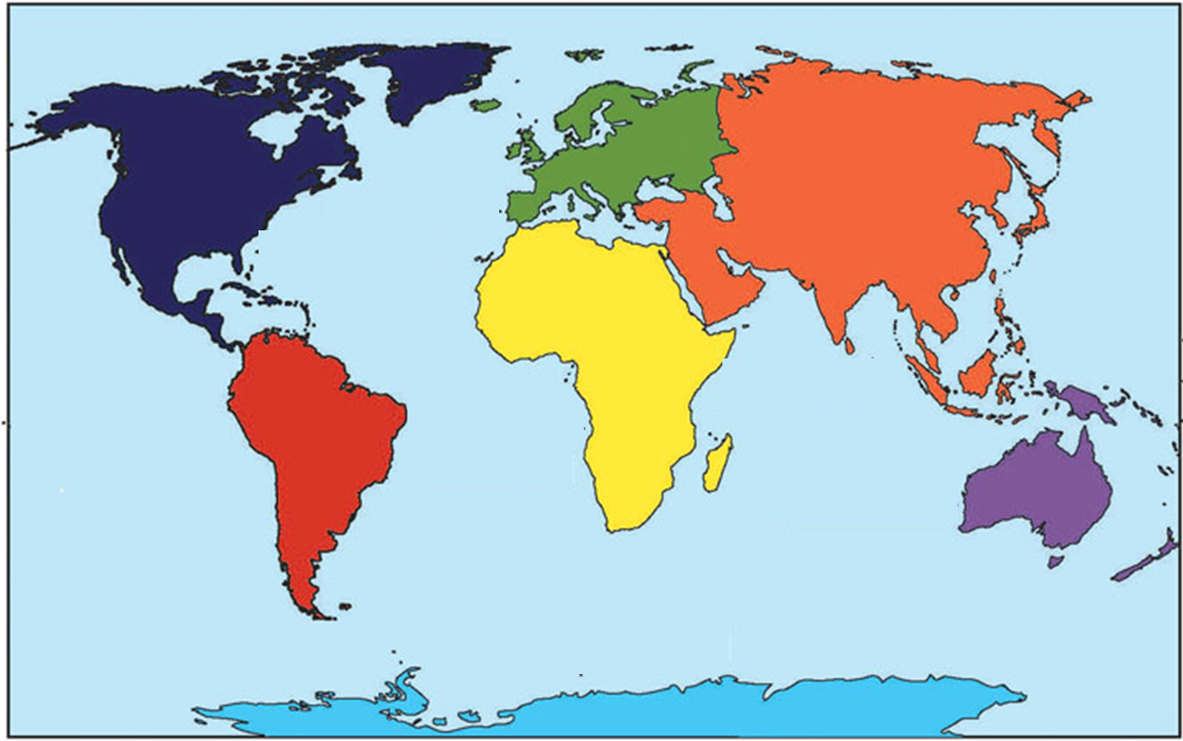
Continents recap
Can you find Asia? Answer on the next page!

Slide 4
Continents recap
Can you find Africa? Answer on the next page!
Asia

Slide 5
Continents recap
Can you find Europe? Answer on the next page!
Asia
Africa

Slide 6
Continents recap
Can you find Australia? Answer on the next page!
Europe
Asia
Africa

Slide 7
Continents recap
Can you find South America? Answer on the next page!
Europe
Asia
Africa
Australia

Slide 8
Continents recap
Can you find North America? Answer on the next page!
Europe
Asia
Africa
South America
Australia

Slide 9
Continents recap
Can you find Antarctica? Answer on the next page!
Europe
Asia
North America
Africa
South America
Australia

Slide 10
Continents recap
Can you find Antarctica? Answer on the next page!
Europe
Asia
North America
Africa
South America
Australia
Antarctica

Slide 11
Antarctica is the coldest continent because it is a polar region.
It is at the bottom of the map at the South Pole.
What is the other pole called?
Europe
Asia
North America
Africa
South America
Australia
Antarctica

Slide 12
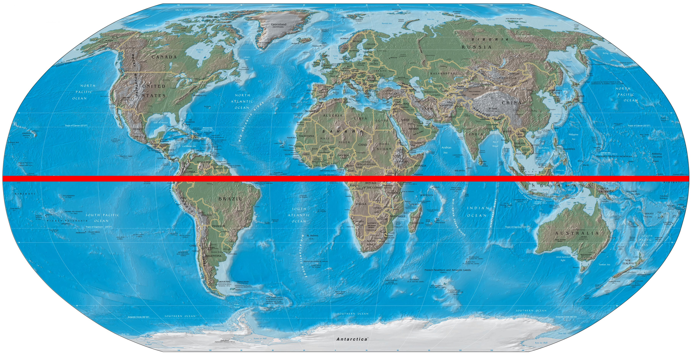
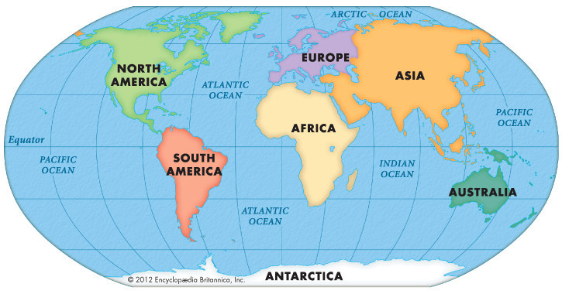
It is so cold because it is far away from the Equator, an invisible line around the middle of the globe.
The warmest places are on the Equator and the coldest places are the furthest away.
Antarctica

Slide 13
Antarctica facts
5000 people live there temporarily (scientists and researchers).
Do you think this is the same as or different to Africa?

Slide 14
Antarctica facts
There are no countries in Antarctica.
Do you think this is the same as or different to Africa?

Slide 15
Antarctica facts
There are no trees growing in Antarctica because it is too cold.
Do you think this is the same as or different to Africa?

Slide 16
Antarctica facts
There are lots of icebergs in Africa.
Do you think this is the same as or different to Africa?

Slide 17
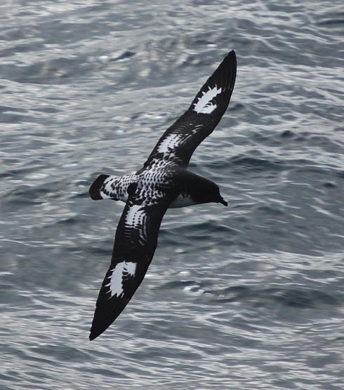
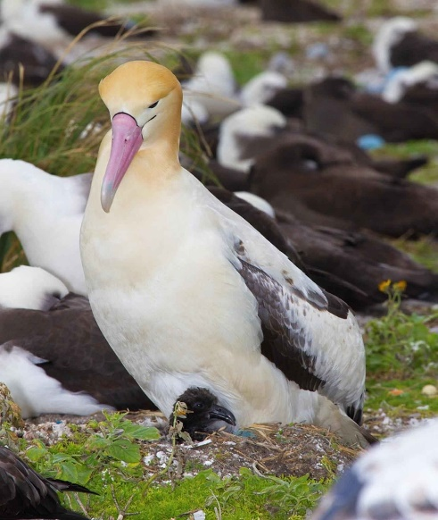
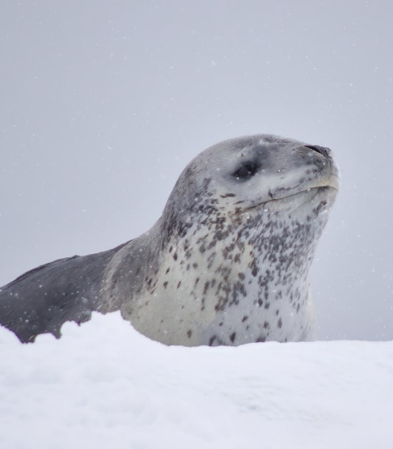
Antarctica facts
These animals live in Antarctica.
penguin Antarctic petrel albatross seal orca (killer whale)
Do you think this is the same as or different to Africa?

Slide 18
True or false task! The answer is on the next page.
Antarctica is the coldest place on earth.
True / False

Slide 19
True or false task! Next question is on the next page.
Antarctica is the coldest place on earth.
True / False

Slide 20
True or false task! The answer is on the next page.
There are millions of trees and plants in Antarctica.
True / False

Slide 21
True or false task! Next question is on the next page.
There are millions of trees and plants in Antarctica.
True / False

Slide 22
True or false task! The answer is on the next page.
A lot of people live in this continent.
True / False

Slide 23
True or false task!
A lot of people live in this continent.
True / False

Slide 24
Where would you like to visit in Antarctica?
Chapel of the Snow: a Christian place of worship
Mount Erebus: an active volcano
Antarctic ice sheet: this is on top of the water and can grow as the sea freezes
Port Lockroy: has a museum and penguins live nearby. Ships can sail here

Slide 25
Antarctica
Would you rather live here…

Slide 26
Africa
… or here?

Slide 27
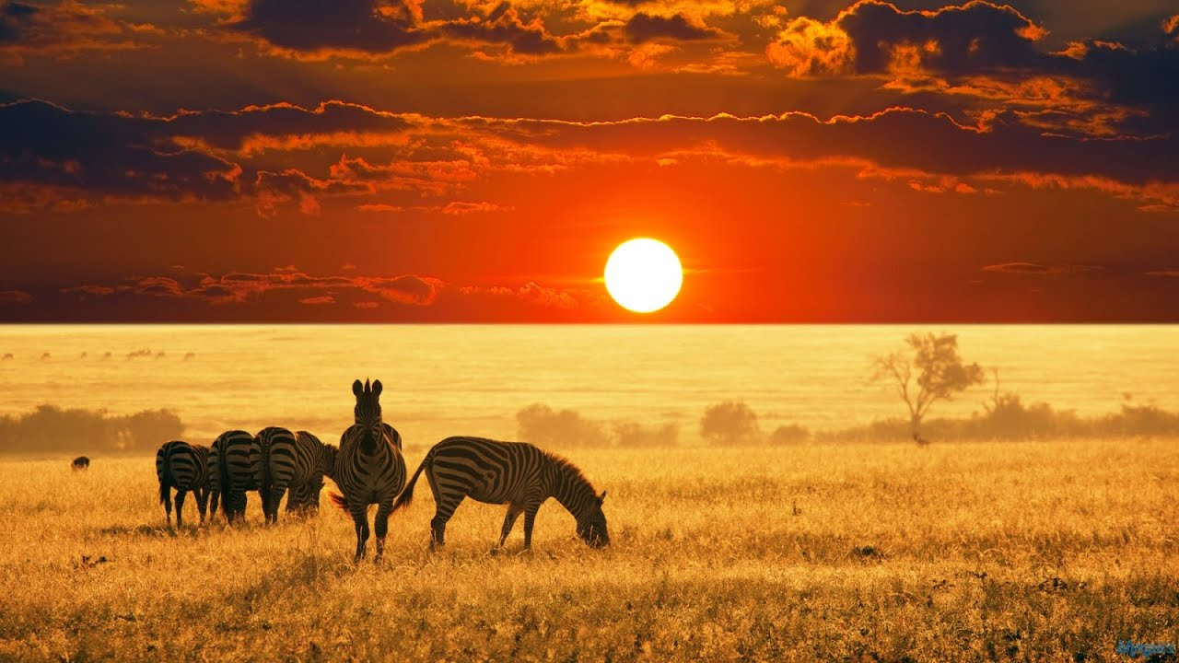
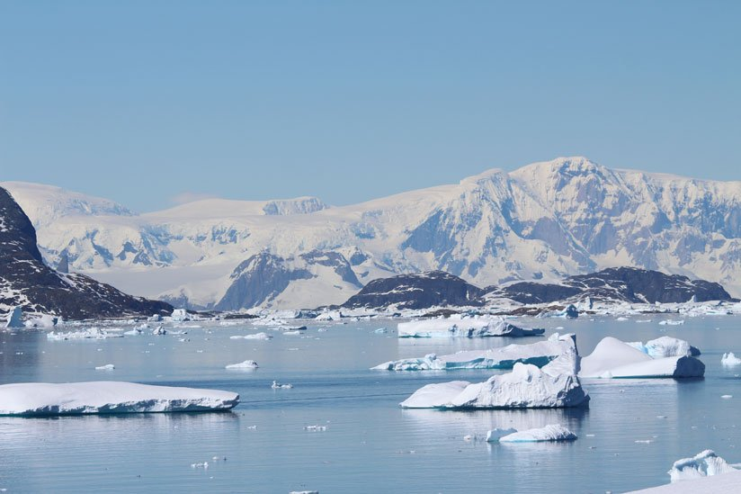
What is the same and different about Antarctica and Africa?
Where would you rather live? Why?

