Slide 1
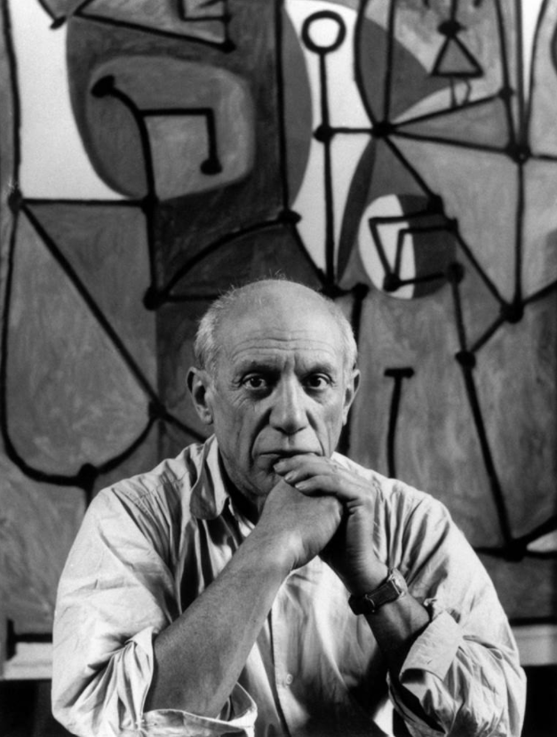

Who is Pablo Picasso?
An Artist
A footballer?
An artist?
A president?
A cartoon character?

Slide 2
Look at the painting on the following slide. It is one of Picassos most famous paintings. It was painted in 1937 and is 3.5m tall and 25.5m wide, so huge! As you look at it ask these questions. - What do you think it shows? - How do the people and animals in the picture feel? - How does it make you feel? - Why do you think Picasso chose the colours he chose to paint it?

Slide 3
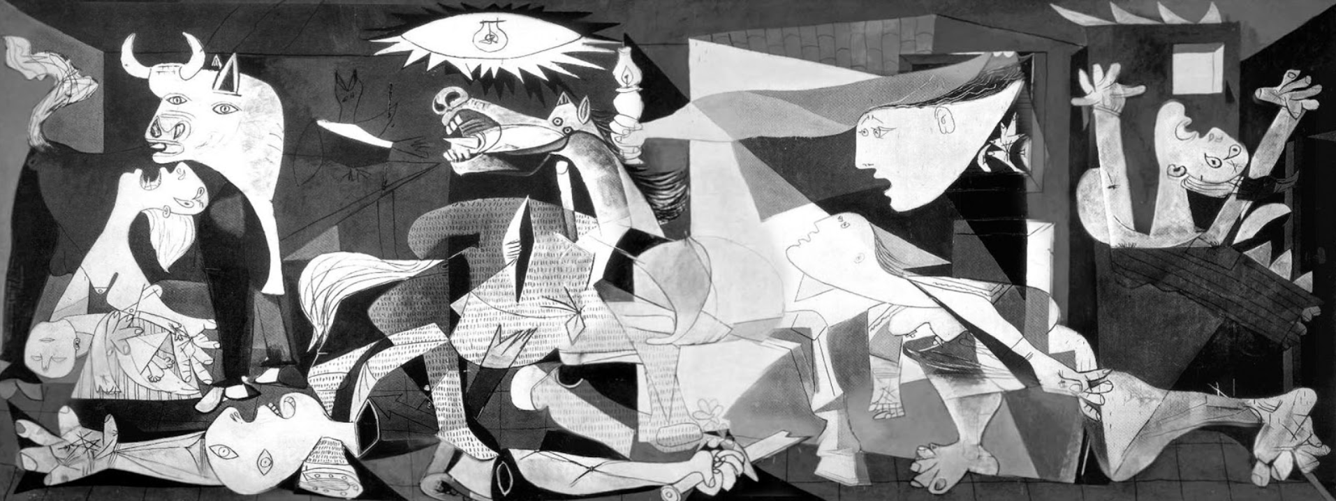

Slide 4
Guernica -
Guernica is a world-famous painting by Pablo Picasso. It is one of the world's greatest anti-war paintings. It is a very large painting which shows the bombing of the Spanish town of Guernica in 1937 during the Spanish Civil War.
The Spanish Republican government asked Picasso to paint a large painting for an art exhibition in Paris. It shows how people, as well as animals, all suffer because of war. The painting soon became so famous that it was seen as a world symbol for peace. The fame of the painting helped to bring the Spanish Civil War to an end.

Slide 5
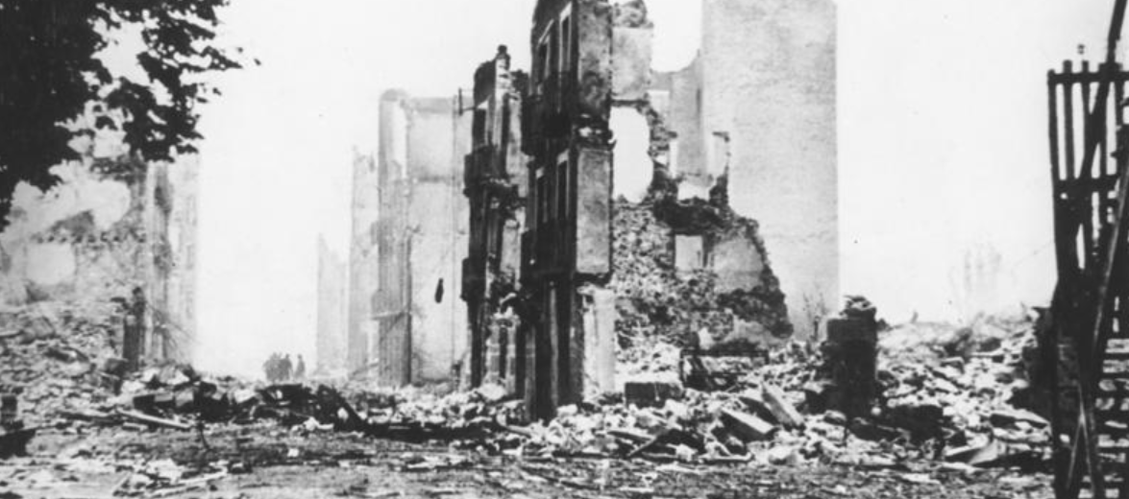
The Real Guernica after it had been bombed

Slide 6
Description of the painting Guernica shows a large, open room with people and animals who are suffering. A bull stands over a woman crying over a dead child in her arms. A horse falls in terrible pain as it dies after being run through with a spear. A dead soldier lies under the horse, his arm has been chopped off, but the hand grasps a shattered sword from which a flower grows. A light bulb shines strongly like an evil eye (the Spanish word for "lightbulb" is "bombilla" which sounds like "bomb"). A female figure floats in, holding a lamp which is a symbol of hope.

Slide 7
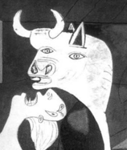
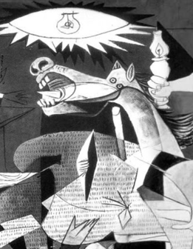
Your Task Guernica –Pablo Picasso 1937
Your task is to draw your version of the painting. You can do the whole painting or choose a smaller section such as the horse or the bull.
Under your drawing describe what the painting shows.
Explain how the painting makes you feel.

