Slide 1
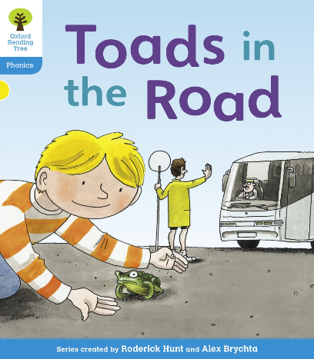

You are going to read the story ‘Toads in the Road’.
In this story you will hear words with the sounds:
oa
ur
oa sound is in the words:
boat
toad
Road
The ur sound is in the words:
hurt
turn
Can you write two words with the oa sound in and two words with the ur sound. Ask an adult to check your spelling.
Look at the picture. What is Kipper doing? What will happen in the story?

Slide 2
Let’s read the words together to practice the sounds we are learning.
toad
road
load
coat
coach
hurt
turn

Slide 3
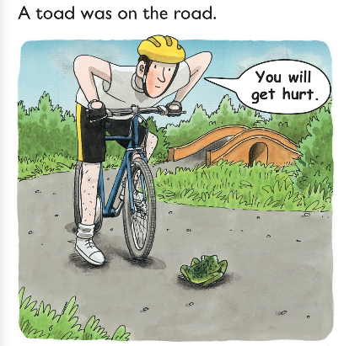
Which words have the oa sound in ?
Which word has the ur sound in?
Where was the toad?

Slide 4
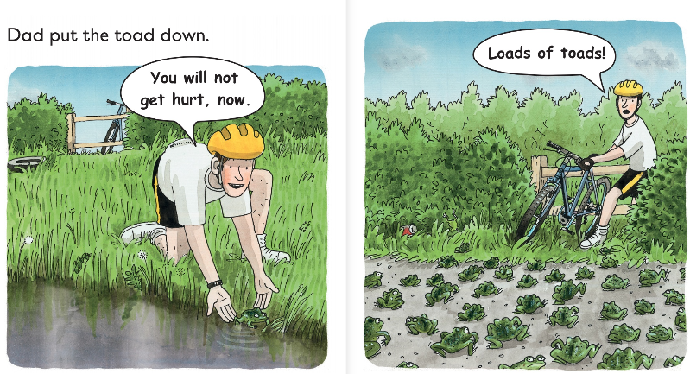
Where did dad put the toad?
Why did he put it there?
What did he see after that?

Slide 5
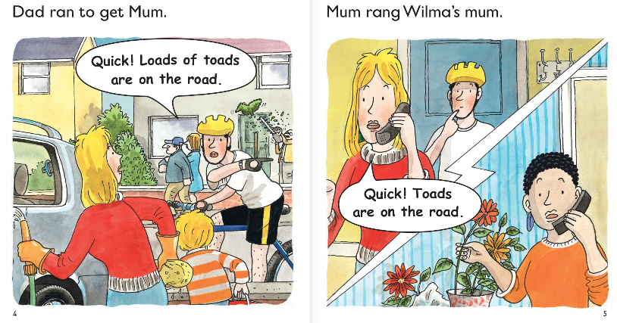
Why did Dad run to get Mum?
What did Mum do?

Slide 6
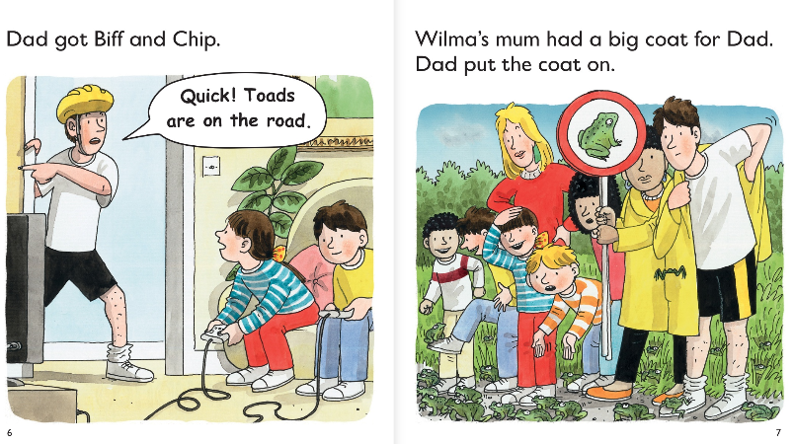
What were Biff and Chip doing when dad went to get them?
What did Wilma’s mum get for Dad? Why?

Slide 7
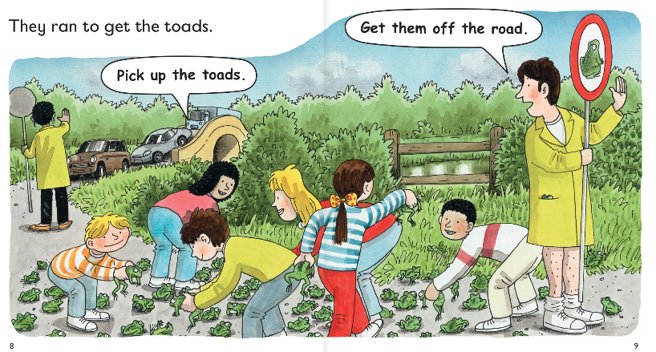
What did the children do to help Dad?
Why has dad got his hand out?

Slide 8
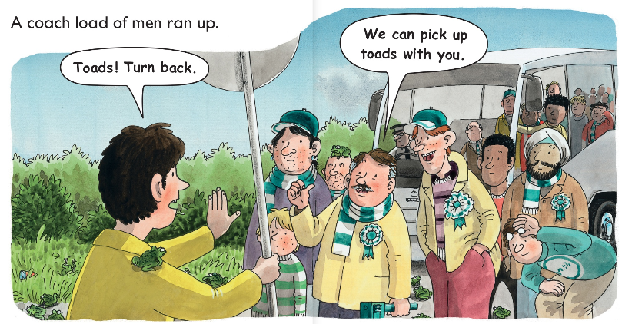
Who ran up to dad?
What did they do to help?

Slide 9
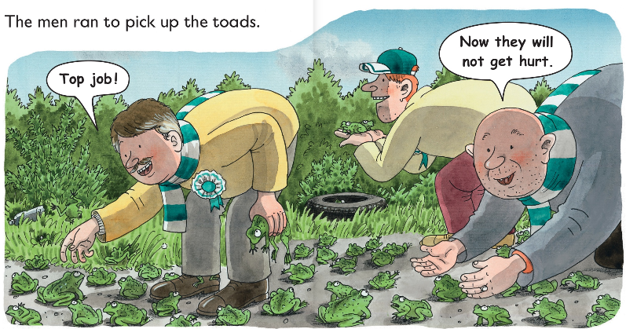
Where did the men put the toads to keep them safe?

Slide 10
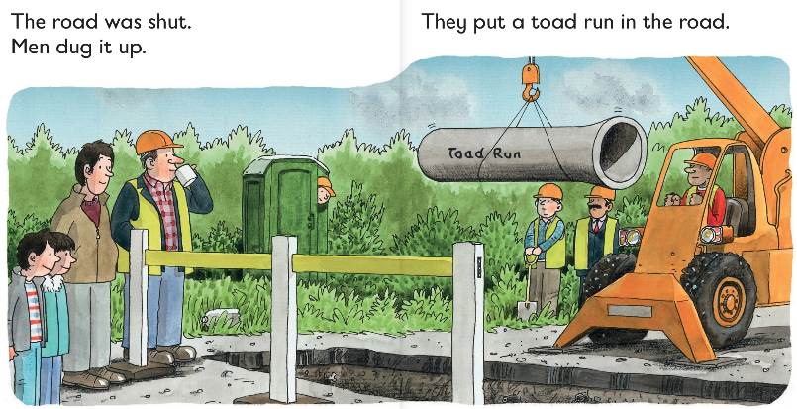
What did these men do to help the toads?

Slide 11
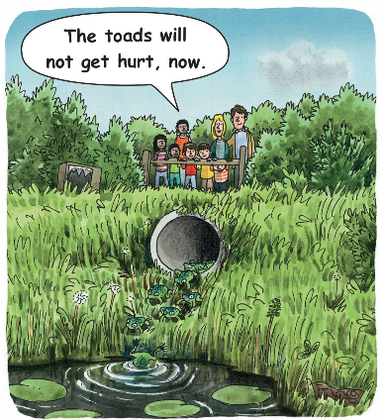
How are the toads able to stay safe now?
Do you think this is the best way to help the frogs?
Can you think of another way they could have helped them?

Slide 12
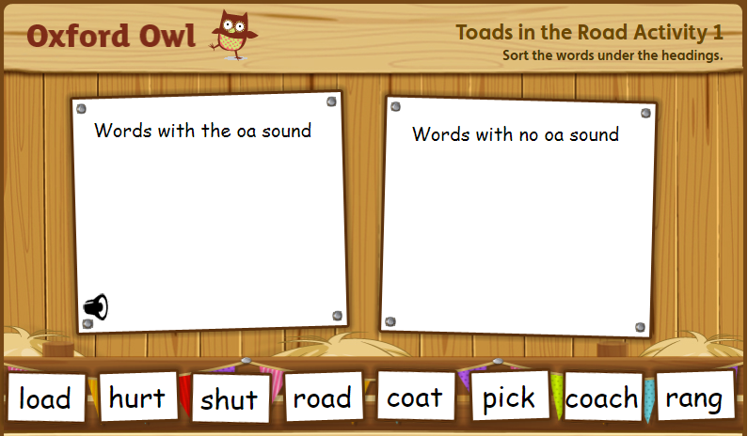
Sort the words with the sounds you have been practising

