Slide 1
Learning intention: Identify turns and movements

Slide 2
Left and right

Slide 3
Follow the instructions below.
Stand up.
What is to your left? What is to your right?
Now turn around.
What is to your left? What is to your right?

Slide 4
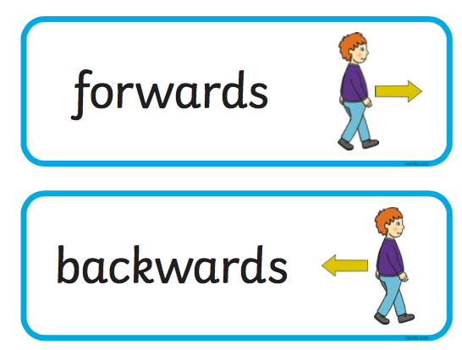
Forwards and backwards

Slide 5
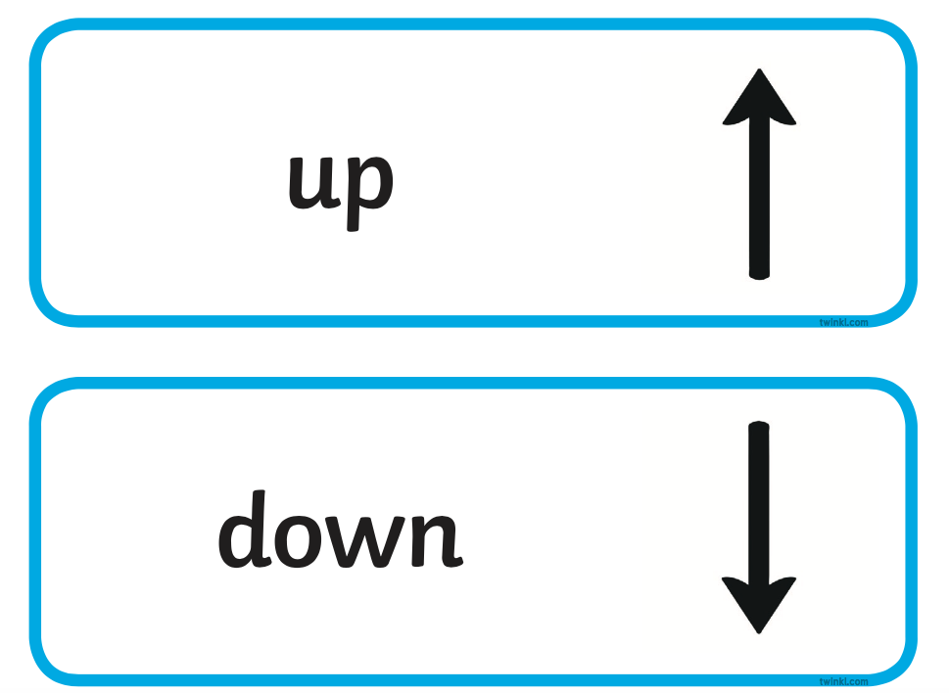
Up and down

Slide 6
Your turn
Stand up and play a robot game with somebody at home.
You are the robot and they need to give you instructions on how to move.
For example: Turn left and walk forwards.
Key vocabulary
Up
Down
Left
Right
Forwards
Backwards

Slide 7
In which direction is the ladybird moving?

Slide 8
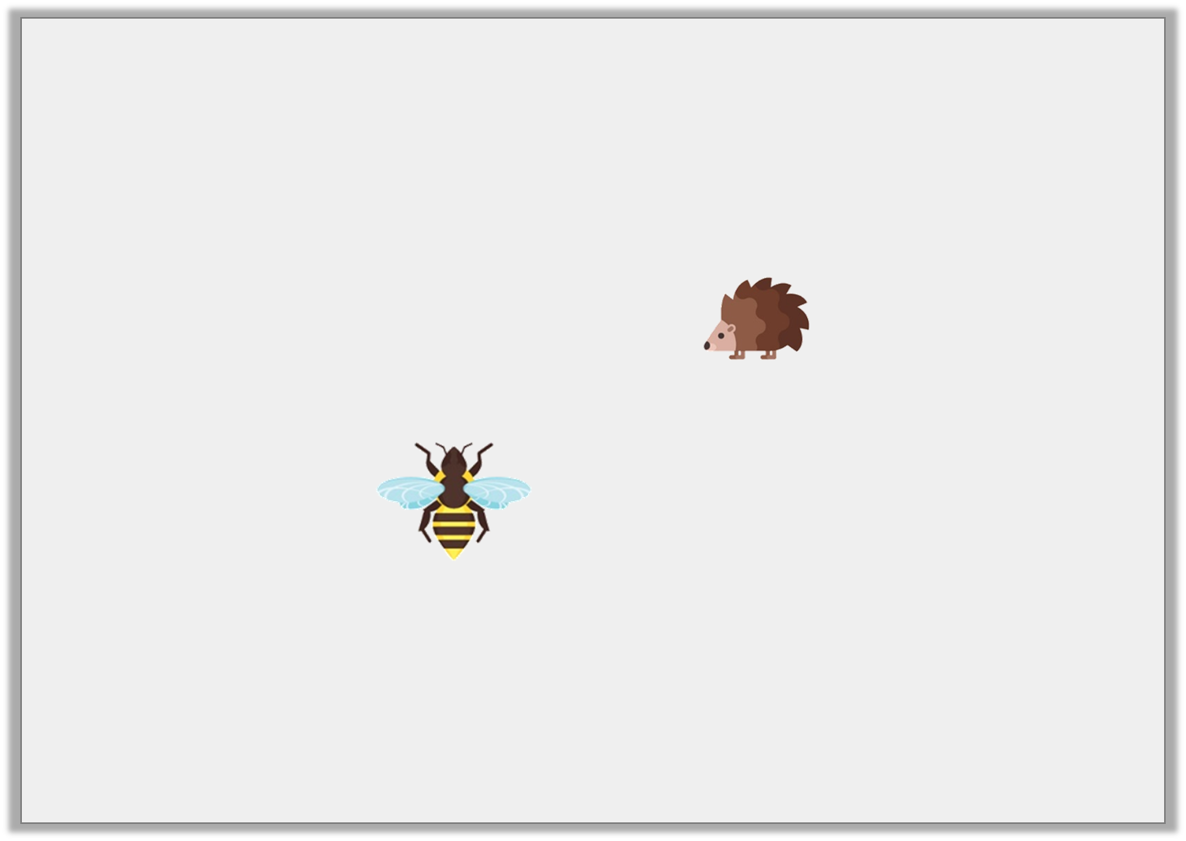
In which direction is each creature moving?

