Slide 1

Maths
Learning Intention: To add fractions where the answer is greater than one

Slide 2

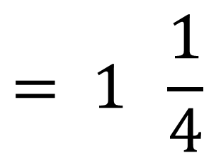

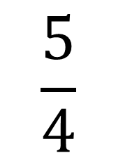

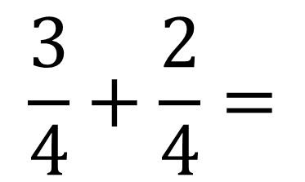


$$\frac{3}{4}+\frac{2}{4}=$$
$$\frac{5}{4}$$
$$= 1 \frac{1}{4}$$

Slide 3


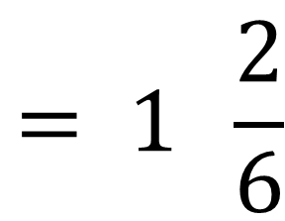



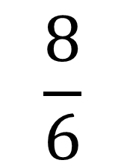

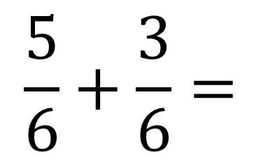



$$\frac{5}{6}+\frac{3}{6}=$$
$$\frac{8}{6}$$
$$= 1 \frac{2}{6}$$

Slide 4


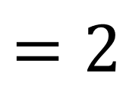



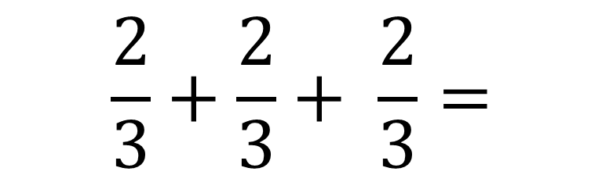




$$\frac{2}{3}+\frac{2}{3}+ \frac{2}{3}=$$
$$\frac{6}{3}$$
$$=2$$

