Slide 1
Let’s practice counting to 10!
Notes:
Let’s practice counting to 10, let’s go forwards first … and then backwards!

Slide 2
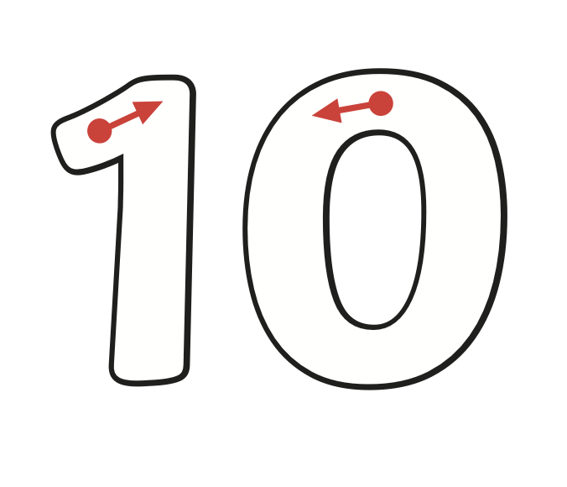
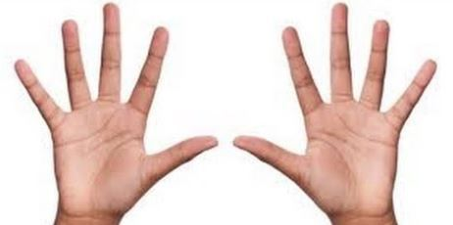
Notes:
Here we have the number 10! Can you trace it? I can count 10 on the base 10 rod, 10 on the Numicon, 10 in the tens frame and 10 with the hands. Can you have a go?

Slide 3
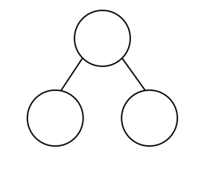
Let’s find more ways to 10!
10
?
?
Notes:
2 parts make a whole! What + what = Ten? Let’s find out!

Slide 4
6
+
=
10
Notes:
Count up from 6 to 10

Slide 5
5
+
=
10

Slide 6
7
+
=
10

Slide 7
10
-
=
2

Slide 8
10
-
=
4

Slide 9
10
-
=
9

Slide 10
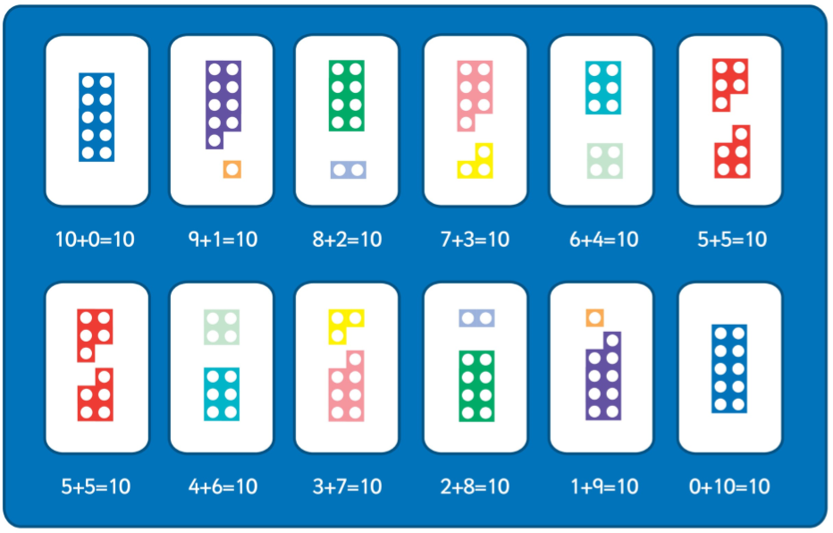
Can you spot the pattern?
Notes:
Can you spot the pattern? Look at the first number in every calculation

Slide 11
Commentary:
Slide 1: Let’s practice counting to 10, let’s go forwards first … and then backwards!
Slide 2: Here we have the number 10! Can you trace it? I can count 10 on the base 10 rod, 10 on the Numicon, 10 in the tens frame and 10 with the hands. Can you have a go? Slide 3: 2 parts make a whole! What + what = Ten? Let’s find out! Slide 4: Count up from 6 to 10 using the number line Slide 5: Count up from 5 to 10 using the number line Slide 6: Count up from 7 to 10 using the number line Slide 7: Count down from 10 to 2 using the number line Slide 8: Count down from 10 to 4 using the number line
Slide 9:Count down from 10 to 9 using the number line
Slide 10: Can you spot the pattern? Look at the first number in every calculation

