Slide 1
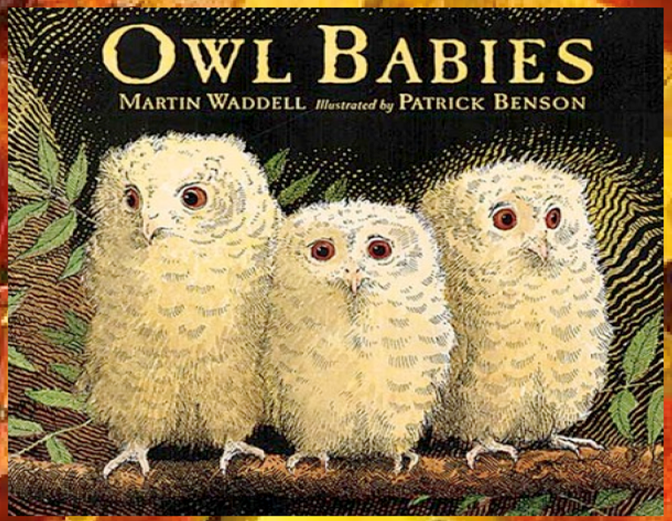
Today we will share the beginning of the story.

Slide 2
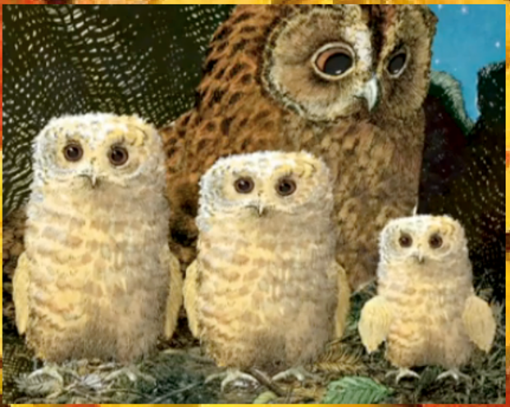
Once there were three owls, Sarah, Percy and Bill. They lived in a whole in the trunk of a tree with their Owl Mother.

Slide 3
Look at the different sizes of the owl babies. Who do you think is the smallest?

Slide 4
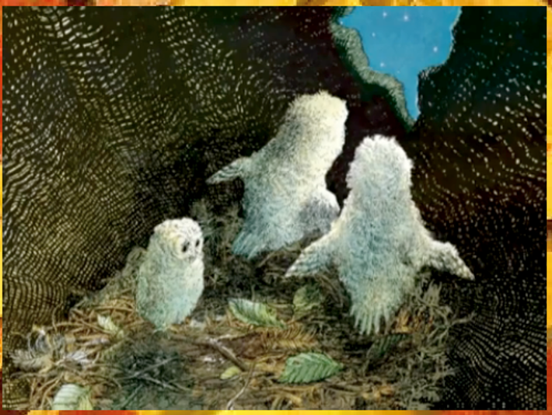
One night they woke up and their Owl Mother was gone!

Slide 5
How do you think they are feeling? The smallest owl looks sad.

Slide 6
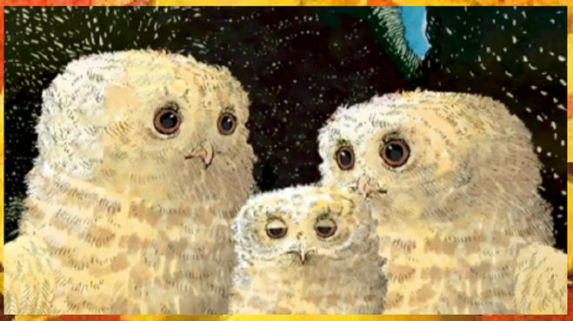
“Where’s Mummy?” asked Sarah. “Oh my goodness!” said Percy. “I want my Mummy!” said Bill. But their Owl Mummy didn’t come . . .

Slide 7
Where could Owl Mother have gone? Do you think she will come back?

Slide 8
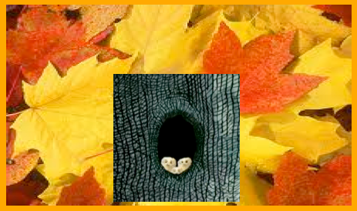
“I think she’s gone hunting,” said Sarah.
“To get us some food,” said Percy.
“I want my mummy,” said Bill.
But their owl mummy did not come…
Can you remember where the owls live?

Slide 9
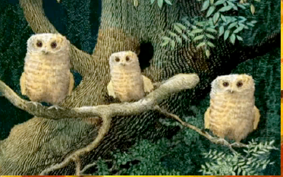
The owl babies came out of their house and waited…
“She’ll be back,” said Sarah.
“She’ll be back soon,” said Percy.
“I want my mummy!” Said Bill.
Why do you think Bill keeps saying that he ‘wants his mummy?’

Slide 10
It was dark in the wood.
They had to be brave.
Things moved all around them.
What things do you think moved around the owls?
Are you frightened of the dark?

