Slide 1
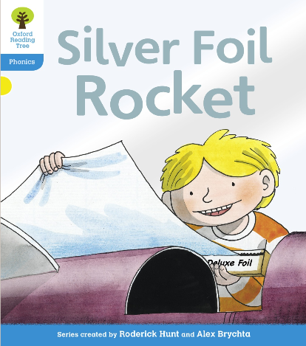

You are going to read the story ‘Silver Foil Rocket’.
In this story you will hear words with the sounds:
or
er
ure
oi
The or sound is in the words:
cord
for
The er sound is in the words:
winner
banner
The ure sound is in the words:
sure
Pure
The oi sound is in the words:
coin
oil

Slide 2
Can you write two words with the or sound in, two words with the er sound, two words with the ure sound and two words with the oi sound? Ask an adult to check your spelling.
Look at the picture. What is Kipper doing? What will happen in the story?

Slide 3
Let’s read the words together to practice the sounds we are learning.
For
Cord
Orbit
Corner
Silver
Banner
Winner
Kipper
Sure
Pure
Oil
Join
Foil
Coins

Slide 4
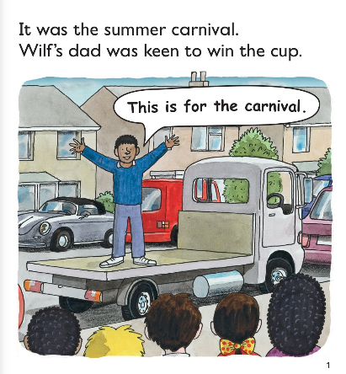
Write down all of the words you can see with the four sounds we are learning today.
What time of year was it?
Why had Wilf’s dad brought the truck?

Slide 5
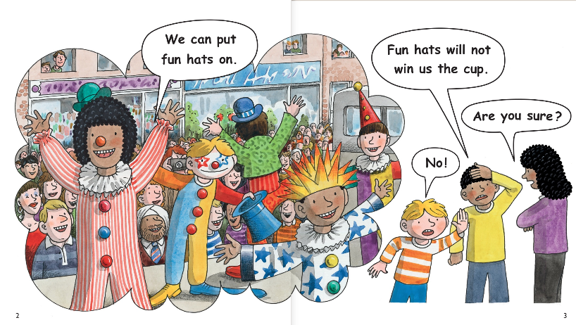
What did Wilma want to do?
Why would Kipper and Wilf not let her do this?

Slide 6
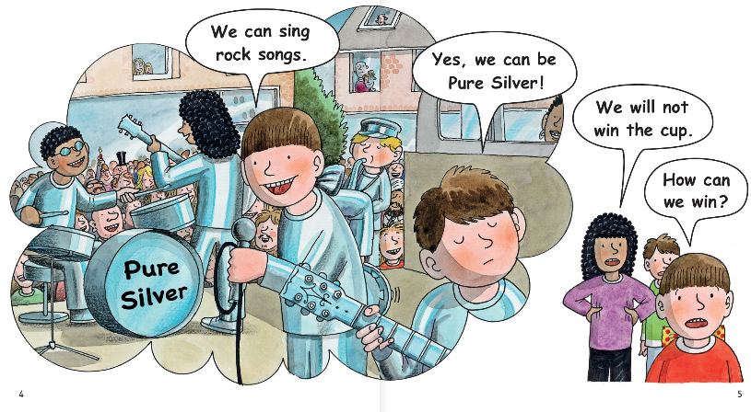
What do Biff and Chip think they should do?
What does Wilma say to them?

Slide 7
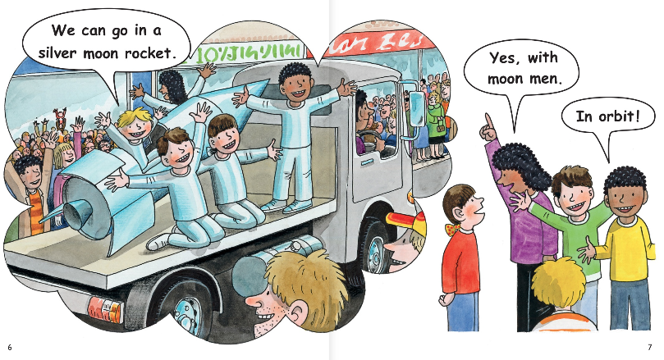
What do the children plan to do?
Do you think they will win the cup with this plan?

Slide 8
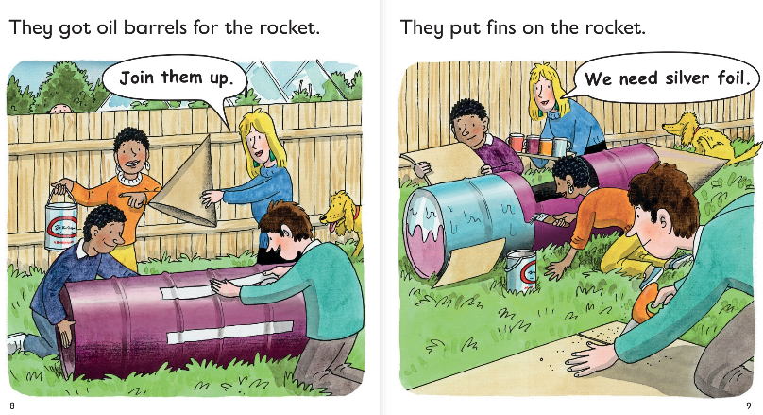
What did they use for the rocket?
What di they need to make it look like a rocket?

Slide 9
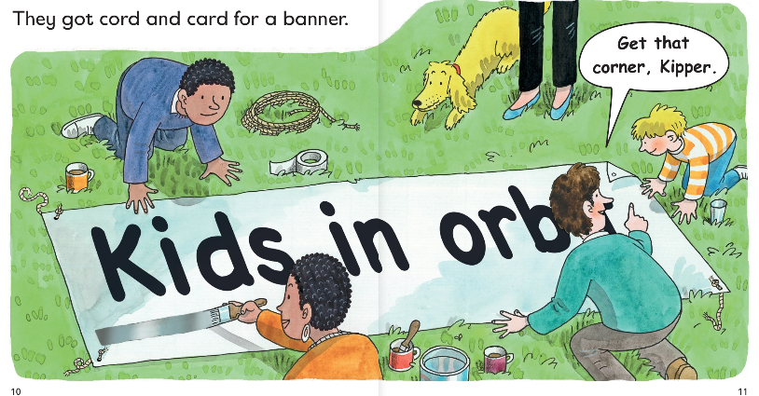
What did the children make to go with the rocket?
What did Kipper have to do?

Slide 10
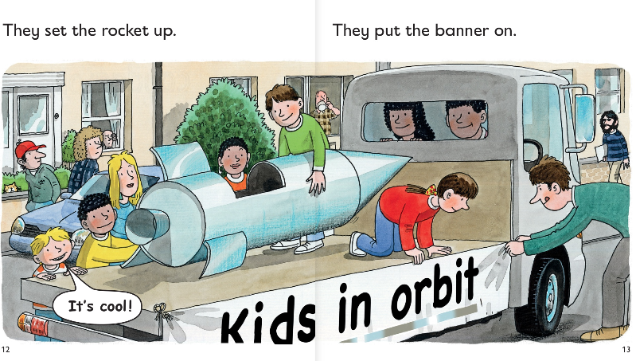
What did the banner say?
What did Kipper think of the rocket?

Slide 11
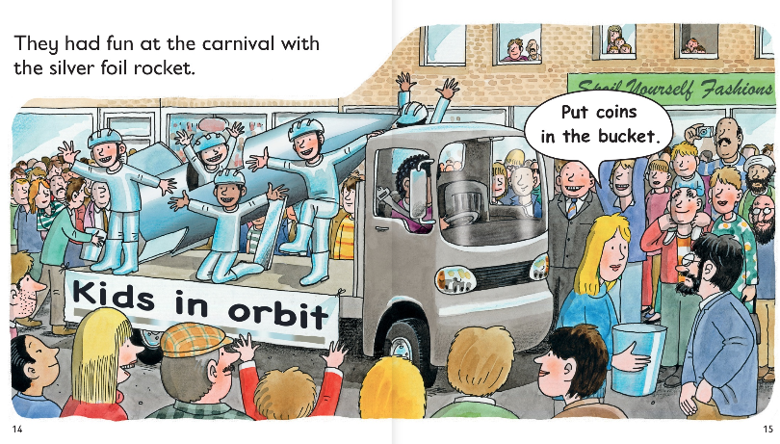
What did the children do at the carnival?
Where did the coins have to go?

Slide 12
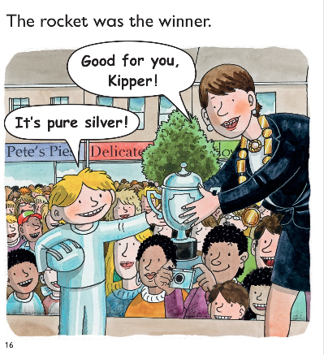
Did the children win the cup?
What was the cup made of?
What would you have made for the carnival to try and win the cup?

Slide 13
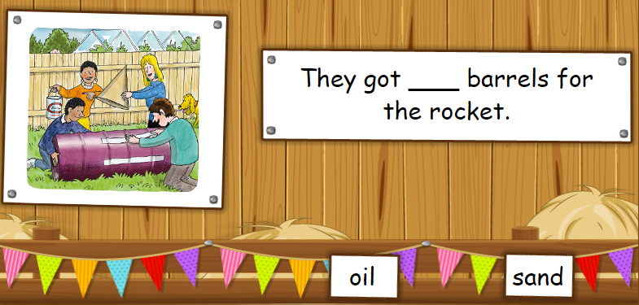
Fill in the missing words in each sentence.

Slide 14
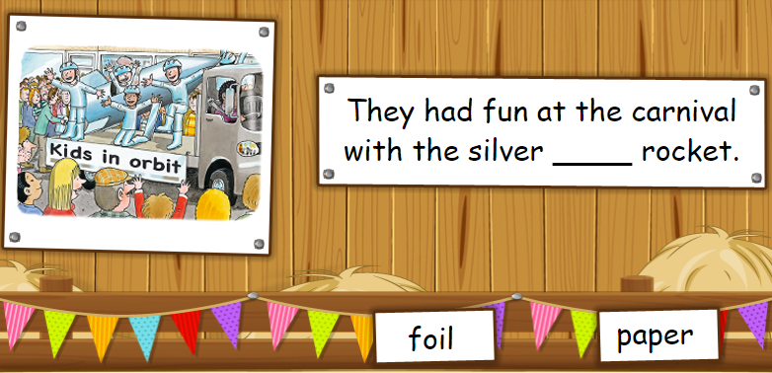

Slide 15
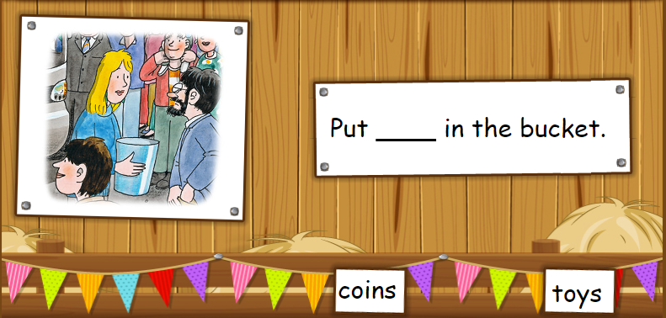

Slide 16

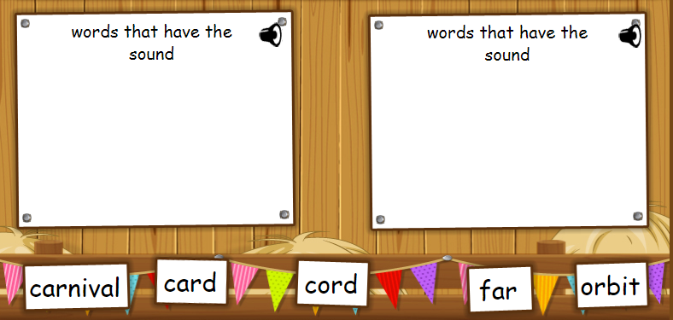
Sort the words that have the or and ar sounds into the correct spaces.
ar

